Slide 1
Model Systems Knowledge Translation Center Traumatic Brain Injury Resource Inventory
Model Systems Knowledge Translation Center
March 2022

Slide 2
About TBI Model Systems
The Traumatic Brain Injury (TBI) Model Systems program, sponsored by the National Institute on Disability, Independent Living, and Rehabilitation Research (NIDILRR), Administration for Community Living, U.S. Department of Health and Human Services, supports innovative projects and research in the delivery, demonstration, and evaluation of medical, rehabilitation, vocational, and other services designed to meet the needs of individuals with TBI.
NIDILRR awards TBI Model Systems grants to institutions that are national leaders in medical research and patient care; these institutions provide the highest level of comprehensive specialty services from the point of injury through eventual re-entry into full community life.
There are 16 currently-funded TBI Model System Centers.
Each TBI Model System contributes to the Traumatic Brain Injury Model Systems National Data and Statistical Center, participates in independent and collaborative research, and provides information and resources to individuals with TBI; their families, caregivers, and friends; health care professionals; and the general public.

Slide 3
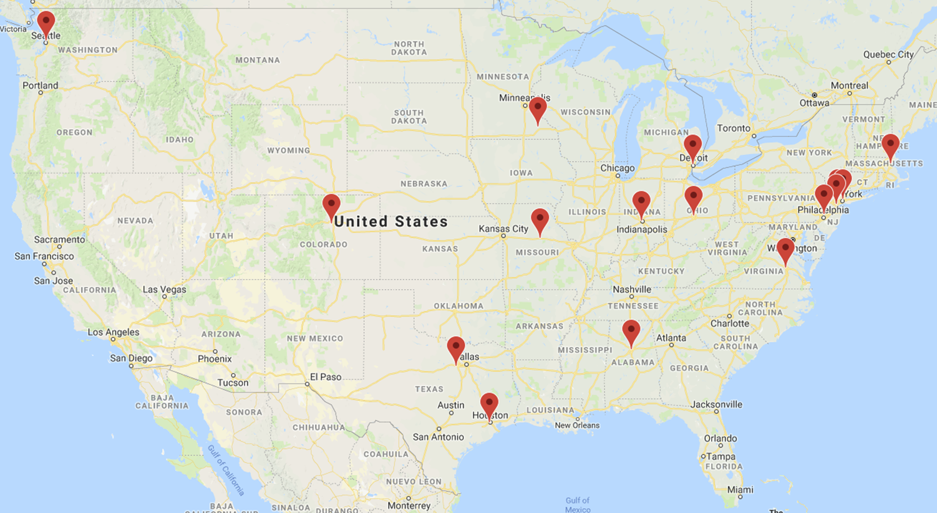
Current TBI Model System Centers
https://msktc.org/tbi/model-system-centers

Slide 4
About TBI Model Systems Database
The TBI Model Systems National Data and Statistical Center (TBINDSC) – established in 1987 – is a central resource for researchers and data collectors within the TBI Model Systems program.
The primary purpose of the database is to advance medical rehabilitation by increasing the rigor and efficiency of scientific efforts to longitudinally assess the experience of individuals with TBI.
As of October 2019, the database contained information on 17,686 persons with TBI.
It is the largest TBI longitudinal database in the world.
It includes data on preinjury, injury, acute care, rehabilitation, and outcomes at 1, 2, and 5 years post-injury and every 5 years with information on persons, so far, up to 30 years post-injury.
Visit the TBI Model Systems Database: https://www.tbindsc.org/.

Slide 5
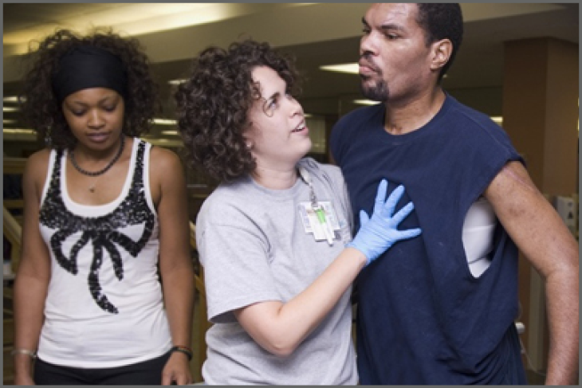
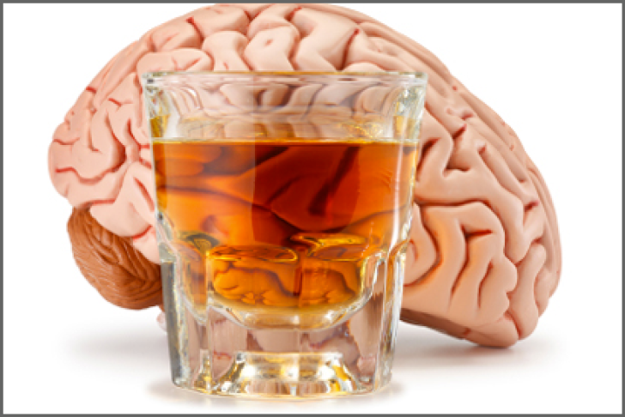
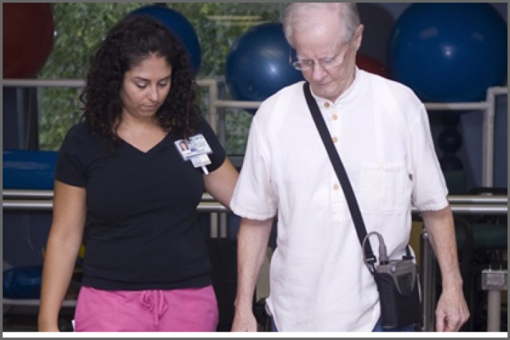
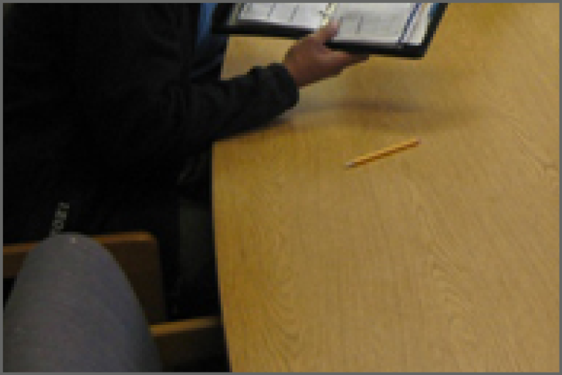
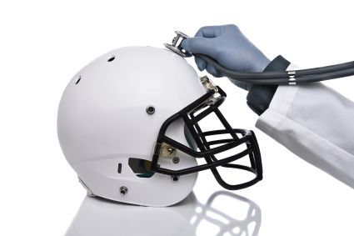
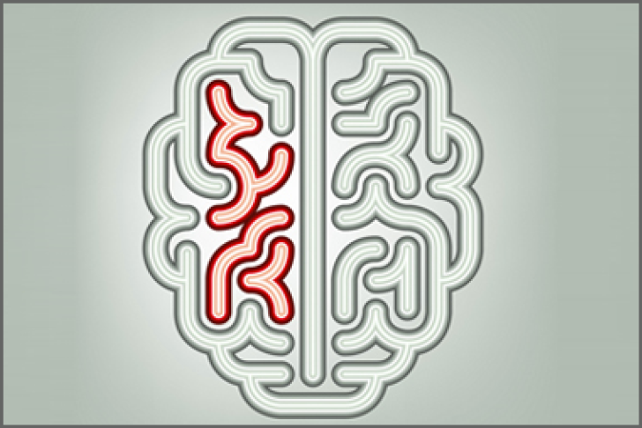
Living with Traumatic Brain Injury (TBI)
https://msktc.org/tbi
ALL TOPICS
Acute Inpatient Rehabilitation
Alcohol and TBI
Balance Problems
Change in Memory After TBI
Chronic Pain & TBI
Cognitive Problems
Concussion Recovery
Driving
Emotional Problems
After TBI
Fatigue & TBI
Headaches
Irritability, Anger, and Aggression After TBI

Slide 6
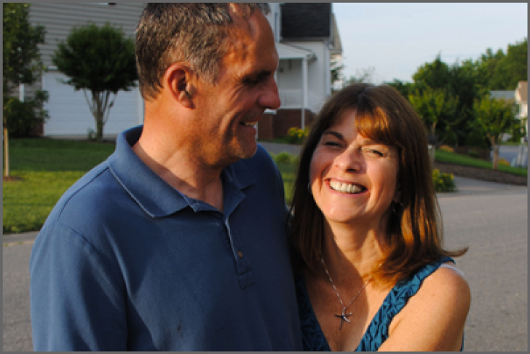
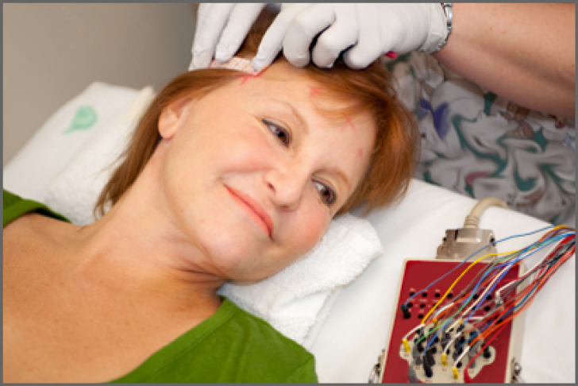
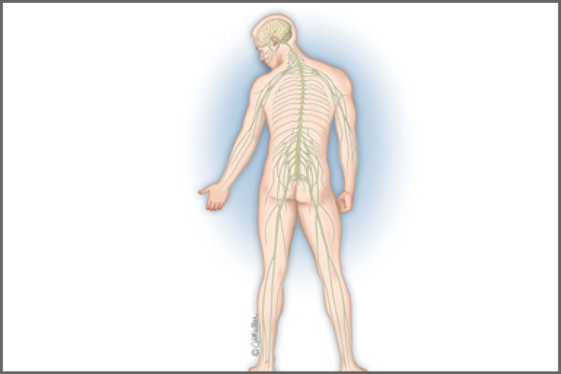
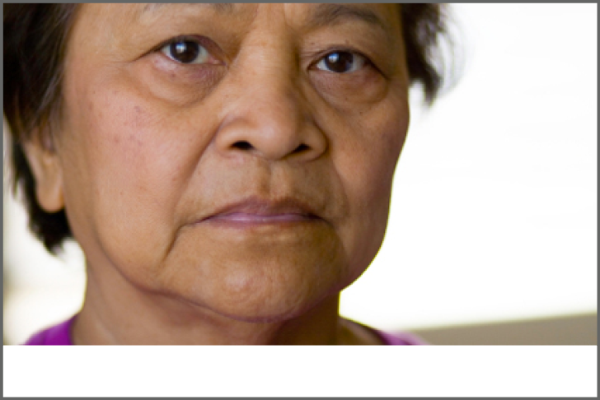
Living with Traumatic Brain Injury (TBI)
https://msktc.org/tbi
ALL TOPICS
Loss of Smell or Taste
After TBI
Relationships After TBI
Returning to School
Relationships After TBI
Seizures
Severe TBI
Sexuality After TBI
Sleep & TBI
Social Skills After TBI
Spasticity & TBI
Stress Management for TBI Caregivers
TBI & Depression
Understanding Behavior Changes after TBI

Slide 7
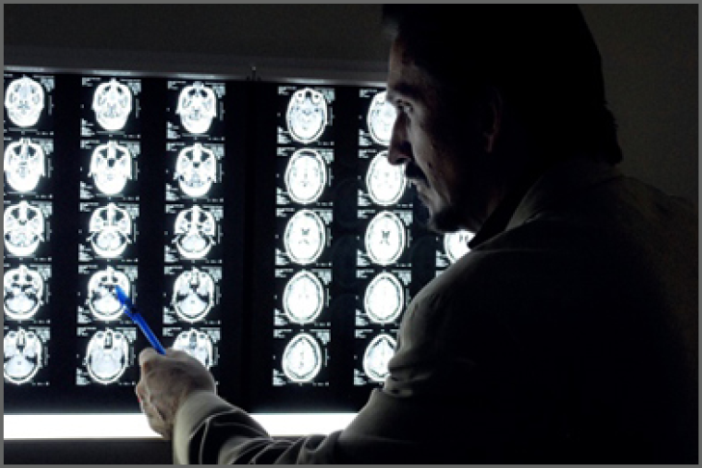
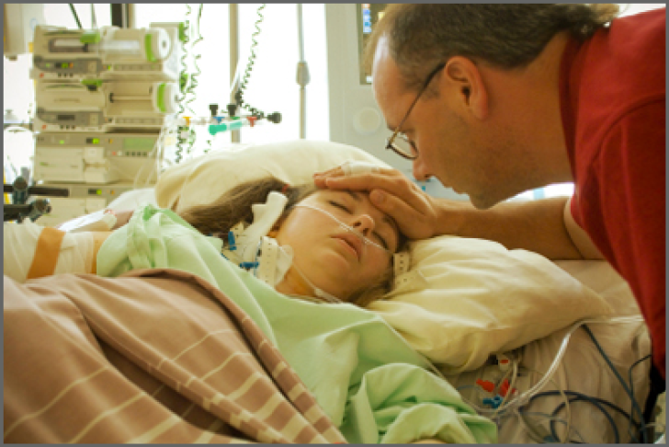
Living with Traumatic Brain Injury (TBI)
https://msktc.org/tbi
ALL TOPICS
Understanding TBI
Vegetative State
Vision Problems
Voting Tips after TBI

Slide 8
Traumatic Brain Injury Resources
https://msktc.org/tbi/tbi-resources

Slide 9
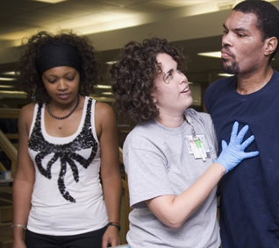
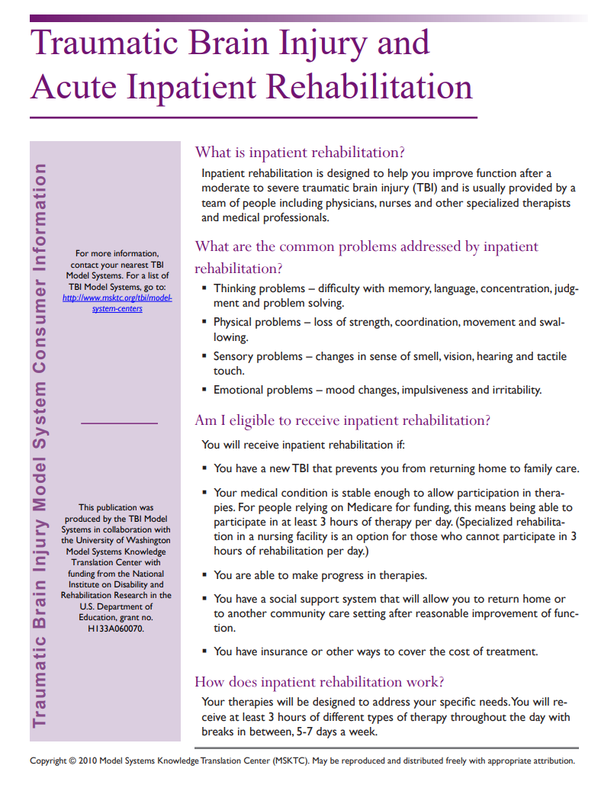
Acute Inpatient Rehabilitation
https://msktc.org/tbi-topics/acute-inpatient-rehabilitation
• TBI and Acute Inpatient Rehabilitation

Slide 10
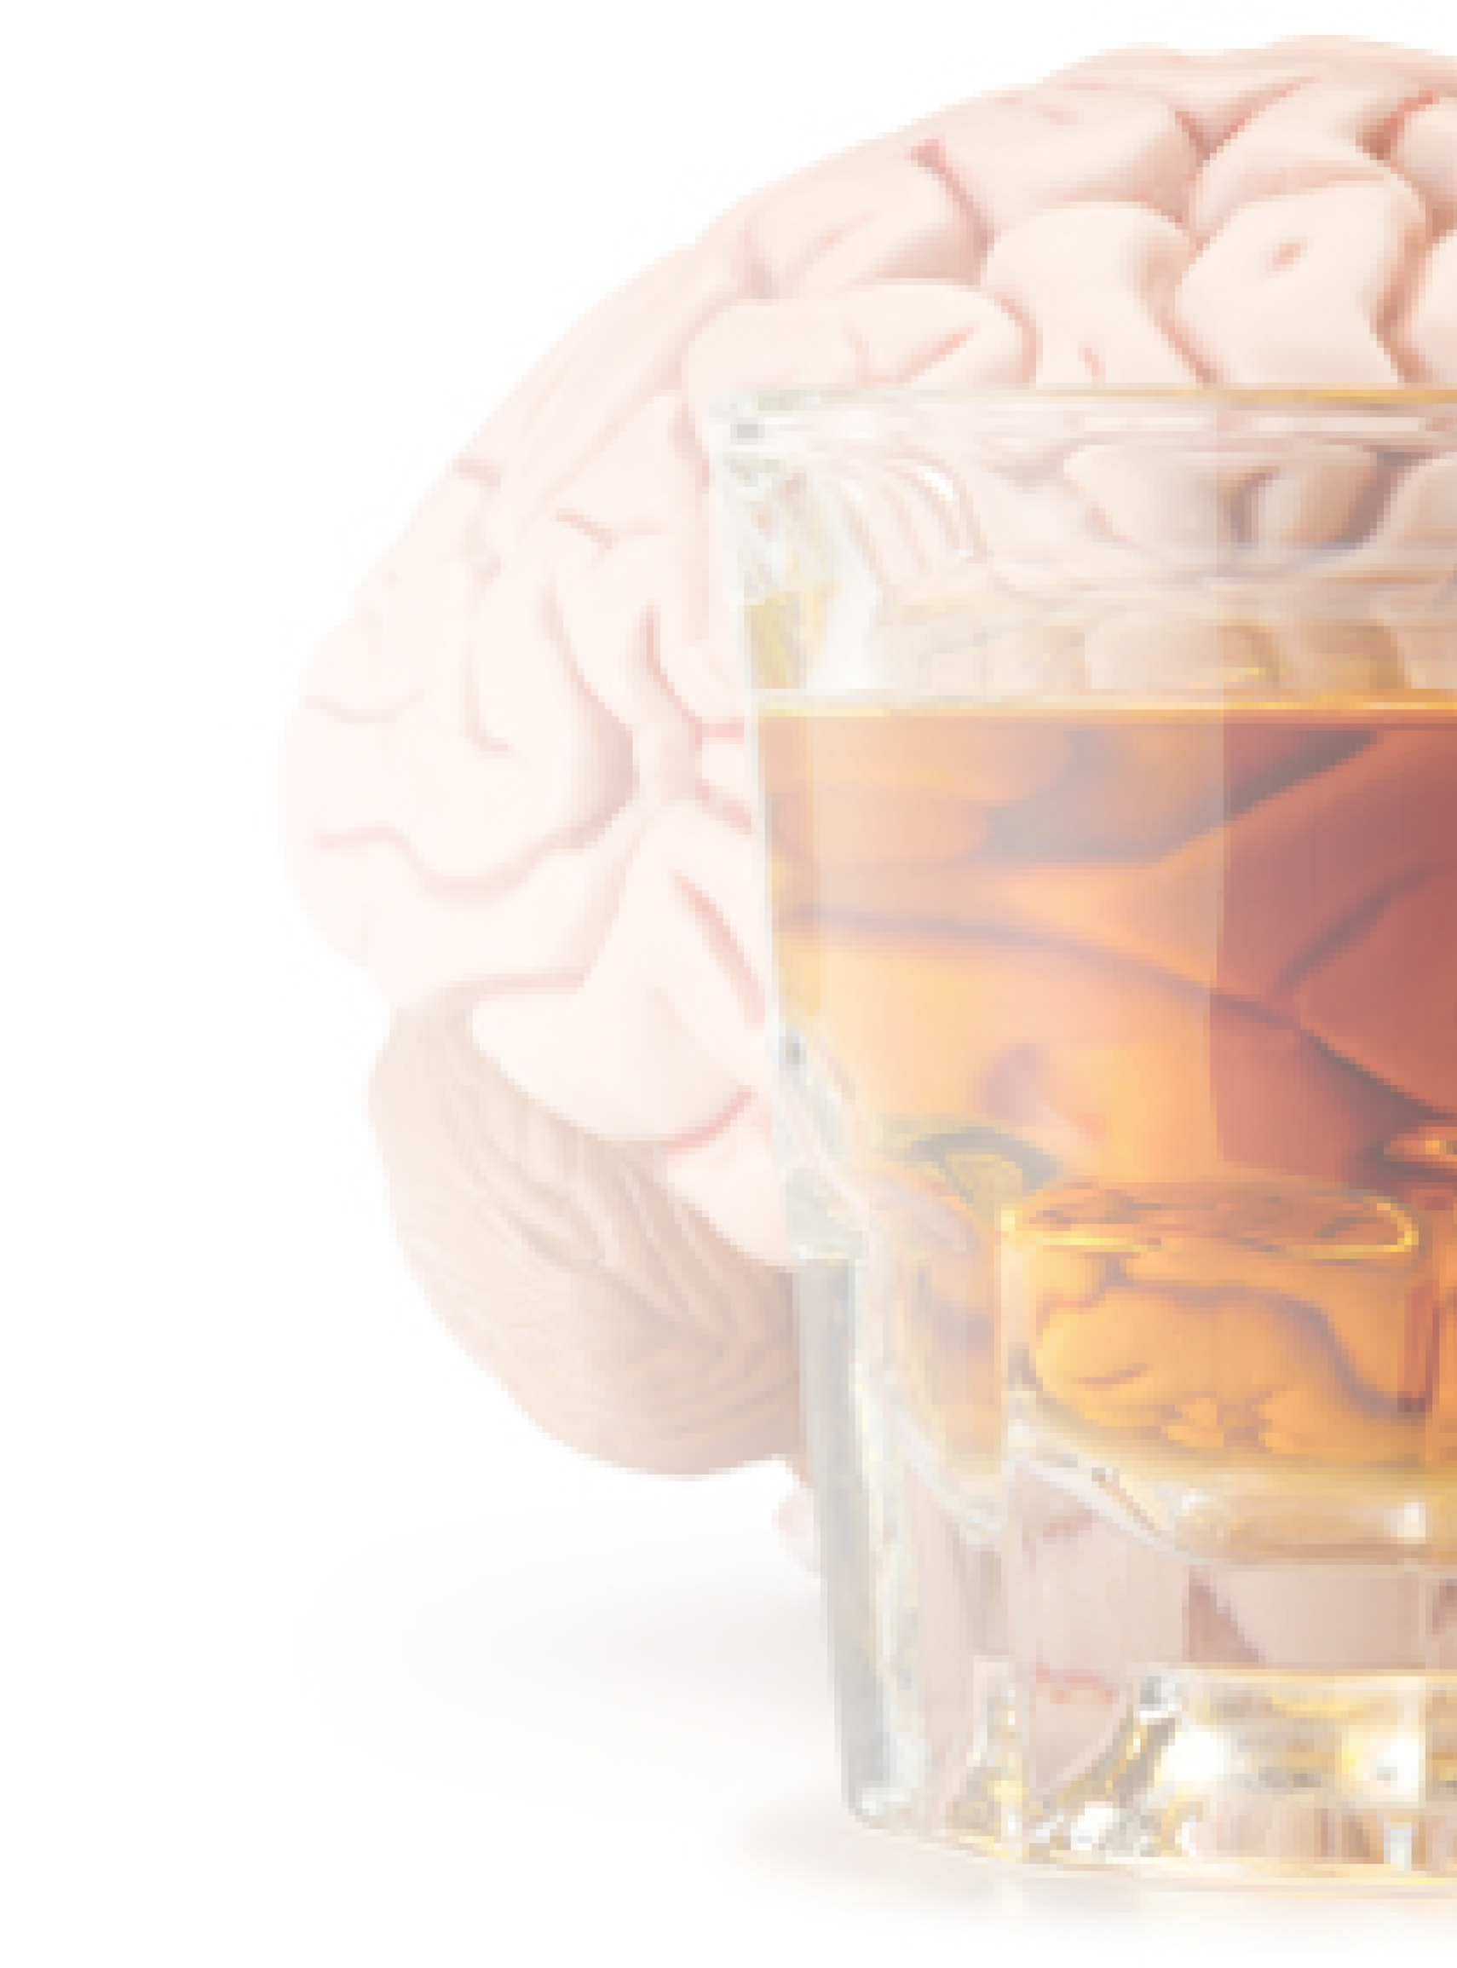
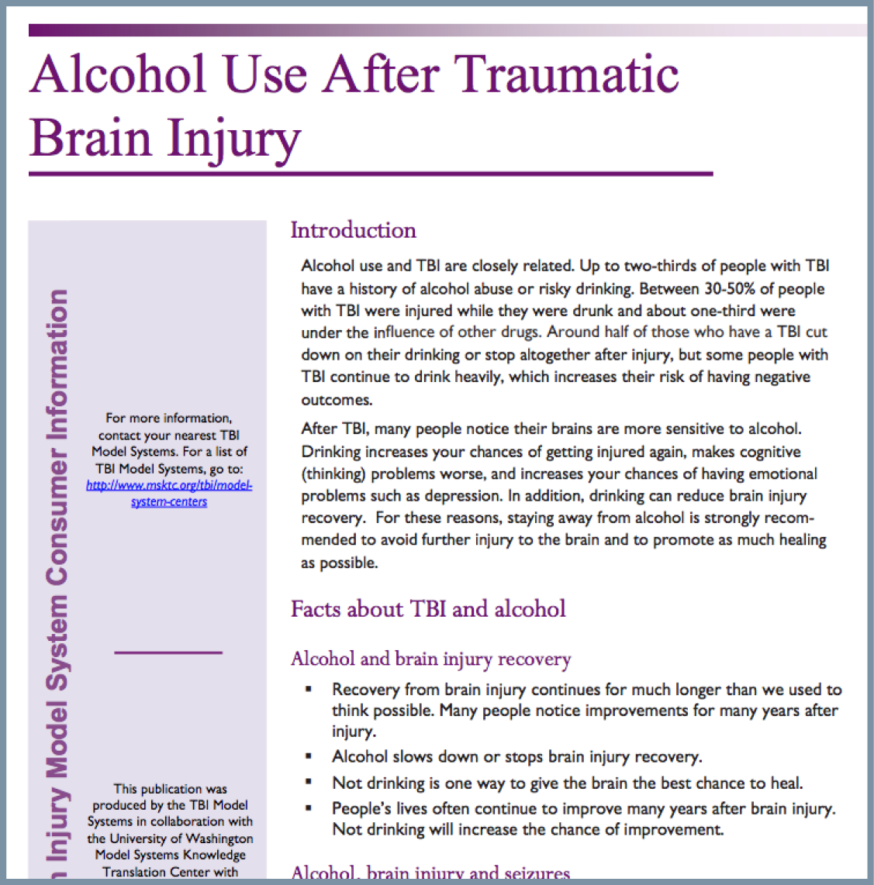
Alcohol & TBI
https://msktc.org/tbi-topics/alcohol-tbi
• Alcohol Use after TBI
• Alcohol Use after TBI

Slide 11
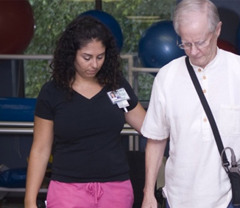
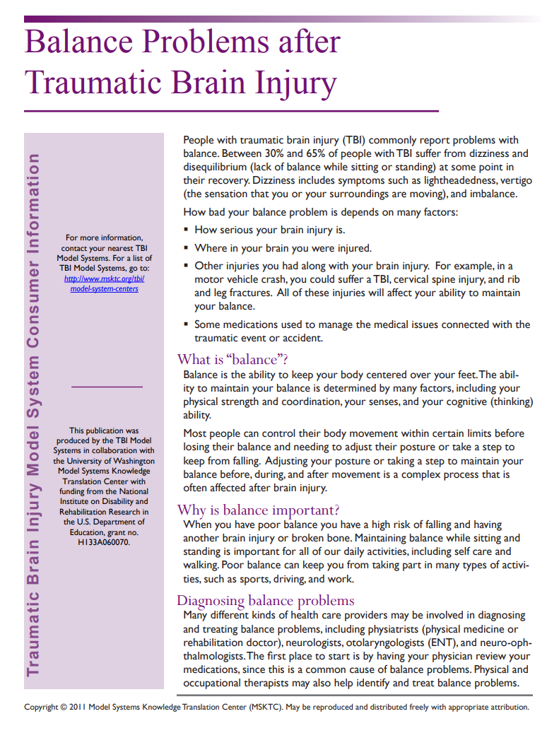
Balance Problems After TBI
https://msktc.org/tbi-topics/balance-problems-tbi
• Balance Problems after TBI

Slide 12
Change in Memory After TBI
https://msktc.org/tbi-topics/change-memory-after-tbi
The Neurology of Memory Problems
Uncertainty About Recovering Memory Function
When Strategies Don’t Work
Advice for Families and Caregivers
Changes in Memory After TBI
Cognitive Rehabilitation for Memory Problems After TBI
Developing Awareness of Memory Issues
Emotional Impact of Memory Problems
Importance of Family Support with Memory Strategies
Initially Resistant to Memory Strategies
It's not just the injury that matters but the brain that is injured.
Learning a New Memory Strategy in Multiple Settings
Low-Tech and No-Tech Strategies for Memory Support
Make Sure It Is a Memory Problem
Medication and Memory Problems After TBI
Memory Is Not a Single Thing
Memory Issues Impacting Other Health Problems
Memory Problems and Returning to Work After TBI
Memory Problems Causing Conflict Within Families
Memory Strategies Don’t Weaken Your Memory
Pillboxes as Memory Supports: Individualizing
Primary Care Providers and Memory Problems After TBI
Remembering the Time Before the Injury
Smartphones as Memory Supports
Social Impact of Memory Problems
The Challenge of Remembering Memory Strategies
Memory & Moderate and Severe TBI
Changes in Memory After TBI
Memory and Moderate to Severe TBI

Slide 13
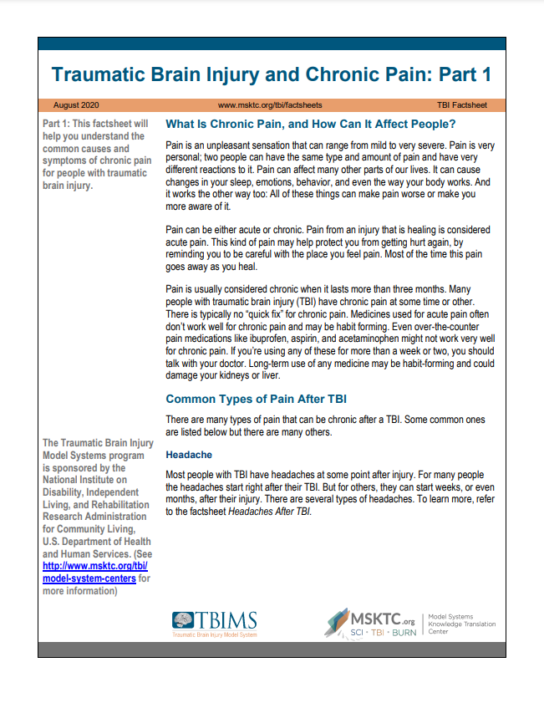
Chronic Pain & TBI
https://msktc.org/tbi-topics/chronic-pain-tbi
• Traumatic Brain Injury and Chronic Pain (2 Parts)

Slide 14
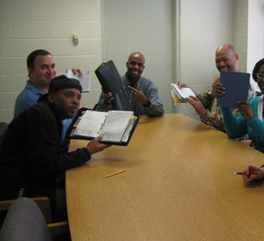
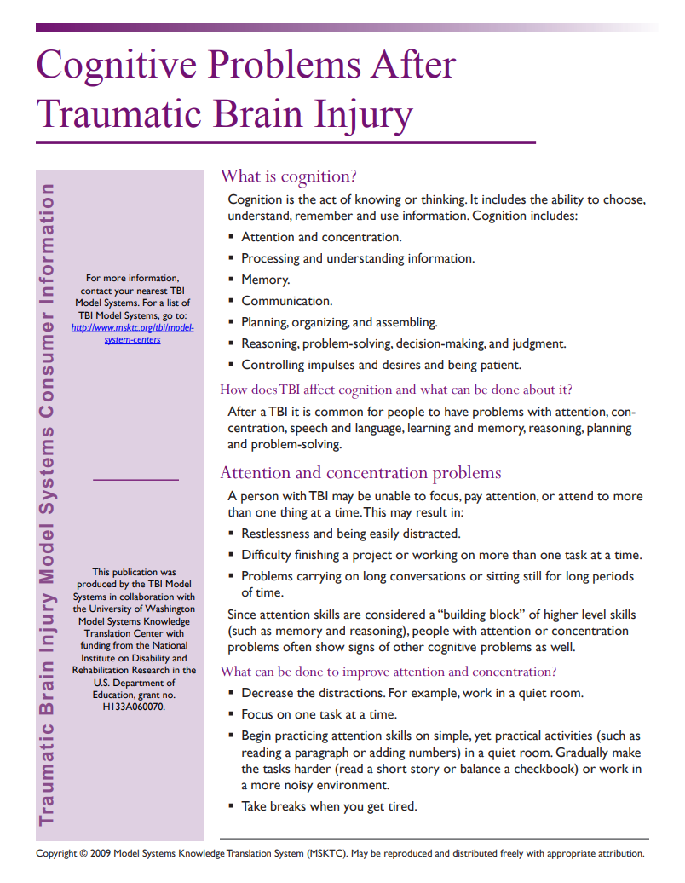
Cognitive Problems After TBI
https://msktc.org/tbi-topics/cognitive-problems
• Cognitive Problems after TBI

Slide 15
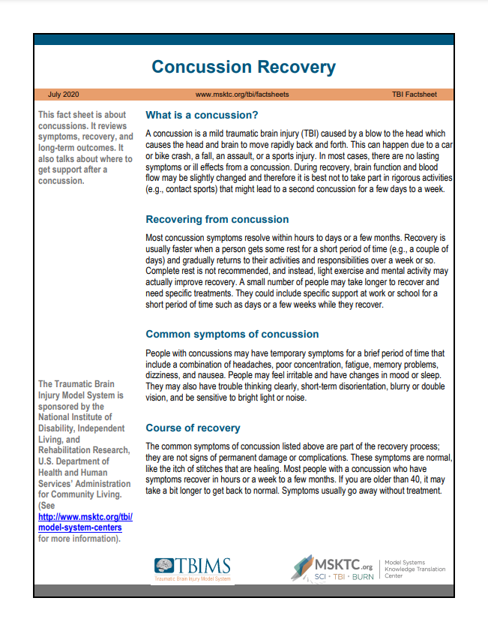
Concussion Recovery
https://msktc.org/tbi-topics/concussion-recovery
• Concussion Recovery

Slide 16
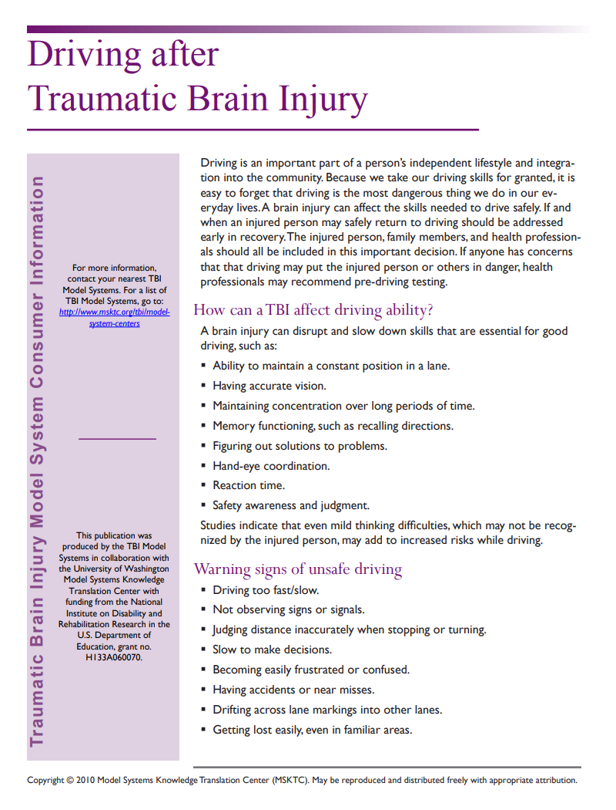
Driving After TBI
https://msktc.org/tbi-topics/driving
• Driving After TBI

Slide 17
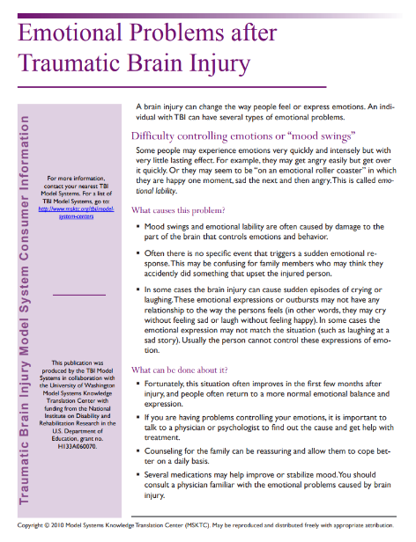
Emotional Problems After TBI
https://msktc.org/tbi-topics/emotional-problems-after-tbi
• Emotional Problems After TBI
• Emotional Problems After TBI

Slide 18
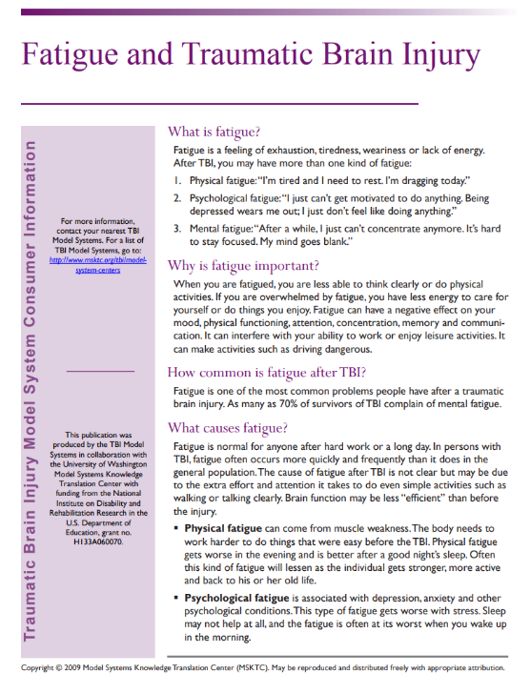
Fatigue and TBI
https://msktc.org/tbi-topics/fatigue-tbi
• Fatigue and TBI
• Fatigue and TBI

Slide 19
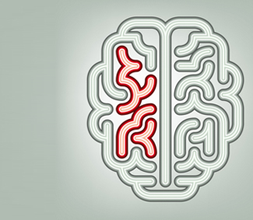
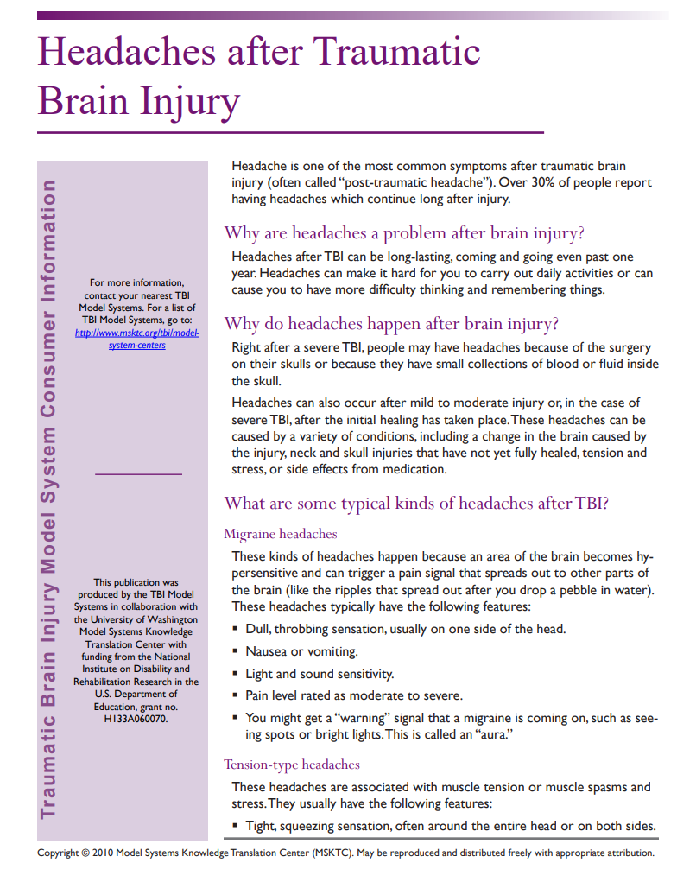
Headaches After TBI
https://msktc.org/tbi-topics/headaches
• Headaches After TBI

Slide 20
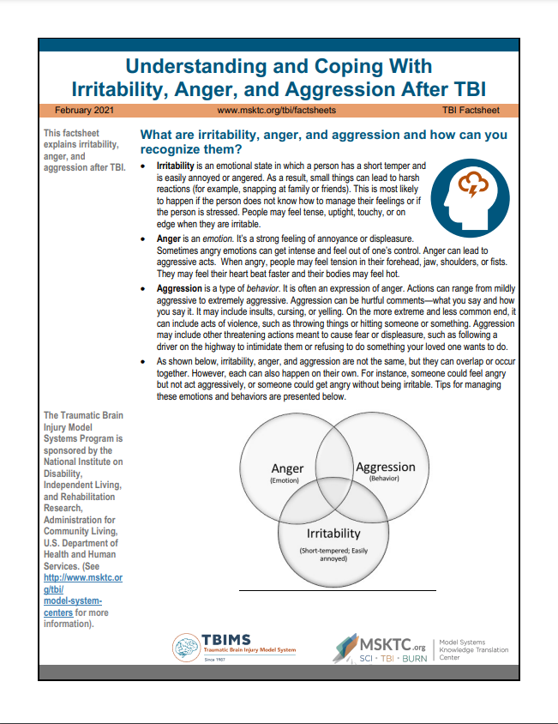
Irritability, Anger, and Aggression After TBI
https://msktc.org/tbi-topics/irritability-anger-and-aggression-after-tbi
• Understanding and Coping With Irritability, Anger, and Aggression After TBI

Slide 21
Loss of Smell or Taste After TBI
https://msktc.org/tbi-topics/loss-smell-or-taste-after-tbi
• Loss of Smell or Taste After TBI

Slide 22
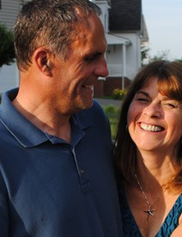
Relationships After TBI
https://msktc.org/tbi-topics/relationships-after-tbi
What Couples Counseling is Like from the Therapist's Perspective
Ambiguous Loss
Don’t Let this Horrible Accident Destroy Your Marriage
Getting Back on the Bike
His Divot
How Family Roles Change After TBI
How to find Help
Impact of Coupled Relationship on Recovery
Insight Into His Cognitive and Physical Changes
Intimacy after TBI
Parenting after TBI in the Family
Recognizing the Positives
Relationships After TBI
The Brain Injury Family Intervention Feelings Checklist
Thoughts on Going to a Relationship Counselor
Treating Each Other with Love
What Couples Counseling is Like from the Couples’ Perspective
Relationships After TBI
Relationships After TBI
Couples' Relationships after TBI

Slide 23
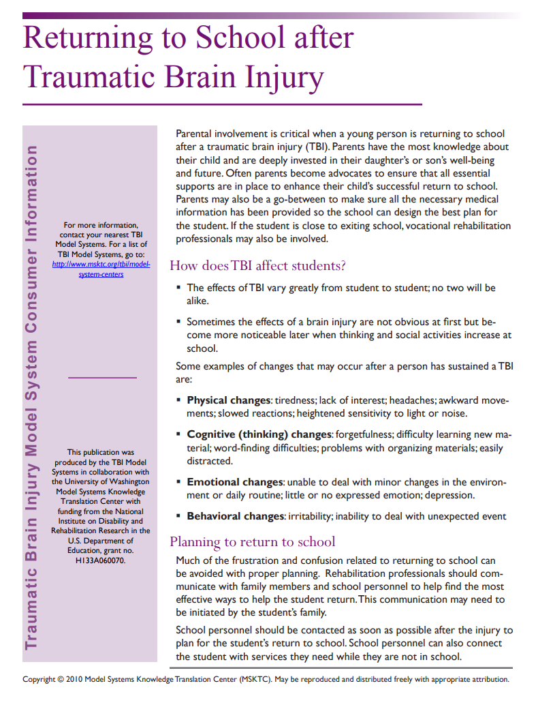
Returning to School After TBI
https://msktc.org/tbi-topics/returning-school
• Returning to School After TBI

Slide 24
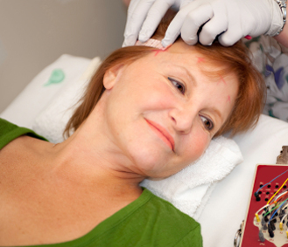
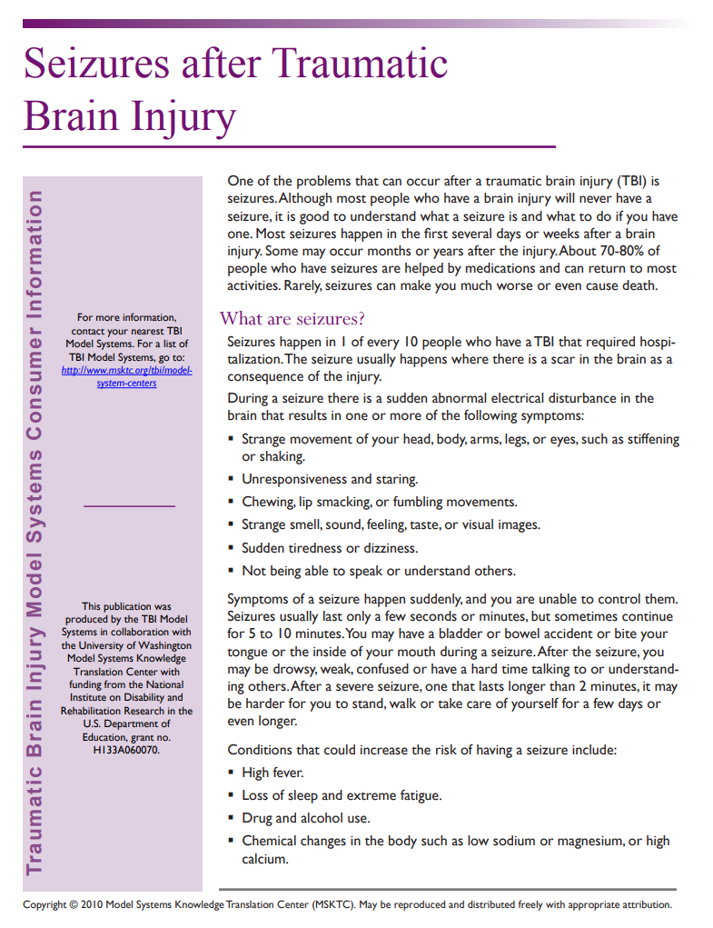
Seizures After TBI
https://msktc.org/tbi-topics/seizures
• Seizures After TBI

Slide 25
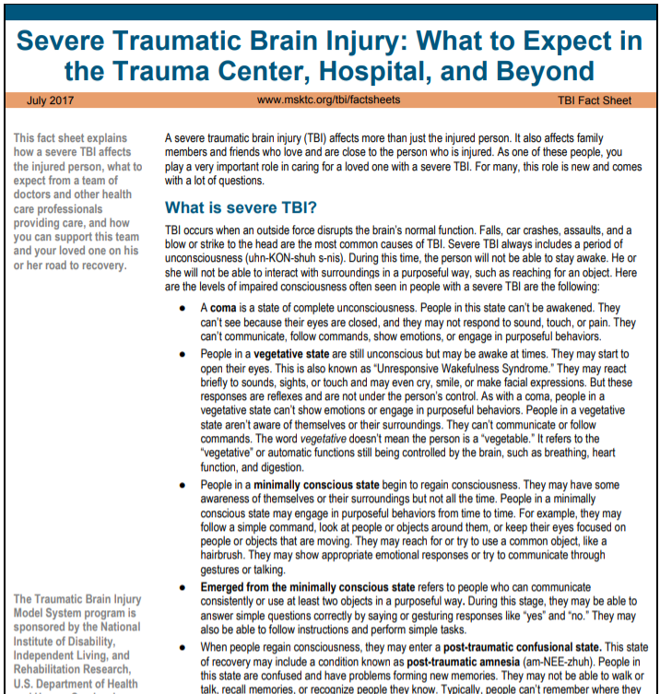
Severe TBI
https://msktc.org/tbi-topics/severe-tbi
• Severe TBI: What to Expect in the
Trauma Center, Hospital, and Beyond

Slide 26
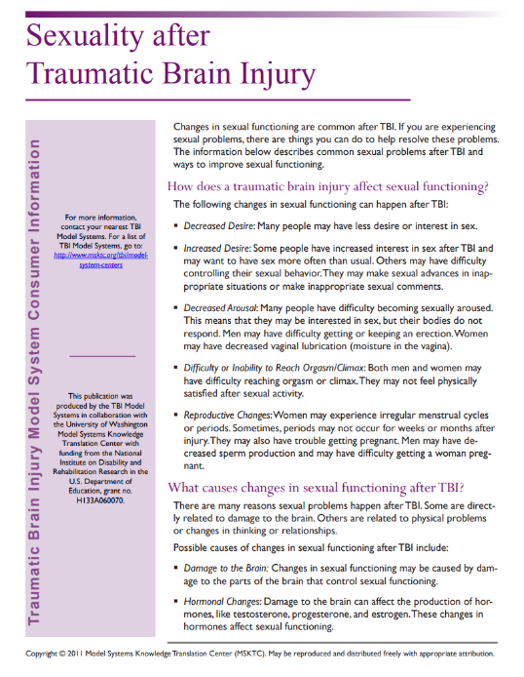
Sexuality After TBI
https://msktc.org/tbi-topics/sexuality-after-tbi
• Sexuality After TBI
• Sexuality After TBI

Slide 27
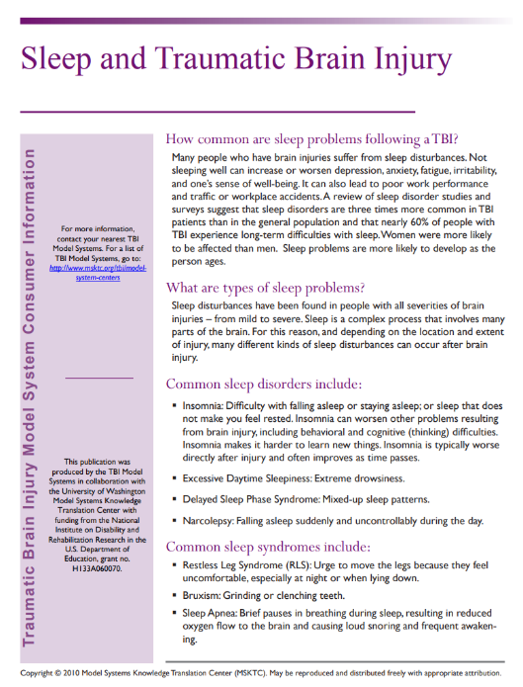
Sleep and TBI
https://msktc.org/tbi-topics/sleep-tbi
• Sleep and TBI
• Sleep and TBI

Slide 28
Social Skills After TBI
https://msktc.org/tbi-topics/social-skills-after-tbi
• Social Skills After TBI

Slide 29
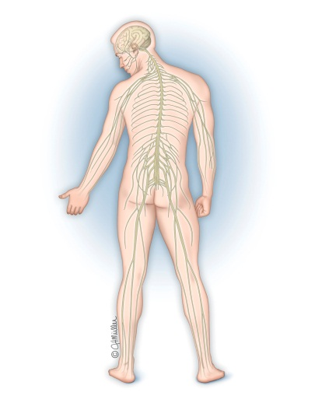
Spasticity and TBI
https://msktc.org/tbi-topics/spasticity-tbi
• Spasticity and TBI
• Spasticity and TBI

Slide 30
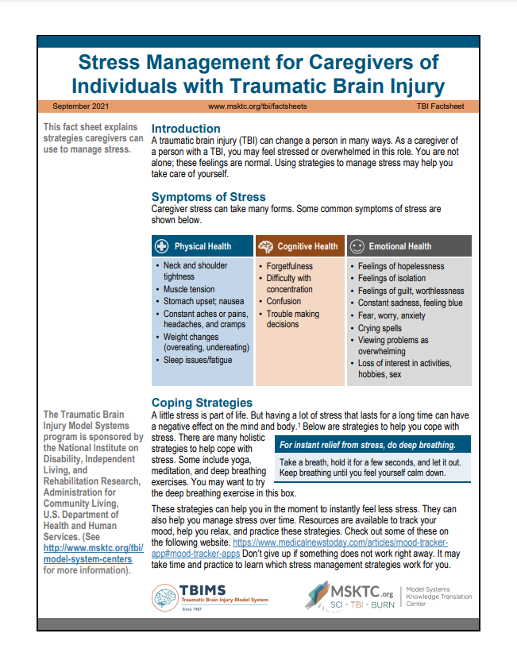
Stress Management for TBI Caregivers
https://msktc.org/tbi-topics/stress-management-tbi-caregivers
• Stress Management for TBI Caregivers

Slide 31
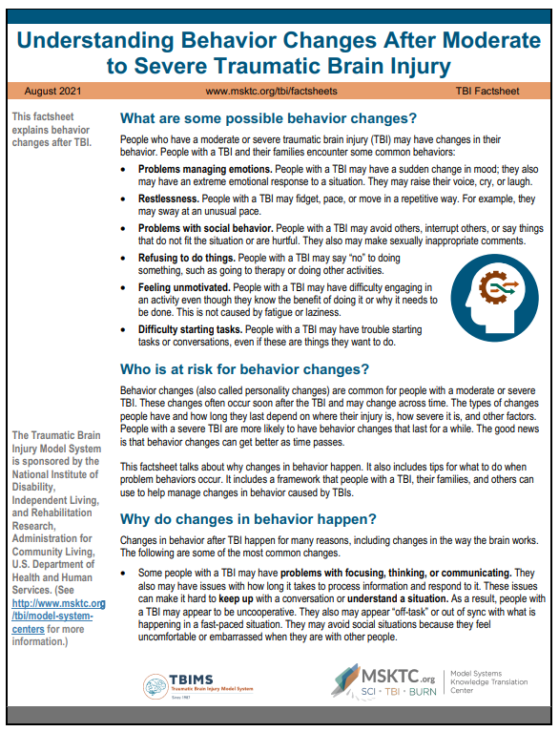
Behavior Changes after TBI
https://msktc.org/tbi/factsheets/understanding-behavior-changes-after-tbi
• Behavior Changes after TBI

Slide 32
TBI and Depression
https://msktc.org/tbi-topics/tbi-depression
What is Vocational Rehab?
Why Do Good People Get Depression after TBI?
Why is it Important to Treat Depression in People with TBI?
Why it’s Critical to Treat Depression in People with TBI
Why it’s Important to Make Adjustments to CBT
Activity Can Help Alleviate Depression
Adjustments to Therapy
Antidepressant Medications
Depression vs. Situational Sadness
Get Back to Doing Enjoyable Things to Combat Depression
How Does Cognitive Behavioral Therapy Work?
How Does Vocational Rehab Help with Depression?
How Prevalent is Depression?
Importance of a Support System
Importance of Recreational Therapy in Returning to Activity
Stigma of Depression as a Barrier
TBI & Depression
Team Approach to Treating TBI & Depression
What are the Best Treatments for Depression with TBI?
What is Depression?
Depression after TBI
TBI and Depression
Depression after TBI

Slide 33
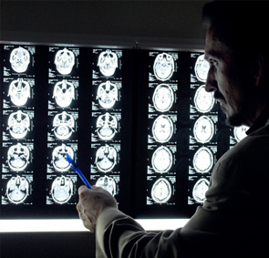
Understanding TBI
https://msktc.org/tbi-topics/understanding-tbi
Understanding TBI: Part 1 - What Happens to the Brain during Injury and the Early Stages of Recovery from TBI
Understanding TBI: Part 2 - Brain Injury Impact on Individuals Functioning
Understanding TBI: Part 3 - The Recovery Process
Understanding TBI: Part 4 - The Impact of a Recent TBI on Family Members and What They Can Do To Help With Recovery

Slide 34
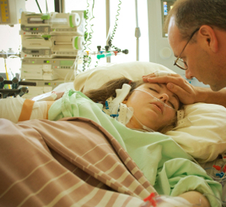
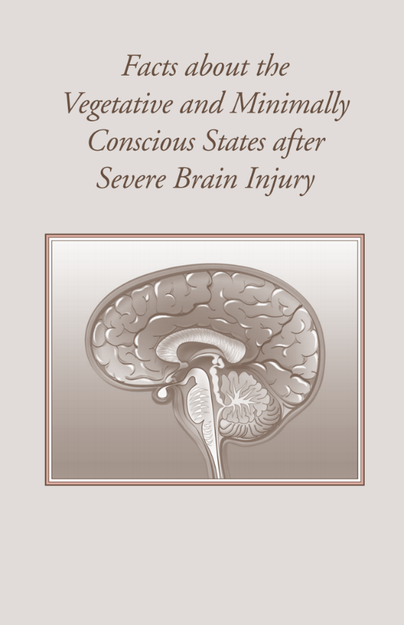
Vegetative and Minimally Conscious State
https://msktc.org/tbi-topics/vegetative-states
• Vegetative and Minimally Conscious States After Severe TBI

Slide 35
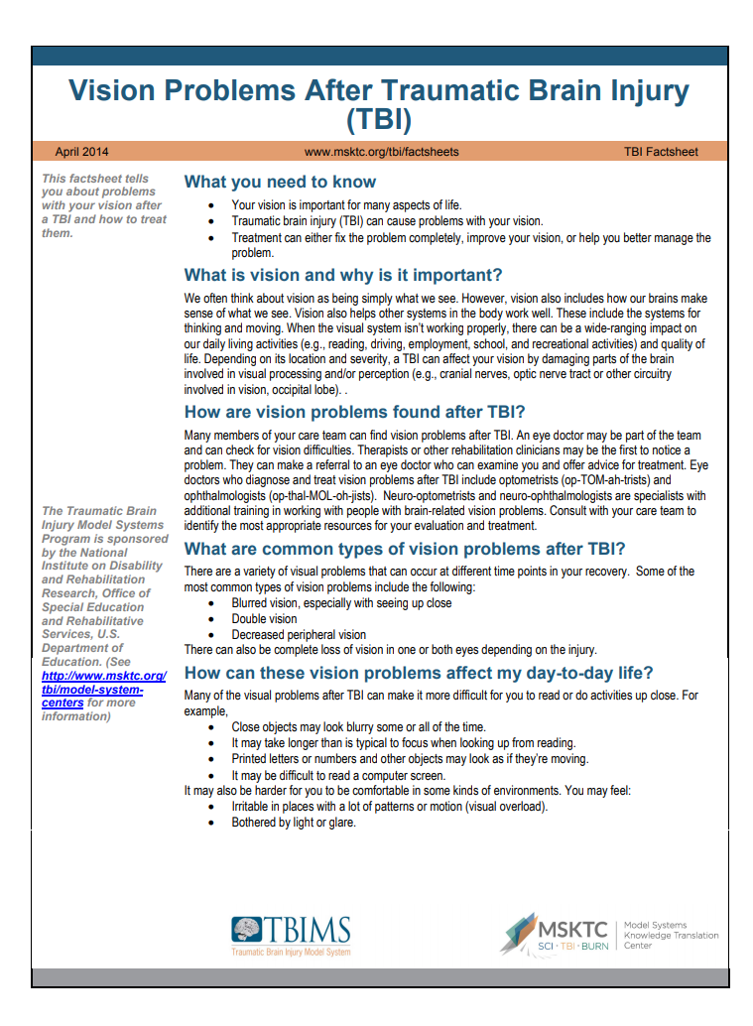
Vision Problems After TBI
https://msktc.org/tbi-topics/vision-problems
• Vision Problems and TBI

Slide 36
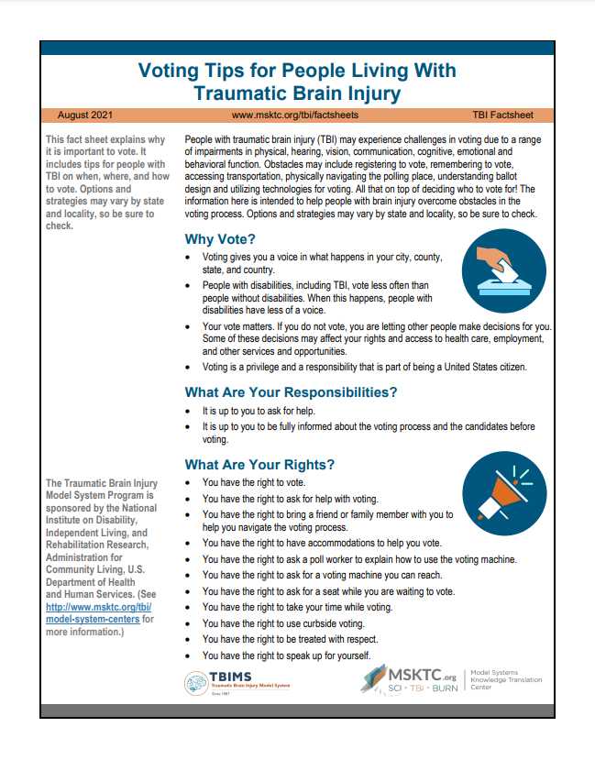
Voting Tips after TBI
https://msktc.org/tbi-topics/voting-tips-after-tbi
• Voting Tips for People Living with Traumatic Brain Injury

Slide 37
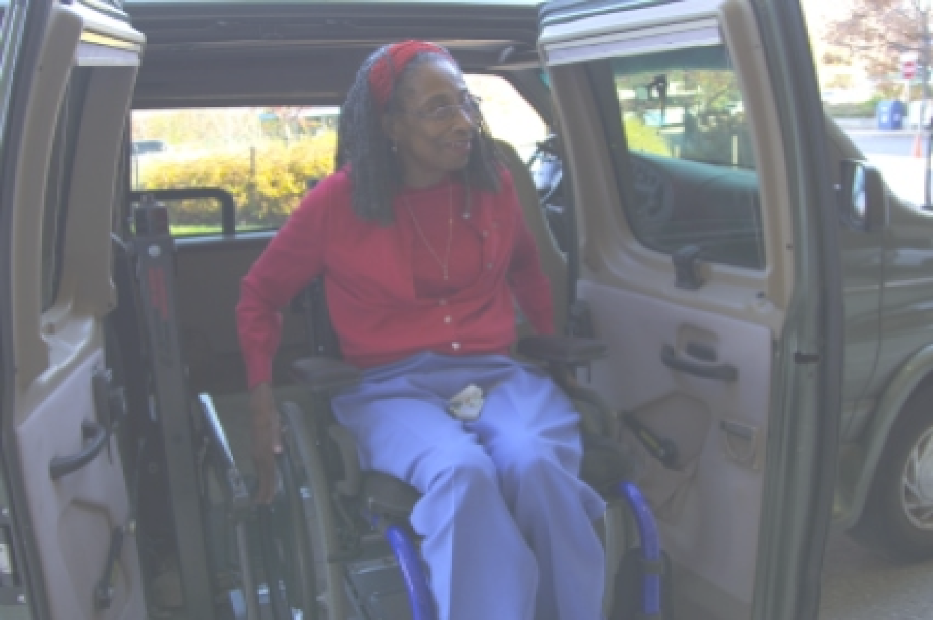
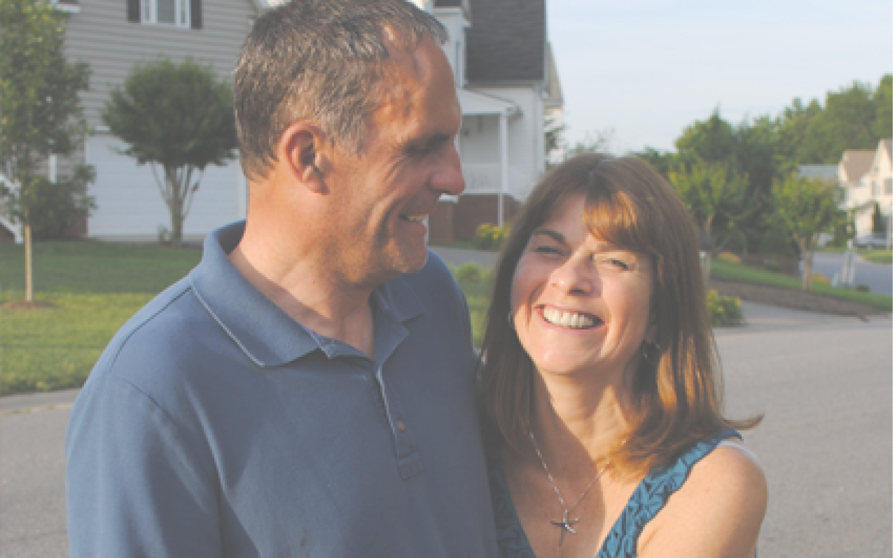
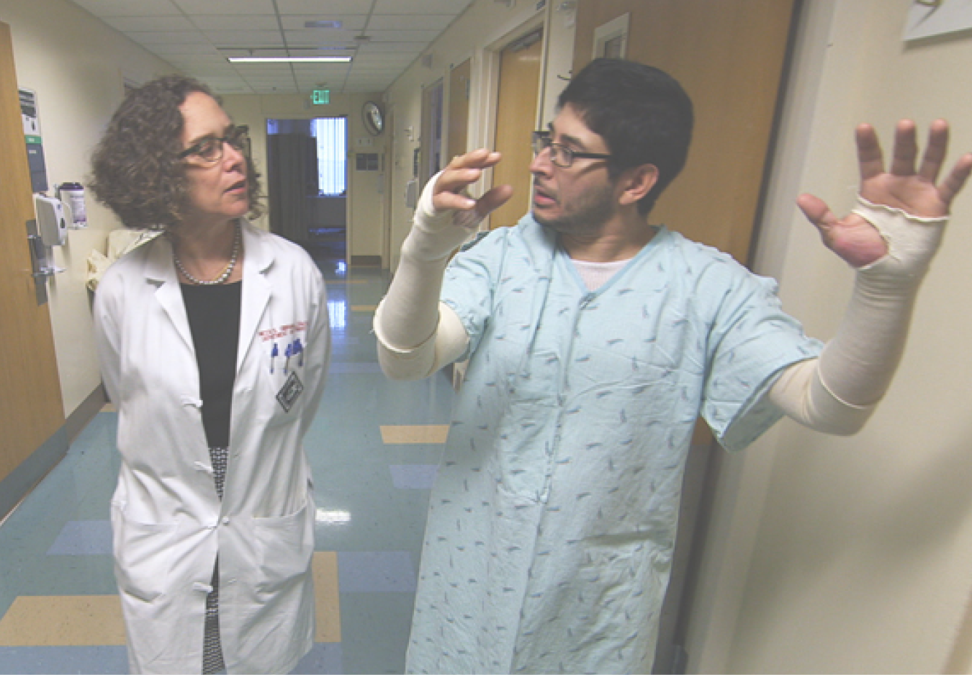
Visit the MSKTC website
Spinal Cord Injury
msktc.org/sci
Traumatic Brain Injury
msktc.org/tbi
Burn Injury
msktc.org/burn

