Slide 1
The Spinal Cord Injury Model System (SCIMS)
Model Systems Knowledge Translation Center
August 2020

Slide 2
Contents
Topics | Slide Number
SCIMS Background Information | 3
Current SCI Model Systems | 10
Formerly Funded Centers That Contributed to the National SCI Database | 20
Model Systems Knowledge Translation Center | 21
SCIMS Research Activity Areas | 25
National SCI Database | 38
National SCIMS Descriptive Data Summary 1973–2019 | 65

Slide 3
Definition of Traumatic Spinal Cord Injury (SCI)
For the purposes of the SCIMS program, a case of SCI is defined as the occurrence of an acute traumatic lesion of neural elements in the spinal canal (spinal cord and cauda equina), resulting in temporary or permanent sensory and/or motor deficit.
The clinical definition of SCI excludes intervertebral disc disease, vertebral injuries in the absence of SCI, nerve root avulsions and injuries to nerve roots and peripheral nerves outside the spinal canal, cancer, spinal cord vascular disease, and other nontraumatic spinal cord diseases.

Slide 4
The Genesis of the SCIMS
Despite advances in understanding SCI, approaches to treatment remained largely fragmented, and comprehensive rehabilitation failed to become widely adopted in the Western hemisphere … until John Young (1919–1990) resolved to correct this.
With the assistance of J. Paul Thomas, then Director of the Medical Sciences Program at the Rehabilitation Services Administration, John Young obtained a Federal grant in 1970 to demonstrate the superiority of comprehensive versus fragmented SCI care in Phoenix, Arizona … and called this demonstration a ‘‘Model System.’’

Slide 5
The Genesis of the SCIMS (continued)
‘‘A Model System must be able to meet the needs of a person with SCI by competently treating the direct injury as well as all organ systems affected (of which there are many); the functional deficits that result, by providing training and equipment; the psychological adjustments that must be made; the vocational/avocational pursuits that must be changed; and the providing of long-term specialized care.
— John Young Donovan, 2006

Slide 6
Project Design
The SCIMS program was established by the Rehabilitation Services Administration in 1970, funding Dr. Young’s vision of integrated SCI care.
Since its inception, a total of 31 centers have been funded by NIDILRR, 29 of which have contributed data to the national SCI database.
The SCI Model Systems are specialized programs of care in SCI that gather information and conduct research with the goal of improving long-term functional, vocational, cognitive, and quality-of-life outcomes for individuals with SCI.
Stover, DeVivo, & Go, 1999; Chen et al., 2016

Slide 7
Project Design (continued)
The SCIMS grantees contribute patient records to a national database, maintained by a national statistical center, which tracks the long-term consequences of SCI and conducts research in the areas of medical rehabilitation, health and wellness, technology, service delivery, short- and long-term interventions, and systems research.
Each SCI Model System is charged with disseminating information and research findings to patients, family members, health care providers, educators, policymakers, and the general public.

Slide 8
Project Priorities: Priority One 2016–2021
The SCIMS program is designed to generate new knowledge that can be used to improve outcomes of individuals with SCI. Each SCIMS Center must contribute to this goal by:
Providing a multidisciplinary system of rehabilitation care, specifically designed to meet the needs of individuals with SCI;
Continuing the assessment of long-term outcomes of individuals with SCI by enrolling at least 30 subjects per year into the SCIMS database, following established protocols for the collection of enrollment and follow-up data on subjects;
Proposing and conducting at least one, but no more than two, site-specific research projects to test innovative approaches to improving outcomes of individuals with SCI or to assessing outcomes of individuals with SCI in one or more domains identified in the Plan: health and function, community living and participation, and employment;

Slide 9
Project Priorities: Priority One 2016–2021 (continued)
Participating as research collaborators in at least one module project;
Addressing the needs of persons with disabilities, including individuals from traditionally underserved populations;
Coordinating with the Model Systems Knowledge Translation Center (MSKTC) to provide scientific results and information for dissemination to clinical and consumer audiences; and
Ensuring participation of persons with disabilities in conducting SCIMS research.

Slide 10
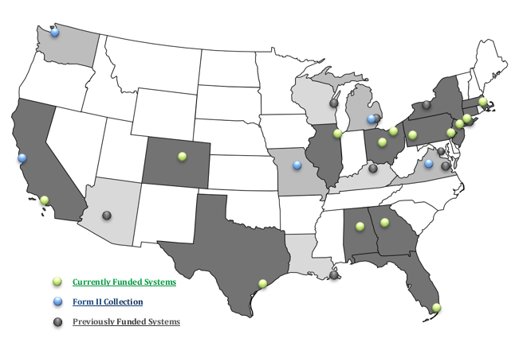
SCI Model Systems 2016–2021

Slide 11
SCI Model Systems Coordinators
Federal Program Management
National Institute on Disability, Independent Living, and Rehabilitation Research, Administration for Community Living, U.S. Department of Health and Human Services (Washington, DC)
Project Officer: Theresa SanAgustin, M.D.
https://acl.gov/about-acl/about-national-institute-disability-independent-living-and-rehabilitation-research
National SCI Statistical Center (NSCISC)
University of Alabama at Birmingham (Birmingham, AL)
Principal Investigator: Yuying Chen, M.D., Ph.D.
https://www.nscisc.uab.edu/

Slide 12
SCI Model Systems Grantees (in alphabetical order by State)
University of Alabama at Birmingham SCI Model System (UAB-SCIMS)
University of Alabama at Birmingham (Birmingham, AL)
Principal Investigator: Amie B. McLain, M.D. http://www.uab.edu/medicine/sci/
Southern California Spinal Cord Injury Model System
Ranchos Los Amigos National Rehabilitation Center (Downey, CA)
Principal Investigator: Yaga Szlachcic, M.D. https://www.ranchoresearch.org/

Slide 13
SCI Model Systems Grantees (in alphabetical order by State, continued 2)

Slide 14
SCI Model Systems Grantees (in alphabetical order by State, continued)
Rocky Mountain Regional Spinal Cord Injury System
Craig Hospital (Englewood, CO)
Principal Investigator: Susan Charlifue, Ph.D. https://craighospital.org/programs/research
South Florida Spinal Cord Injury Model System
University of Miami (Miami, FL)
Principal Investigator: Elizabeth Roy Felix, Ph.D. http://scimiami.med.miami.edu/
Southeastern Regional Spinal Cord Injury Model System
Shepherd Center (Atlanta, GA)
Principal Investigator: Edelle Field-Fote, PT, Ph.D., FAPTA http://www.shepherd.org/research/model-system-of-care
Midwest Regional Spinal Cord Injury Care System (MRSCICS)
Rehabilitation Institute of Chicago (Chicago, IL)
Principal Investigators: Allen W. Heinemann, Ph.D., and David Chen, M.D.
https://www.sralab.org/conditions/spinal-cord-injury

Slide 15
SCI Model Systems Grantees (in alphabetical order by State, continued 3)
Spaulding New England Regional Spinal Cord Injury Center (SNERSCIC)
Spaulding Rehabilitation Network (Charlestown, MA)
Principal Investigator: Ross Zafonte, D.O. http://snerscic.org/
Northern New Jersey Spinal Cord Injury System (NNJSCIS)
Kessler Foundation, Inc. (West Orange, NJ)
Principal Investigators: Trevor Dyson-Hudson, M.D., and Steven Kirshblum, M.D. https://kesslerfoundation.org/NNJSCIS

Slide 16
SCI Model Systems Grantees (in alphabetical order by State, continued 4)
Mount Sinai Spinal Cord Injury Model System (MSSCIMS)
Mount Sinai Medical Center (New York, NY)
Principal Investigator: Thomas Bryce, M.D.
https://icahn.mssm.edu/research/spinal-cord-injury/about
Northeast Ohio Regional Spinal Cord Injury System (NORSCIS)
Case Western Reserve University and the MetroHealth System (Cleveland, OH)
Principal Investigators: Gregory A. Nemunaitis, M.D., and Mary Joan Roach, Ph.D.
https://www.metrohealth.org/rehabilitation

Slide 17
SCI Model Systems Grantees (in alphabetical order by State, continued 5)
Ohio Regional Spinal Cord Injury Model System (ORSCIMS)
Ohio State University (Columbus, OH)
Principal Investigator: Jan Schwab, M.D. https://wexnermedical.osu.edu/neurological-institute/departments-and-centers/research-centers/spinal-cord-injury-model-systems
Regional Spinal Cord Injury Center of the Delaware Valley (RSCICDV)
Thomas Jefferson University (Philadelphia, PA)
Principal Investigator: Ralph J. Marino, M.D.
http://www.spinalcordcenter.org/

Slide 18
SCI Model Systems Grantees (in alphabetical order by State, continued 6)
University of Pittsburgh Model Center on Spinal Cord Injury (UPMC-SCI)
University of Pittsburgh (Pittsburgh, PA)
Principal Investigator: Michael L. Boninger, M.D.
http://www.upmc-sci.pitt.edu/
Texas Spinal Cord Injury Model System at TIRR
TIRR Memorial Hermann (Houston, TX)
Principal Investigators: Heather Taylor, Ph.D., and Margaret Nosek, Ph.D.
http://tirr.memorialhermann.org/research/

Slide 19
Form II Centers for Follow-Up Data Collection
Subcontracts by NSCISC:
Santa Clara Valley Medical Center (San Jose, CA)
Principal Investigator: Kazuko Shem, M.D.
University of Michigan (Ann Arbor, MI)
Principal Investigator: Denise Tate, Ph.D.
University of Washington (Seattle, WA)
Principal Investigator: Jeanne Hoffman, Ph.D.
Data collected by NSCISC:
University of Missouri (Columbia, MO)
Woodrow Wilson Rehabilitation Center (Fishersville, VA)

Slide 20
Formerly Funded Centers That Contributed to the National SCI Database
Arizona, Phoenix: 1973–1985; 2006–2011*
California, San Jose: 1973–1985; 1990–2006; 2006–2021*
District of Columbia, Washington: 2006–2011
Kentucky, Louisville: 2011–2016
Louisiana, New Orleans: 1983–1985
Massachusetts, BUMC: 1975–1990; 1995–2016; 2016–2021**
Michigan, Detroit: 1982–2000
Michigan, Ann Arbor: 1985–2016; 2016–2021*
Missouri, Columbia: 1979–1981; 1995–2006; 2006–2021*
New York, New York: 1973–1990; 2006–2011*
New York, Rochester: 1982–1990
Virginia, Fishersville: 1973–1983; 1985–1990; 2006–2021*
Virginia, Richmond: 1995–2006; 2006–2011*
Washington, Seattle: 1974–1985; 1990–2016; 2016–2021*
Wisconsin, Milwaukee: 1995–1999
*Form II center that collects follow-up data only.
**Affiliated with Spaulding New England SCIMS.

Slide 21
Model Systems Knowledge Translation Center
Aims to enhance the relevance and visibility of Model Systems research and communicate Model Systems research effectively to stakeholders
Currently operated by the American Institutes for Research (AIR) (Washington, DC) in collaboration with WETA/Brainline (Arlington, VA) and George Mason University (Fairfax, VA)
Principal Investigators: Steven Garfinkel, Ph.D., and Lynn Gerber, M.D.
Project Director: Xinsheng “Cindy” Cai, Ph.D.
Funded by National Institute on Disability, Independent Living, and Rehabilitation Research (Washington, DC)
Project Officer: Pimjai Sudsawad
http://www.msktc.org/

Slide 22
MSKTC Goals
Three overarching goals guide the work of the MSKTC:
Goal 1: Enhance the understanding of the quality and relevance of knowledge among researchers and multiple users on the topics of SCI, traumatic brain injury (TBI), and burn injury (Burn).
Goal 2: Enhance the knowledge of advances in SCI, TBI, and Burn research among diverse audience members who need this information.
Goal 3: Create a centralized repository of empirical information and resources on research in SCI, TBI, and Burn areas and actively conduct outreach and dissemination activities to communicate this knowledge.

Slide 23
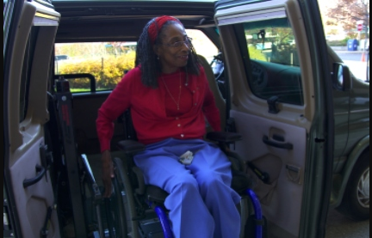
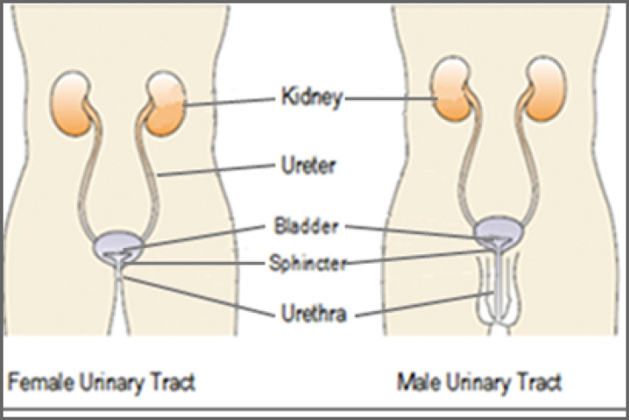
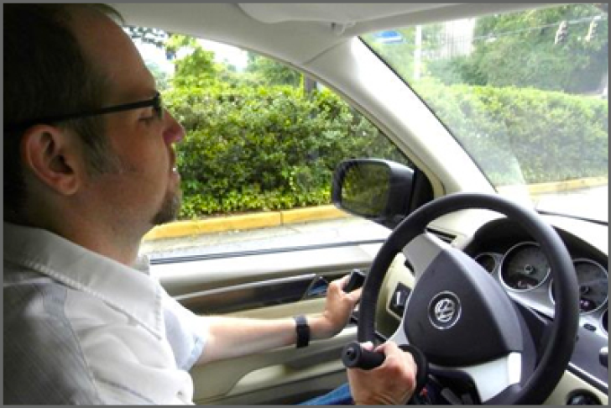
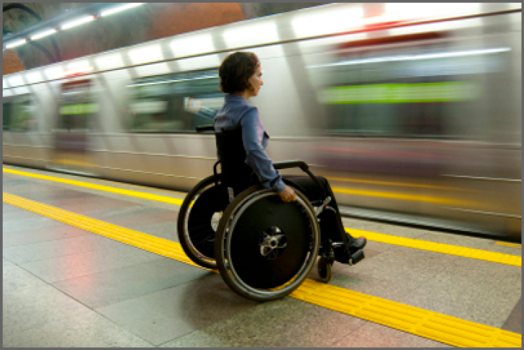
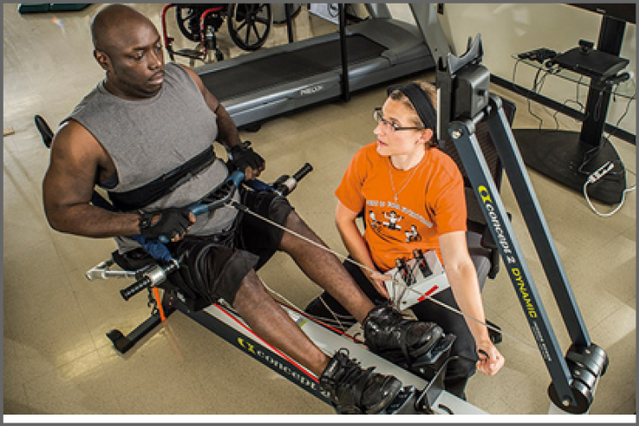
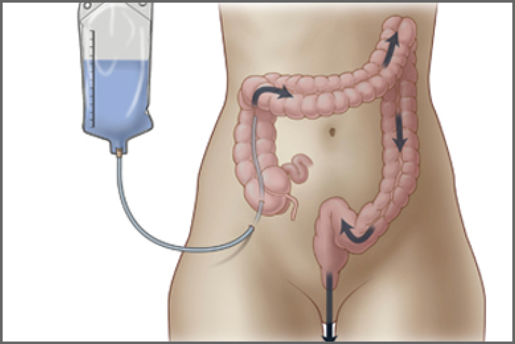
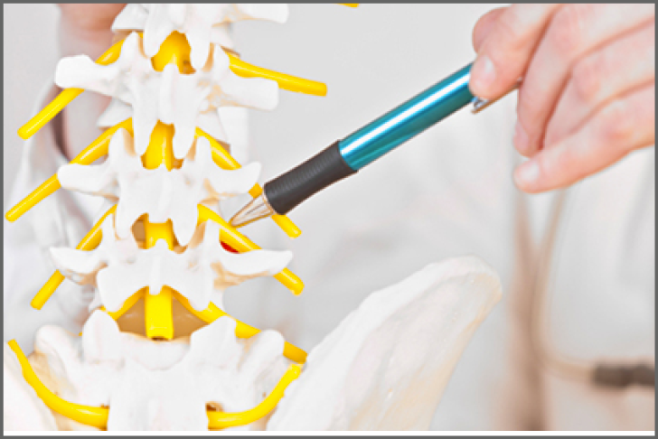
MSKTC SCI Resources
https://msktc.org/sci
ALL TOPICS
Adjusting to Life
Aging and SCI
Autonomic Dysreflexia
Bladder Management
Depression and SCI
Driving after SCI
Employment after SCI
Exercise and Fitness after SCI
Gait Training and SCI
Managing Bowel Function
Managing Pain after SCI
Pregnancy and SCI

Slide 24
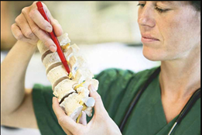
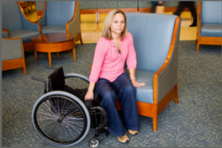
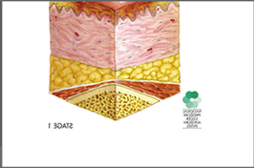
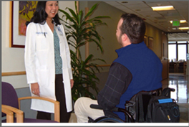
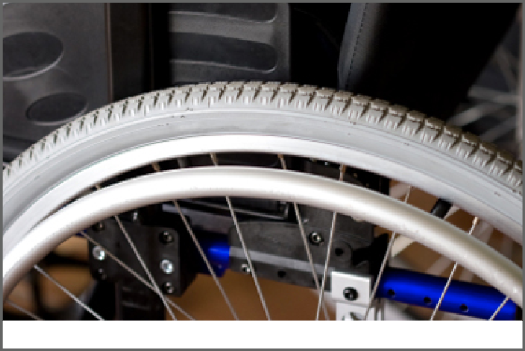
MSKTC SCI Resources (continued)
https://msktc.org/sci
ALL TOPICS
Respiratory Health and SCI
Safe Transfer Techniques
Sexuality after SCI
Skin Care and Pressure Sores
Spasticity and SCI
Surgical and Reconstructive Treatment of Pressure Injuries
Understanding SCI
Urinary Tract Infection and SCI
Wheelchair Information

Slide 25
SCIMS Research Activity Areas
Site-specific research projects
Research carried out within each center
Module projects
Collaborative research involving several SCIMS centers
Contributions to the National SCI Database
Enrollment of new inpatients
Follow-up of discharged patients

Slide 26
Site-Specific Research Projects (in alphabetical order by State)
Center | Project Title
UAB-SCI Model System (AL) | Utilizing a Low-Carbohydrate/High-Protein Diet to Improve Metabolic Health in Individuals with Spinal Cord Injury
Southern California SCI Model System (CA) | A Randomized Comparative Effectiveness Trial to Evaluate Two Programs for Promotion of Physical Activity after Spinal Cord Injury in Manual Wheelchair Users
Rocky Mountain Regional Spinal Cord Injury System (CO) | Simvastatin to Improve Bone Health in SCI: A Double-Blind, Randomized, Placebo-Controlled Clinical Trial

Slide 27
Site-Specific Research Projects (in alphabetical order by State, continued)
Center | Project Title
South Florida SCI Model System (FL) | Randomized, Double-Blinded, Controlled Trial of Early-Intervention TENS for the Reduction of the Prevalence and Severity of Chronic Neuropathic Pain During the First Year after SCI
Southeastern Regional SCI Model System (GA) | Enhancing Corticospinal Activation for Improved Walking Function Emergency Department Visits, Related Hospitalizations, and Reasons for Utilization of the Emergency Department after SCI
Midwest Regional SCI Care System (IL) | Evaluating the Effectiveness of Acute Intermittent Hypoxia to Enhance Upper Extremity Function

Slide 28
Site-Specific Research Projects (in alphabetical order by State, continued 2)
Center | Project Title
Spaulding New England Regional Spinal Cord Injury Center (MA) | Moving Beyond the FIM to Track Functional Prognosis Post SCI SCI-FI/AT Inpatient Short Forms
Northern New Jersey SCI Model System (NJ) | Efficacy and Tolerability of Mirabegron Compared to Oxybutynin Chloride Immediate Release for Neurogenic Detrusor Overactivity in Persons with Chronic Spinal Cord Injury: A Randomized, Double-Blind, Controlled, Cross-Over Clinical Trial (Mirabegron ad Oxybutynin Safety and Efficacy Trial [MOSET] in SCI)
Mount Sinai Hospital Spinal Cord Injury Model System (NY) | Treatment of Post-SCI Hypotension: A Randomized Controlled Study of Usual Care Versus Anti-hypotension Therapy

Slide 29
Site-Specific Research Projects (in alphabetical order by State, continued 3)
Center | Project Title
Northeast Ohio Regional Spinal Cord Injury System (OH) | Early Characterization of UE Paralysis in Cervical SCI as a Means to Informing Prognosis and Guiding Time-critical Interventions Methods for the Reduction of “Unavoidable” Pressure Ulcers in Persons with Acute SCI
Ohio Regional SCI Model System (OH) | Prediction of SCI-Associated Infections (SCI-AI) by Markers of Autonomic Instability (the ADDITION-SCI Study – Autonomic Dynamic Dysfunction to predict InfecTIONs after SCI)
Regional SCI Center of the Delaware Valley (PA) | Feasibility of Tele-rehabilitation-Supported Home Activity-Based Rehabilitation for the Upper Extremity in Persons with Cervical Incomplete Spinal Cord Injury

Slide 30
Site-Specific Research Projects (in alphabetical order by State, continued 4)
Center | Project Title
University of Pittsburgh Model Center on SCI (PA) | Studying Effectiveness of Remote Training (SERT)
Texas Spinal Cord Injury Model System at TIRR (TX) | Promoting the Psychological Health of Women with SCI: A Virtual World Intervention

Slide 31
Module Projects (in alphabetical order by State of lead center)
Module Project Title | Collaborating Centers
Interactive Telehealth and Biofeedback Sensor System for Pressure Ulcer Prevention after SCI | Southern California SCIMS (lead) (CA), UAB-SCIMS (AL), South Florida SCIMS (FL), and Regional SCI Center of the Delaware Valley (PA)
Utilization of Complementary and Integrative Healthcare to Treat Pain in Persons with Spinal Cord Injury | Rocky Mountain Regional SCI System (lead) (CO), Midwest Regional SCI Care System (IL), Spaulding New England Regional Spinal Cord Injury Center (MA), Northern New Jersey SCIMS (NJ), and Texas Spinal Cord Injury Model System at TIRR (TX)
Impact of Pain at Follow-Up in Individuals with SCI | South Florida SCIMS (lead) (FL), UAB-SCIMS (AL), Southern California SCIMS (CA), Southeastern Regional SCIMS (GA), and University of Pittsburgh Model Center on SCI (PA)

Slide 32
Module Projects (in alphabetical order by State of lead center, continued)
Module Project Title | Collaborating Centers
A Population Study of Persons with Chronic SCI Assessing Stakeholder Perceived and Objectively Measured Cardio-Endocrine Disease Risks, Their Change Over Time, and Effectiveness of Remediation | South Florida SCIMS (lead) (FL), Southern California SCIMS (CA), Southeastern Regional SCIMS (GA), and University of Pittsburgh Model Center on SCI (PA)
Characterizing the Experience of Spasticity after Spinal Cord Injury | Southeastern Regional SCIMS (lead) (GA), South Florida SCIMS (FL), Midwest Regional SCI Care System (IL), Northern New Jersey SCI System (NJ), Regional SCI Center of the Delaware Valley (PA), and University of Pittsburgh Model Center on SCI (PA)

Slide 33
Module Projects (in alphabetical order by State of lead center, continued 2)
Module Project Title | Collaborating Centers
Using a Health Technology Assessment Framework for Evaluating the Utilization and Efficiency of Wearable Exoskeletons for SCI Rehabilitation | Midwest Regional SCI Care System (lead) (IL), Rocky Mountain Regional SCI System (CO), Southeastern Regional SCIMS (GA), and Texas SCIMS at TIRR (TX)
Residential Instability in Chronic SCI: An Investigation of Patterns and Consequences | Northern New Jersey SCI System (lead) (NJ), Southern California SCIMS (CA), Rocky Mountain Regional SCI System (CO), Northeast Ohio Regional SCI System (OH), and University of Pittsburgh Model Center on SCI (PA)
Early Predictors of Rehabilitation Outcomes After Acute Traumatic SCI | Northeast Ohio Regional SCI System (lead) (OH), UAB-SCIMS (AL), Spaulding New England Regional SCI Center (MA), Northern New Jersey SCI System (NJ), Ohio Regional SCI Model System (OH), University of Pittsburgh Model Center on SCI (PA), and Texas SCIMS at TIRR (TX)

Slide 34
Module Projects (in alphabetical order by State of lead center, continued 3)
Module Project Title | Collaborating Centers
Equity and Quality in Assistive Technology (EQUATE) | University of Pittsburgh Model Center on SCI (lead) (PA), UAB-SCIMS (AL), Midwest Regional SCI Care System (IL), Spaulding New England Regional SCI Center (MA), Northeast Ohio Regional SCI System (OH), Ohio Regional SCI Model System (OH), and Texas SCIMS at TIRR (TX)
Identifying Upper Extremity Motor Capabilities Required to Perform Self-Care and Fine Motor Task | Regional SCI Center of the Delaware Valley (lead) (PA), Southern California SCIMS (CA), South Florida SCIMS (FL), and Southeastern Regional SCIMS (GA)

Slide 35
SCIMS Collaborative Projects 2017–2022
Collaborative projects are multisite research projects to conduct research that contributes to evidence-based rehabilitation interventions and clinical practice guidelines that improve the lives of individuals with SCI. Multisite research projects generally involve:
Three or more SCIMS centers (and may include non-SCIMS sites), and
Research to improve long-term outcomes to answer questions important to SCI rehabilitation.
SCIM Collaborative Projects are funded via a separate competition that takes place after SCIMS grants have been awarded.

Slide 36
Collaborative Project
A Multi-center Clinical Trial to Evaluate the Effectiveness of Intermittent Hypoxia Therapy in Individuals with SCI
Goal: To test whether daily acute intermittent hypoxia (AIH) improves upper-limb function in persons with incomplete cervical SCI. Investigators will evaluate training when AIH is used alone, in combination with task-specific traditional training, or using a sensorized robotic device (RAPAEL Smart Glove).
Lead Center, PI: Shirley Ryan, AbilityLab (PI: William Z. Rymer, MD)
Collaborating Centers:
Northern New Jersey SCI Model System
South Florida SCI Model System
University of Chicago (not a model system)
University of Florida (not a model system)

Slide 37
National SCI Database
Began in 1975
Data obtained retrospectively to 1973 and prospectively since 1975
Currently captures approximately 6% of all new SCI occurring in the United States every year
National SCI Statistical Center (NSCISC) at the University of Alabama at Birmingham has managed the database since 1983
As of September 2019
Registry—14,467 participants (1987–2019)
Form I—34,130 participants (1973–2019)
Form II—124,188 records (1975–2019) among 28,463 participants, with the longest follow-up of 45 years post injury

Slide 38
National SCI Database Goals
Examine the longitudinal course of SCI
Evaluate trends over time
Etiology, demographics, injury characteristics, health services delivery, treatment outcomes, etc.
Establish rehabilitation outcomes standards
Facilitate other research
Generate research hypotheses
Identify study subjects

Slide 39
National SCI Database Data Sharing Policy
SCIMS Center Requests
SCIMS centers are requested to share research proposals, using the National SCI Database, via email notification to avoid conflicts and invite collaboration
Comparing SCIMS centers is prohibited
A Data Use Agreement must be signed with National SCI Statistical Center
All publications must acknowledge NIDILRR

Slide 40
National SCI Database Data Sharing Policy (continued)
External Independent Research Requests of Limited Data Set with a Data Agreement
Requestor must provide a proposal, outlining the study purpose and methods, commercial use/relationships, confidentiality protections, responsible party, data required, and proof of IRB (institutional review board) approval
The proposal must be reviewed by NSCISC; the final proposal is then forwarded to the SCIMS Project Directors and NIDILRR for approval
The decision to release data is made by a majority vote of the Project Directors
A Limited Data Set is stripped of all HIPAA-defined identifiers except age, dates, city, state or zip.
A copy of the manuscript must be sent to NSCISC for review before submitting it for publication
All publications must acknowledge NIDILRR and have an appropriate disclaimer

Slide 41
National SCI Database Data Sharing Policy (continued 2)
Public Access to De-identified Data
De-identified Data collected before October 1, 2016 are freely available for download.
De-identified Data are stripped of all HIPAA-defined identifiers, including names, geographic subdivisions smaller than a state, elements of dates (except year) related to an individual, telephone numbers, fax numbers, email addresses, social security numbers, and medical record numbers.

Slide 42
Eligibility for the SCIMS
Presence of an external traumatic event that results in an SCI
Temporary or permanent loss of sensory and/or motor function as a result of the traumatic event
Admission to the system within 1 year of the injury
Discharge from the system as:
Inpatient acute rehabilitation is completed,
A neurologic status of normal or minimal deficit is achieved, or
When deceased
Must not have completed an organized rehabilitation program before admission to the system
Signed informed consent and Health Insurance Portability and Accountability Act (HIPAA) forms

Slide 43
National SCI Database Structure
Form I or Registry (inpatient data collection at enrollment)
Initial hospital care data
Patients residing outside the catchment area are enrolled in the Registry
Less detailed data collection than Form I
Registry data have been used for epidemiological and survival studies
No longitudinal follow-up data are collected for Registry cases
Form II (follow-up data collection)
Follow-up data on Form I participants
Currently in years 1, 5, and 10, and every 5 years thereafter

Slide 44
Data Collection Sources
Medical record review
May be supplemented by site-specific data collection forms completed by clinicians or inpatient interview
Neurological examination
Typically conducted as part of routine SCI care
Patient interview
Telephone, mailed questionnaire, in-person interview
Death records

Slide 45
Follow-Up Guidelines
Find participants
Check the Social Security Death Index (SSDI), genealogy, or other death search site for record of death
Search system (hospital and clinical) records for recent activity and updated contact information
Conduct at least two free Internet searches and a fee-based search if available
Attempt to schedule a clinical follow-up visit
Call viable phone numbers at least six times at different times of the day and week
Mail a Form II survey to a viable address

Slide 46
National SCI Database Variables
Demographics
Injury characteristics (severity, etiology, associated injuries, spinal surgery, etc.)
Hospitalizations
Medical, functional, and psychosocial outcomes measures
Use of assistive technology
Use of information/communication technology

Slide 47
Demographics (at the time of injury)
Age, sex, and race/ethnicity
English language ability
Health literacy
Marital status
Level of education
Occupational status and job census code
Primary insurance
Veteran status
Family income
Geographic identifiers (geocode) and ZIP code
Place of residence (at admission and discharge)

Slide 48
Injury Characteristics
Date of injury
Traumatic etiology
External cause of injury (ICD-10-CM)
Work-related injury (yes/no)
Vertebral injury (yes/no)
Associated injuries (yes/no)
Spinal surgery (yes/no)

Slide 49
Neurological Exam
Collected at:
Initial system admission (for Day 1 admit patients only)
Admission to rehabilitation
Discharge from rehabilitation
First anniversary of injury
International Standards for Neurological Classification of SCI:
Date of exam
Motor scores (C5−S1) and motor levels
Presence of anal sensation and/or sphincter contraction
Sensory score (C2−S4/5) and sensory level
Level of neurological injury
Category of neurologic impairment
American Spinal Injury Association Impairment (AIS) Scale, A through E

Slide 50
Initial Hospitalization
Medical history:
Diabetes
Hypertension
Hyperlipidemia
Arthritis
Pregnancy
Depression
Anxiety
Alcohol use – Alcohol Use Disorders Identification Test (AUDIT) C
Substance use – WHO ASSIST
Length of stay in medical/surgical unit and rehabilitation
Height and weight
Bladder/bowel management and incontinence
Use of mechanical ventilation (at rehabilitation admission and discharge)

Slide 51
Initial Hospitalization
Functional status – CARE tool (at rehabilitation admission and discharge)
Self-care, such as eating, oral hygiene, toileting hygiene, bathing, and dressing
Mobility, such as rolling, transferring, and locomotion
Functional status – SCI-Functional Index Assistive Technology (SCI-FI AT, at rehabilitation discharge)
Basic mobility
Self-care
Fine motor
Ambulation
Wheelchair mobility
Depression – Patient Health Questionnaire (PHQ-9)
Resilience – SCI-QoL Resilience short form

Slide 52
Follow-Up Data Collection
Current sociodemographic information
Marital status
Level of education
Occupational status and job census code
Place of residence
Geographic identifiers (geocode) and ZIP code
Primary insurance
Family income
Alcohol use – Alcohol Use Disorders Identification Test (AUDIT) C
Substance use – WHO ASSIST
Use of the VA Health System services (yes/no)

Slide 53
Follow-Up Data Collection (continued)
Neurological exam and use of mechanical ventilation (required for Year 1 only)
Method of bladder management and reason for change
Bowel management
Medical and secondary conditions
Pain
Urinary tract infection
Pressure ulcer
Diabetes
Hypertension
Hyperlipidemia
Arthritis
Pregnancy
Sleep difficulties
Falls

Slide 54
Follow-Up Data Collection (continued 2)
Rehospitalizations over the last 12 months
Length of stay
Reason
Functional status – SCI-FI AT
Height and weight
Ambulation

Slide 55
Follow-Up Data Collection (continued 3)
Self-perceived health status – two items from the Short Form [SF] 36, Health Survey
Health rating on a five-point scale, ranging from “Excellent” to “Poor”
Current health compared to 1 year ago
Satisfaction With Life Scale (SWLS)
Five-item self-report scale

Slide 56
Follow-Up Data Collection (continued 4)
Depression – Patient Health Questionnaire (PHQ-9)
Participation – Craig Handicap Assessment and Reporting Technique—Short Form (CHART-SF)
Physical independence
Mobility
Occupation
Social integration

Slide 57
Follow-Up Data Collection (continued 5)
Assistive technology use
Mobility aids for ambulation
Wheelchair or scooter use
Modified vehicle availability and use
Information/communication technology use
Computer
Internet/email
Mobile phone
Key information sources

Slide 58
Record Status
Vital status date
Date of death or date last known alive
Primary and secondary causes of death
Participant status:
Registry/Form I
Eligibility for future follow-up, such as neurological recovery, consent withdrawn, etc.
Participant Form II statistics:
Total Form IIs
Last Form II anniversary year and follow-up status

Slide 59
Data Quality
Standard operating procedures and policies
Data dictionary
Data collectors’ training conferences
Software quality control procedures
Range and legal value checks
Cross-variable and cross-record consistency
Supportive site visits to review system-specific procedures
Onsite quality assurance
Data collectors’ certification program

Slide 60
Internal Dissemination
Annual Statistical Report and Mid-Year Report
Produced by National SCI Statistical Center
Data management reports
Follow-up tracking report
Subject recruitment and enrollment report
Missing data report
Report Cards (center-specific performance summary)
Benchmark management plan

Slide 61
External Dissemination
Online Data Collection Forms and Data Dictionary
https://www.nscisc.uab.edu/Public_Pages/Database
Facts and Figures at a Glance https://www.nscisc.uab.edu/
Published annually by the National SCI Statistical Center
Annual Statistical Reports – Public Version
Published annually by National SCI Statistical Center
https://www.nscisc.uab.edu/Public_Pages/ReportsStats
Slideshow to educate others about the SCIMS
Quick Search Public Tools https://www.nscisc.uab.edu/Public_Pages/QuickSearchTools
Leading Causes of SCI
Life Expectancy Calculator

Slide 62
External Dissemination (continued)
National professional meetings
Peer-reviewed publications
Compilation of SCIMS research
Books (1986, 1990, 1995)
Special issues of Archives of Physical Medicine and Rehabilitation (1999, 2004, 2011, 2016)

Slide 63
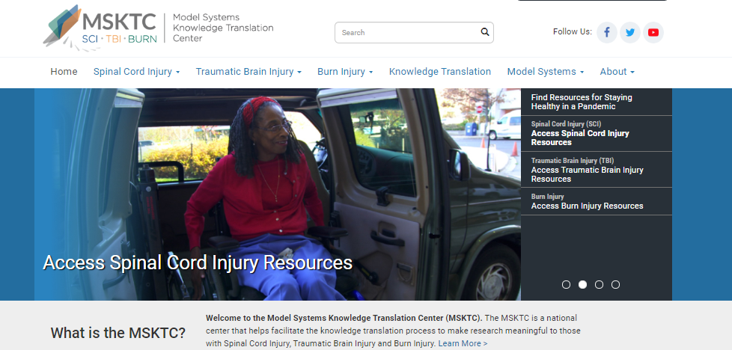
External Dissemination (continued 2)
Collaborate with MSKTC (https://msktc.org/) to develop and disseminate

Slide 64
National SCI Model System Descriptive Data Summary From 1973 to 2019
Source: The 2019 Annual Statistical Report for the SCI Model Systems National SCI Statistical Center, Birmingham, AL https://www.nscisc.uab.edu/Public_Pages/ReportsStats

Slide 65
Age at Injury and Gender
Males: 27,453 (80.4%) Females: 6,672 (19.6%)

Slide 66
Education (at the time of injury)
Since 2015

Slide 67
Marital Status (at the time of injury)
Since 2015

Slide 68
Occupational Status (at the time of injury)

Slide 69
Race

Slide 70
Neurological Level and Extent of Lesion

Slide 71
SCI Grouped Etiology
Percentage

Slide 72
Long-Term Survival (life expectancy in years)
Age | Survive first 24 hours: Motor Fx, Any Level | Survive first 24 hours: Para | Survive first 24 hours: Low Tetra (C5–C8) | Survive first 24 hours: High Tetra (C1–C4) | Survive first 24 hours: Vent. Dep., Any Level | Survive >1 year post injury: Motor Fx, Any Level | Survive >1 year post injury: Para | Survive >1 year post injury: Low Tetra (C5–C8) | Survive >1 year post injury: High Tetra (C1–C4) | Survive >1 year post injury: Vent. Dep., Any Level
20 | 52.0 | 44.7 | 39.1 | 32.5 | 9.8 | 52.0 | 44.7 | 39.1 | 32.5 | 9.8
40 | 34.8 | 29.5 | 24.7 | 20.6 | 8.6 | 34.8 | 29.5 | 24.7 | 20.6 | 8.6
60 | 19.2 | 16.0 | 13.0 | 11.1 | 3.6 | 19.2 | 16.0 | 13.0 | 11.1 | 3.6
Facts and Figures, 2020

Slide 73
Major Accomplishments of the SCIMS
Provides trends in SCI demographics, causes, and severity
Crucial for the design of preventive measures
Useful for projecting health care needs and allocating resources
Provides information about the course of recovery, health service delivery and costs, treatment, and rehabilitation outcomes
Benchmark for the judicial system to determine awards for life care needs
Sets standards for the assessment, treatment, and management of persons with SCI nationally and internationally
Development of the Clinical Practice Guidelines in collaboration with American Spinal Injury Association and the Paralyzed Veterans of America
Ditunno et al., 2003
Chen et al., 2016

Slide 74
Major Accomplishments of the SCIMS (continued)
Research agenda has broadened from emphasis on acute care to include social determinants of health, physical and psychological functioning, and technology
Rapid expansion propelled by consumer involvement and advances in research methodology
Clinical excellence of the SCIMS provided the foundation from which clinical research focusing on key issues about the health of persons with SCI grew dramatically in the last five decades
Development of new measurement tools to capture neurological, psychosocial, and emotional functioning
Ditunno et al., 2003
Chen et al., 2016

Slide 75
Major Accomplishments of the SCIMS (continued 2)
National SCI Database—the largest and longest in the world
The SCI statistics have been widely used and referenced
Google search for “SCI statistics”—NSCISC website ranked first
Produced specific life-expectancy estimates for court cases in the United States and also countries outside the United States, such as Canada, Australia, England, Scotland, Northern Ireland, Ireland, and Hong Kong

Slide 76
Research Contributions of the SCIMS
Emergency and acute care outcomes
Trends in patient demographics and injury characteristics
Medical rehabilitation treatment outcomes
Development of classification systems (AIS Scale, pain)
Preexisting conditions and secondary complications
Psychosocial and vocational outcomes
Tate & Forchheimer, 2002

Slide 77
Research Contributions of the SCIMS (continued)
Health care cost issues
Functional independence outcomes
Pain and sexuality
Community integration and consumer involvement
National priorities: health disparity, obesity, pain, substance use
Assistive technology, wheelchair skills
Technology use and quality of life
Outcome measurements via computer-adapted testing (CAT)
Community and neighborhood
Big data modeling: artificial neural network and other techniques
Tate & Forchheimer, 2002; Chen et al., 2011; Chen & Heinemann, 2016

Slide 78
References
Chen, Y., Deutsch, A., DeVivo, M. J., Johnson, K., Kalpakjian, C., Nemunaitis, G., … Tulsky, D. (2011). Current research outcomes from the Spinal Cord Injury Model Systems. Archives of Physical Medicine Rehabilitation, 92, 329–331.
Chen, Y., DeVivo, M. J., Richards, J. S., & SanAgustin, T. B. (2016). Spinal Cord Injury Model Systems: Review of program and national database from 1970 to 2015. Archives of Physical Medicine Rehabilitation, 97, 1797–1804.
Chen, Y., & Heinemann, A. W. (2016). Current research outcomes from the Spinal Cord Injury Model Systems. Archives of Physical Medicine Rehabilitation, 97, 1607–1609.
Ditunno, J., Apple, D., Burns, A., Donovan, W., Hagglund, K., Lammertse, D., … Tulsky, D. (2003). A view of the future model spinal cord injury system through the prism of past achievements and current challenges. Journal of Spinal Cord Medicine, 26(2), 110–115.

Slide 79
References (continued)
Donovan, W. (2006). Donald Munro Lecture: Spinal cord injury—Past, present and future. Journal of Spinal Cord Medicine, 30, 85−100.
Stover, S. L., DeVivo, M. J., & Go, B. K. (1999). History, implementation, and current status of the national spinal cord injury database. Archives of Physical Medicine and Rehabilitation, 80, 1365−1371.
Tate, D. G., & Forchheimer, M. (2002). Contributions from the model systems programs to spinal cord injury research. Journal of Spinal Cord Medicine, 25(4), 316−330.

