Slide 1
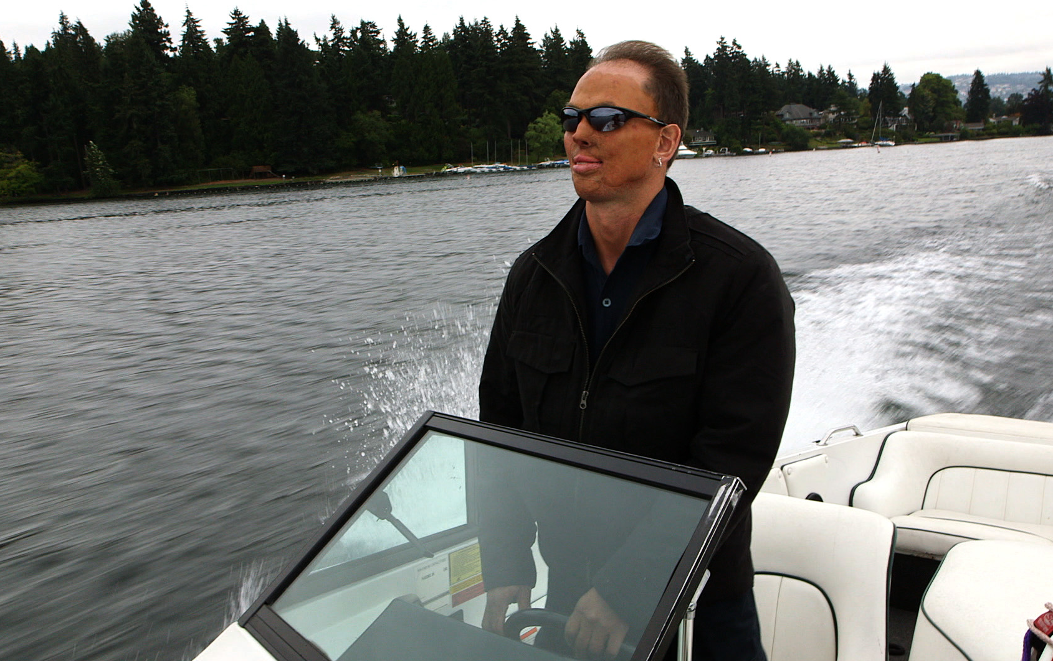
Model Systems Knowledge Translation Center Burn Injury Resource Inventory
Model Systems Knowledge Translation Center
March 2022

Slide 2
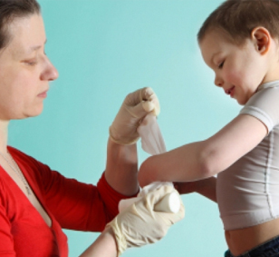
About Burn Model Systems Database
The Burn Model Systems (BMS) program, sponsored by the National Institute on Disability, Independent Living, and Rehabilitation Research (NIDILRRR), Administration for Community Living, U.S. Department of Health and Human Services, supports innovative projects and research in the delivery, demonstration, and evaluation of medical, rehabilitation, vocational, and other services designed to meet the needs of individuals with burn injury.
NIDILRR awards Burn Model Systems grants to institutions that are national leaders in medical research and patient care; these institutions provide the highest level of comprehensive specialty services from the point of injury through eventual re-entry into full community life.
There are 4 currently-funded Burn Model System Centers.
Each Burn Model System contributes to the Burn Model System National Data and Statistical Center, participates in independent and collaborative research, and provides information and resources to individuals with burn injury; their families, caregivers, and friends; health care professionals; and the general public.

Slide 3
Current Burn Model Systems Centers

Slide 4
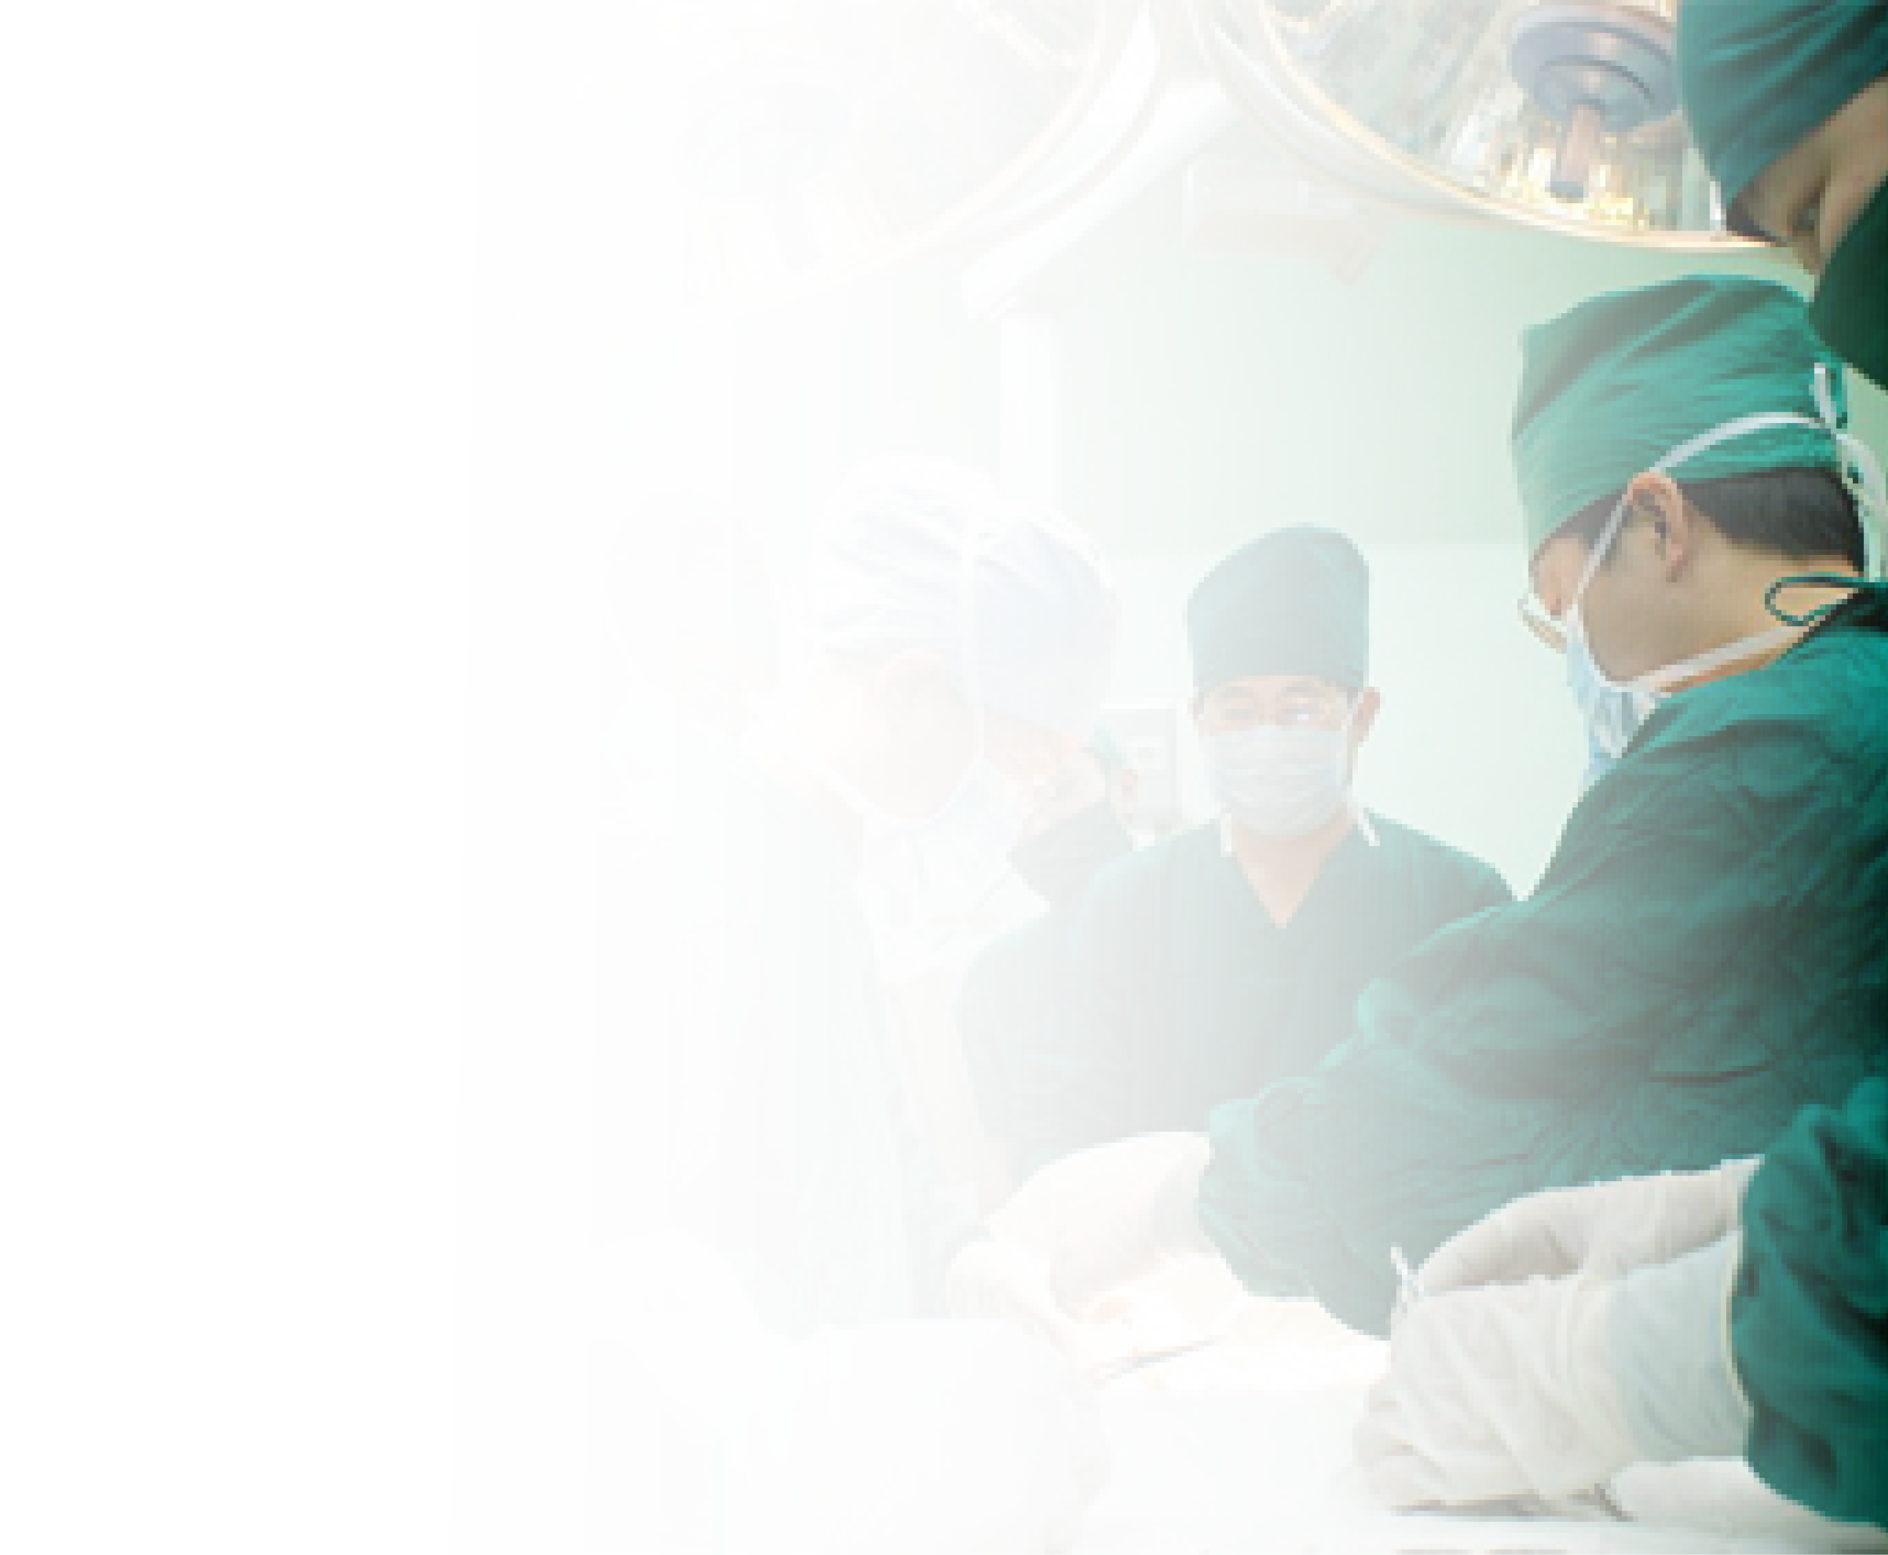
About BMS Model Systems Database
The BMS National Database is a prospective, longitudinal, multicenter research study that examines functional and psychosocial outcomes of burn survivors.
It consists of common data elements from a unique, well-characterized population of individuals with moderate to severe burn injury.
On December 31, 2018, the database contained information for 4,021 adults (18 years of age and older at the time of burn) and 2,287 children (17 years of age and younger at the time of burn).
The BMS National Database includes data on pre-injury, injury, acute care, rehabilitation, and outcomes at 6, 12, and 24 months as well as every 5 years post-injury.
Visit the Burn Model Systems Database: http://burndata.washington.edu/.

Slide 5
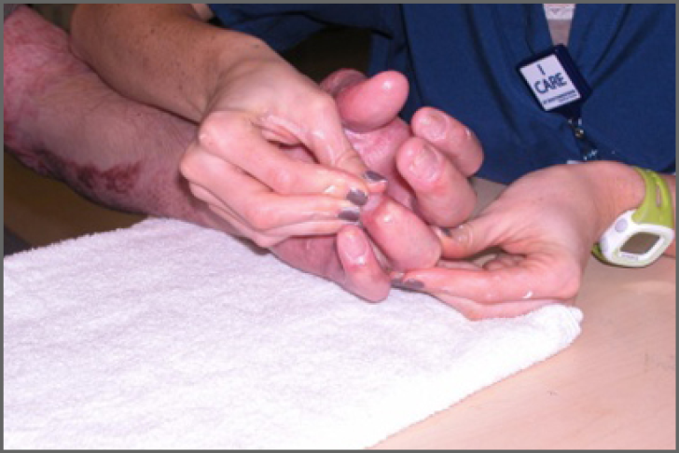
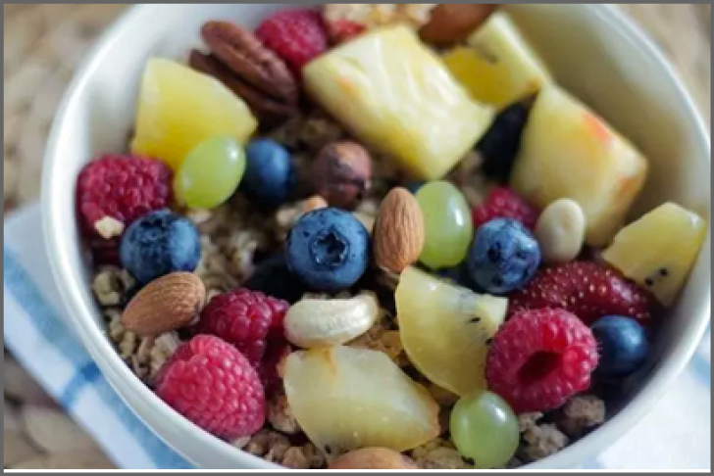
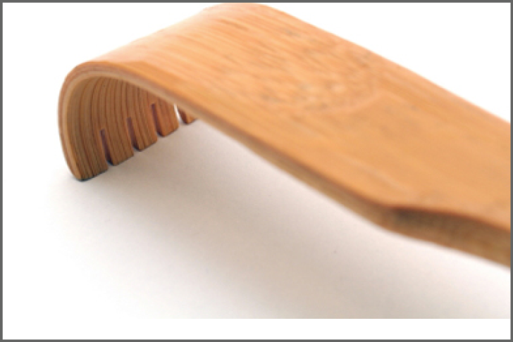
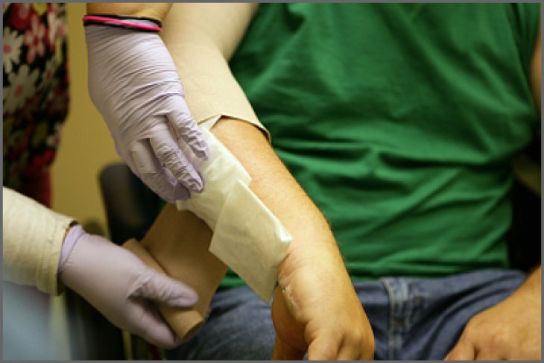
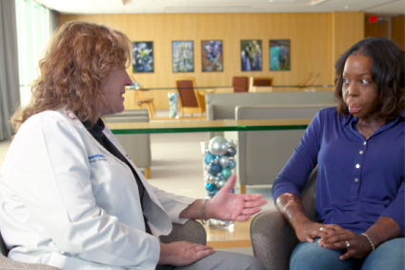
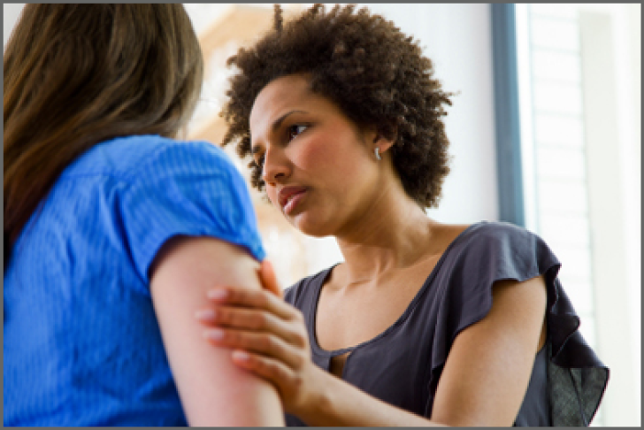
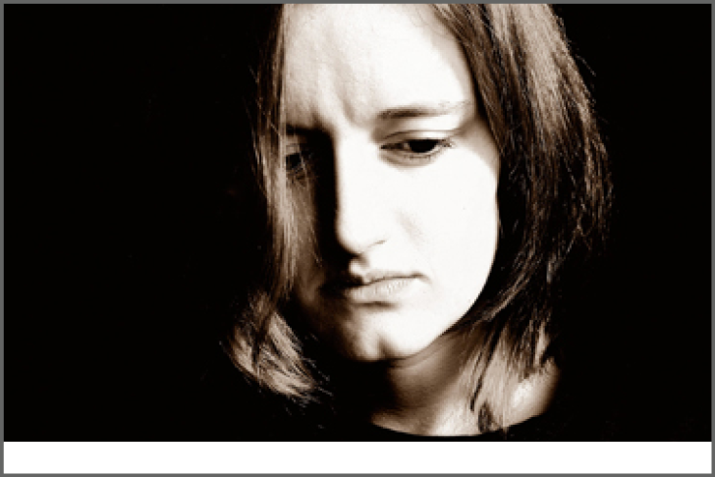
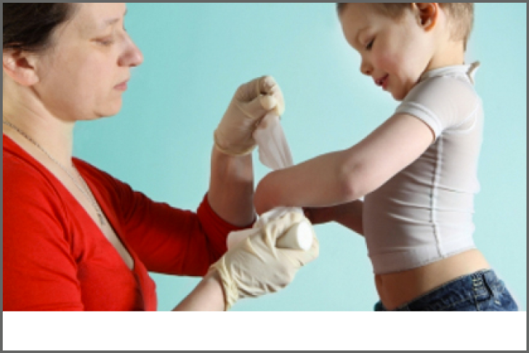
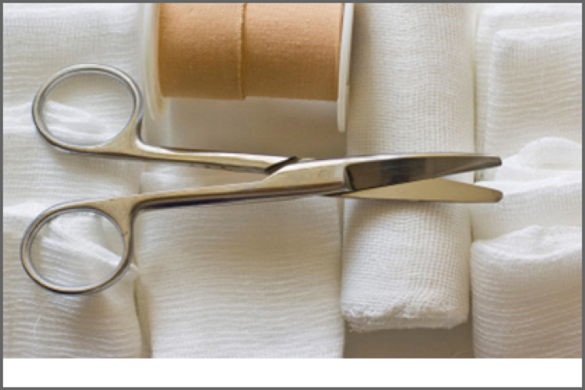
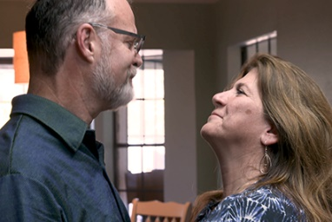
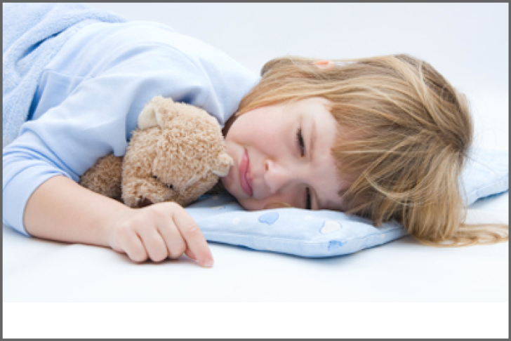
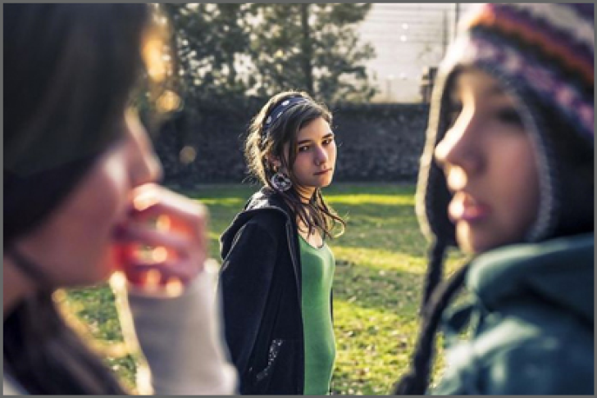
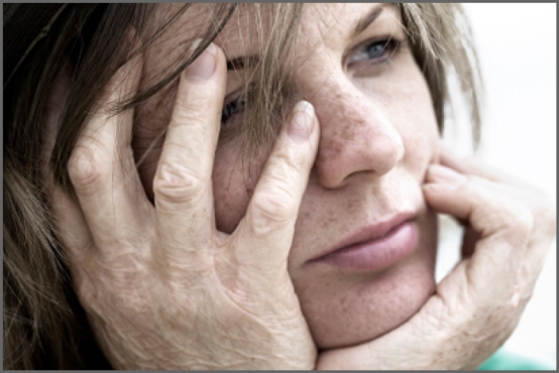
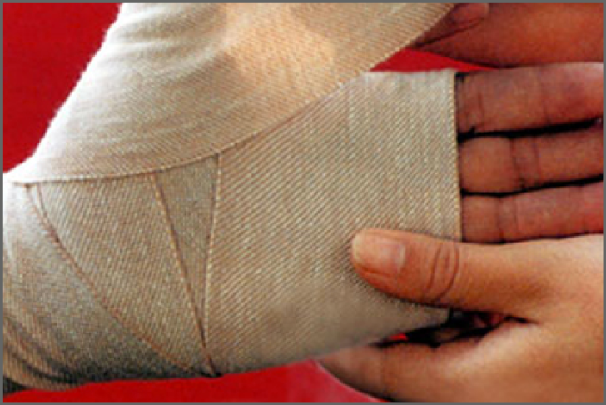
Living with Burn Injury
ALL TOPICS
Employment After Burn Injury
Exercise After Burn Injury
Healthy Eating-Adults
Healthy Eating-Kids
Itchy Skin After
Burn Injury
Managing Pain
Outpatient Opioid Management for Adult Burn Survivors
Psychological
Distress
PTSD
Resilience
Return to School
Scar Management
Sexuality and Intimacy
Sleep Problems
Social Interaction After Burn Injury
Understanding and Improving Body Image After Burn Injury
Wound Care
Understanding
Burn Injury
Sun Protection After
Burn Injury

Slide 6
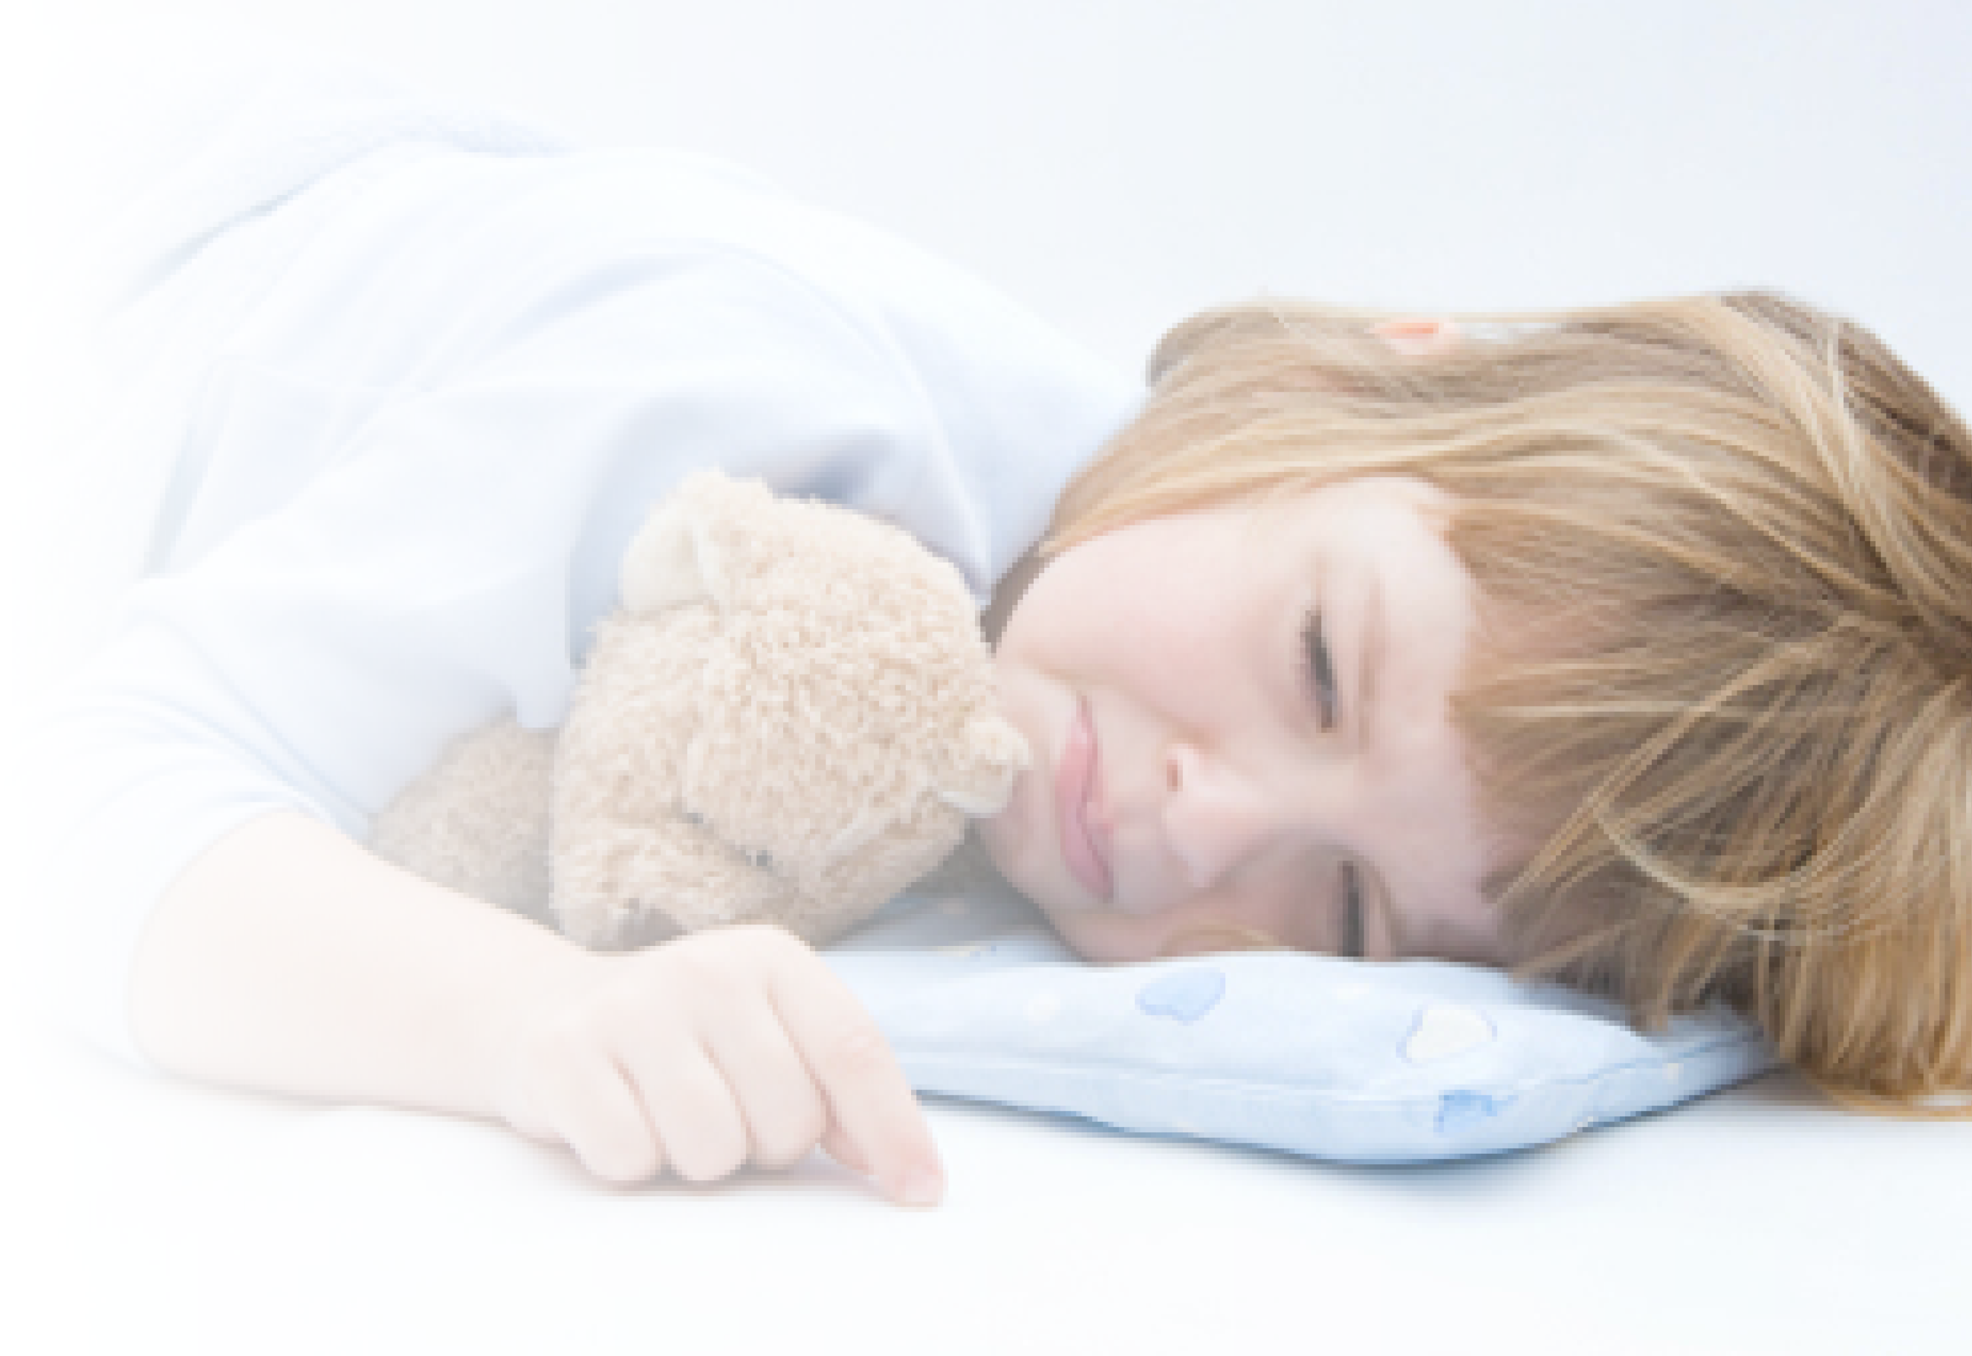
Burn Injury Resources
https://msktc.org/burn/burn-resources

Slide 7
Employment After Burn Injury
https://msktc.org/burn-topics/employment-after-burn-injury
Accommodations Employers Might Make
BMS Research On Barriers to Returning To Work
Employment After Burn Injury
How Ben Responds to Strangers' Questions
Increasing Awareness About People With Burn Injuries
Keys to A Successful Return to Work Plan
Psychological Issues Burn Injury Patients Face
Returning to Work Can Help
Some Common Mistakes Employers Make
The Importance of Staying Active
What Burn Patients Go Through
What Co-Workers & Employers Can Do to Help Workers Return
What Patients Can Do As They Return to Work
When to Go Back To Work
Employment After Burn Injury
Employment After Burn Injury
Employment After Burn Injury

Slide 8
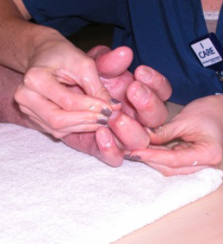
Exercise After Burn Injury
https://msktc.org/burn-topics/exercise-after-burn-injury
A Caregiver's Perspective
Cardio After Burn Injury
Coming to Terms with Your Scars
Competitive Athletes After Burn
Exercise After Burn Injury
Exercise and Autonomy
Exercise and Contractures
Exercising After Amputation from Burn Injury
Getting Back to Yoga Class
Muji Karim and Exercising with Prosthetic Limbs
The Benefits of Yoga for People with Burn Injury
The Importance of Family Support
The LIBRE Project
The Value of Peer Support
Thriving Long Term
Tips for Exercising After Burn Injury
Transition Home
Why Exercise Is Critical After Burn Injury
Why Exercise May Be Hard After Burn Injury
Exercise After Burn Injury
Exercise After Burn Injury
Exercise After Burn Injury

Slide 9
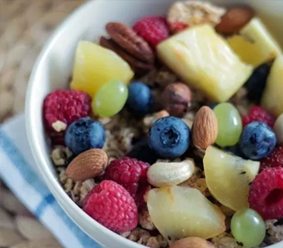
Health Eating After Burn – Adults
https://msktc.org/burn-topics/healthy-eating-adults
• Healthy Eating After Burn Injury – For Adults

Slide 10
Health Eating After Burn – Kids
https://msktc.org/burn-topics/healthy-eating-kids
• Healthy Eating For Kids with Burn Injury

Slide 11
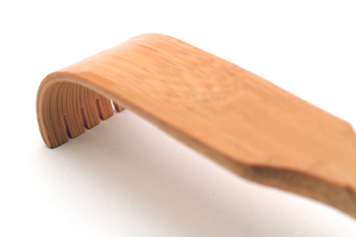
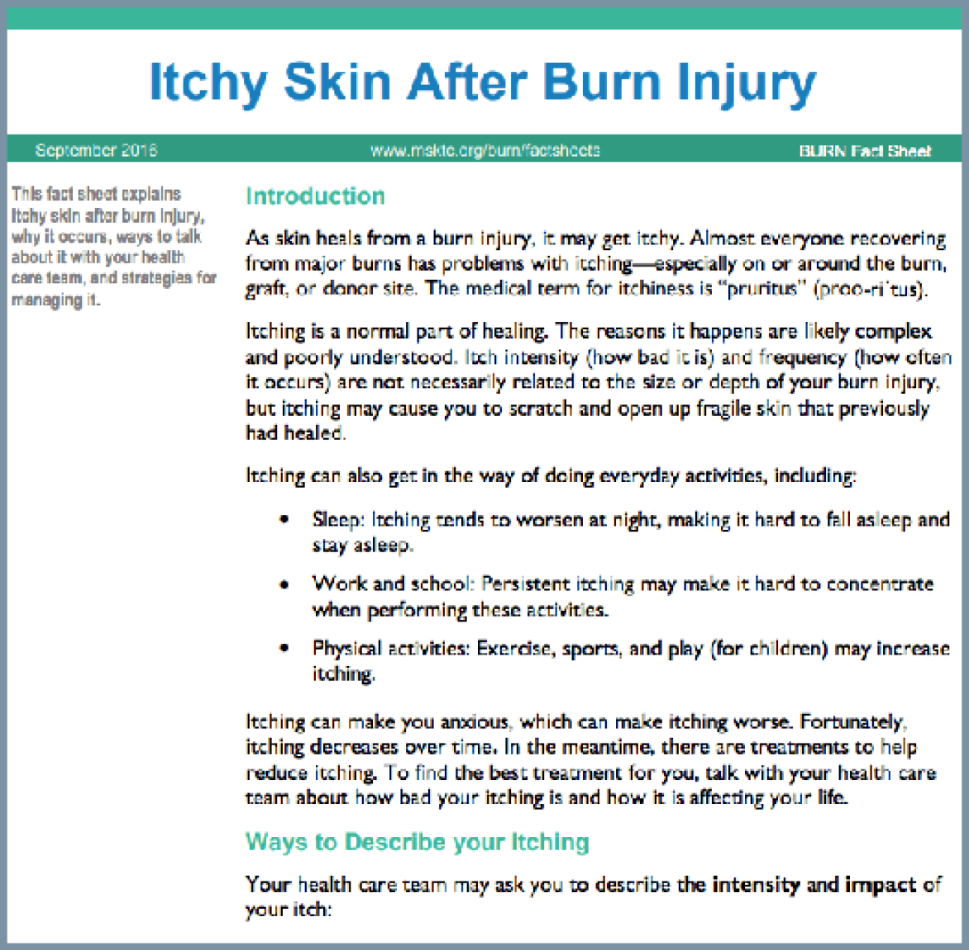
Itchy Skin After Burn Injury
https://msktc.org/burn-topics/itchy-skin-after-burn-injury
• Itchy Skin After Burn Injury
• Itchy Skin After Burn Injury

Slide 12
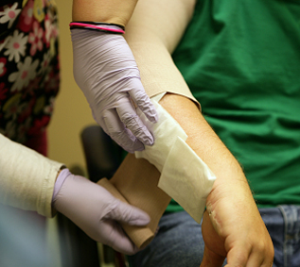
Managing Pain After Burn Injury
https://msktc.org/burn-topics/managing-pain
• Managing Pain After Burn Injury

Slide 13
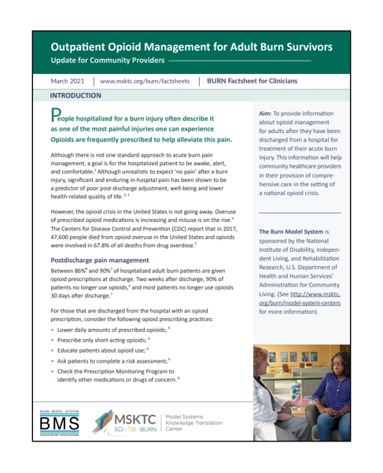
Outpatient Opioid Management for Adult Burn Survivors
https://msktc.org/burn-topics/outpatient-opioid-management-adult-burn-survivors
• Outpatient Opioid Management for Adult Burn Survivors

Slide 14
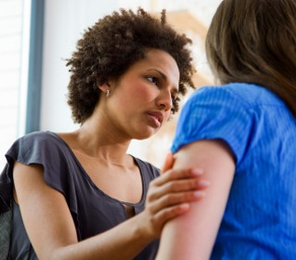
Psychological Distress After Burn
https://msktc.org/burn-topics/psychological-distress
• Psychological Distress After Burn
Injury

Slide 15
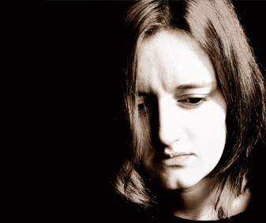
PTSD After Burn Injury
https://msktc.org/burn-topics/ptsd
• Post-Traumatic Stress Disorder (PTSD) After Burn Injury

Slide 16
Resilience After Burn Injury
https://msktc.org/burn-topics/resilience
• Help Your Child Recover- Build Your Child's Resilience After Burn Injury

Slide 17
Return to School After Burn Injury
https://msktc.org/burn-topics/return-school
• Going Back to School After a Major Burn Injury

Slide 18
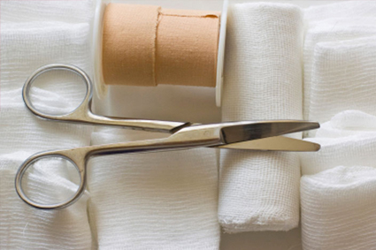
Scar Management After Burn Injury
https://msktc.org/burn-topics/scar-management
• Scar Management After Burn Injury

Slide 19
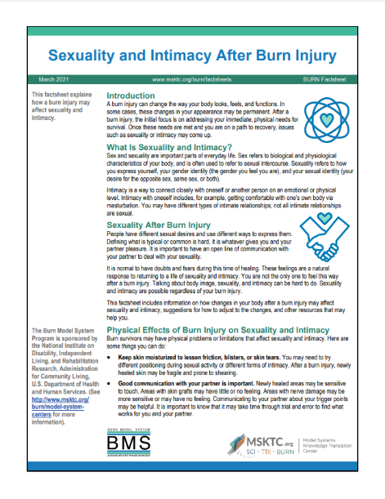
Sexuality and Intimacy After Burn Injury
https://msktc.org/burn-topics/sexuality-and-intimacy
Breaking the Taboo
Caregiving’s Impact on Intimacy
Challenges to Sexuality
Dating and Hidden Burns
Physical Factors
Intimacy and Changes in Skin Sensation
Learn to Love Your New Body
Myths About Sex After Burn
Returning to Sex After Burn
Scar Management & Sexuality
Sex is not Just Intercourse
Sexuality & Intimacy After Burn
Supporting Emotional Intimacy
• Sexuality and Intimacy After Burn Injury
• Sexuality and Intimacy After Burn Injury

Slide 20
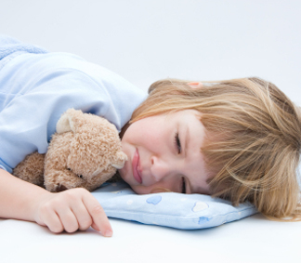
Sleep Problems After Burn Injury
https://msktc.org/burn-topics/sleep-problems
• Sleep Problems After Burn Injury

Slide 21
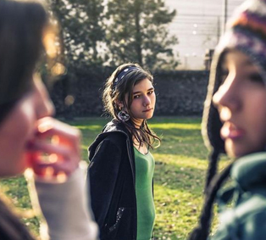
Social Interaction After Burn
https://msktc.org/burn-topics/social-interaction-after-burn-injury
• Social Interaction After Burn Injury
• Social Interaction After Burn Injury

Slide 22
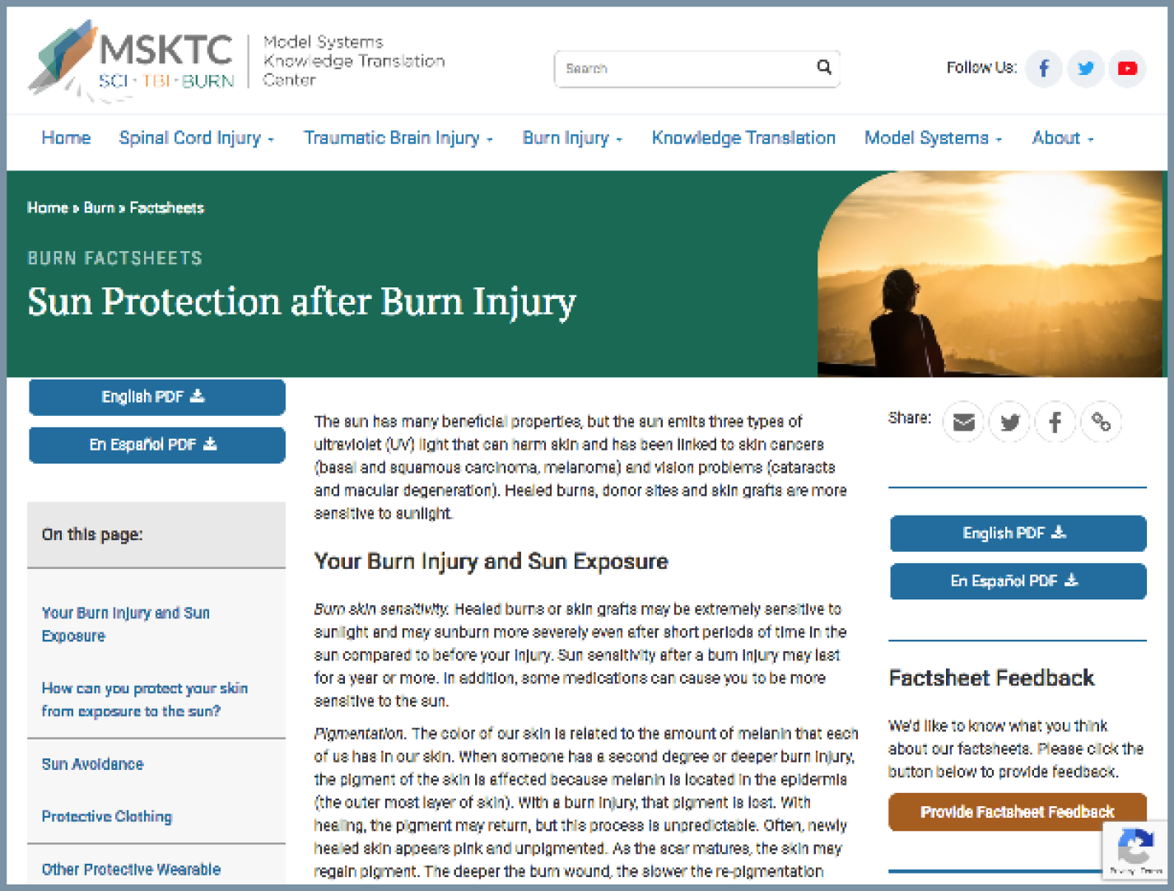
Sun Protection After Burn Injury
https://msktc.org/burn-topics/sun-protection-after-burn-injury
• Sun Protection After Burn Injury

Slide 23
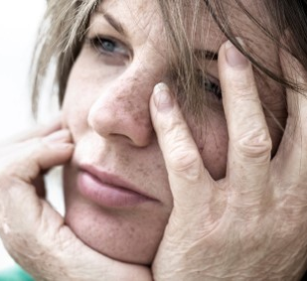
Understanding and Improving Body Image
https://msktc.org/burn-topics/understanding-and-improving-body-image-after-burn-injury
• Understanding and Improving Body Image After Burn Injury
• Understanding and Improving Body Image After Burn Injury

Slide 24
Understanding Burn Injury
https://msktc.org/burn-topics/understanding-burn-injury
• Understanding a Burn Injury

Slide 25
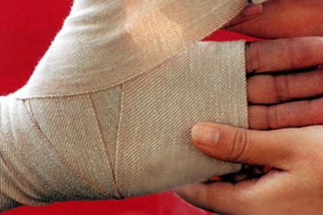
Wound Care After Burn Injury
https://msktc.org/burn-topics/wound-care
• Wound Care After Burn Injury

Slide 26
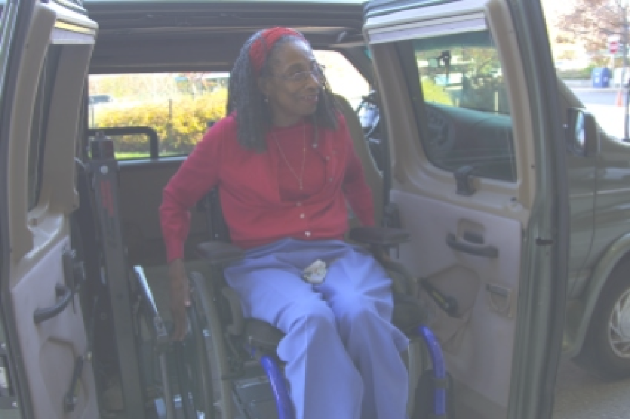
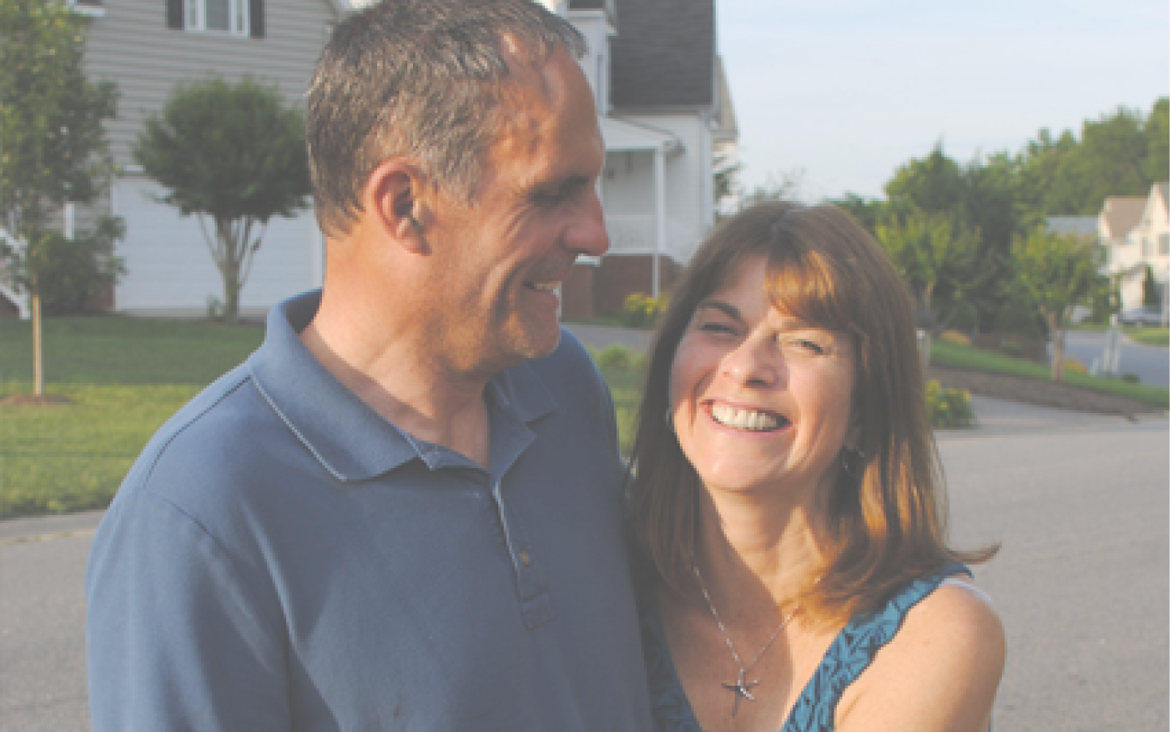
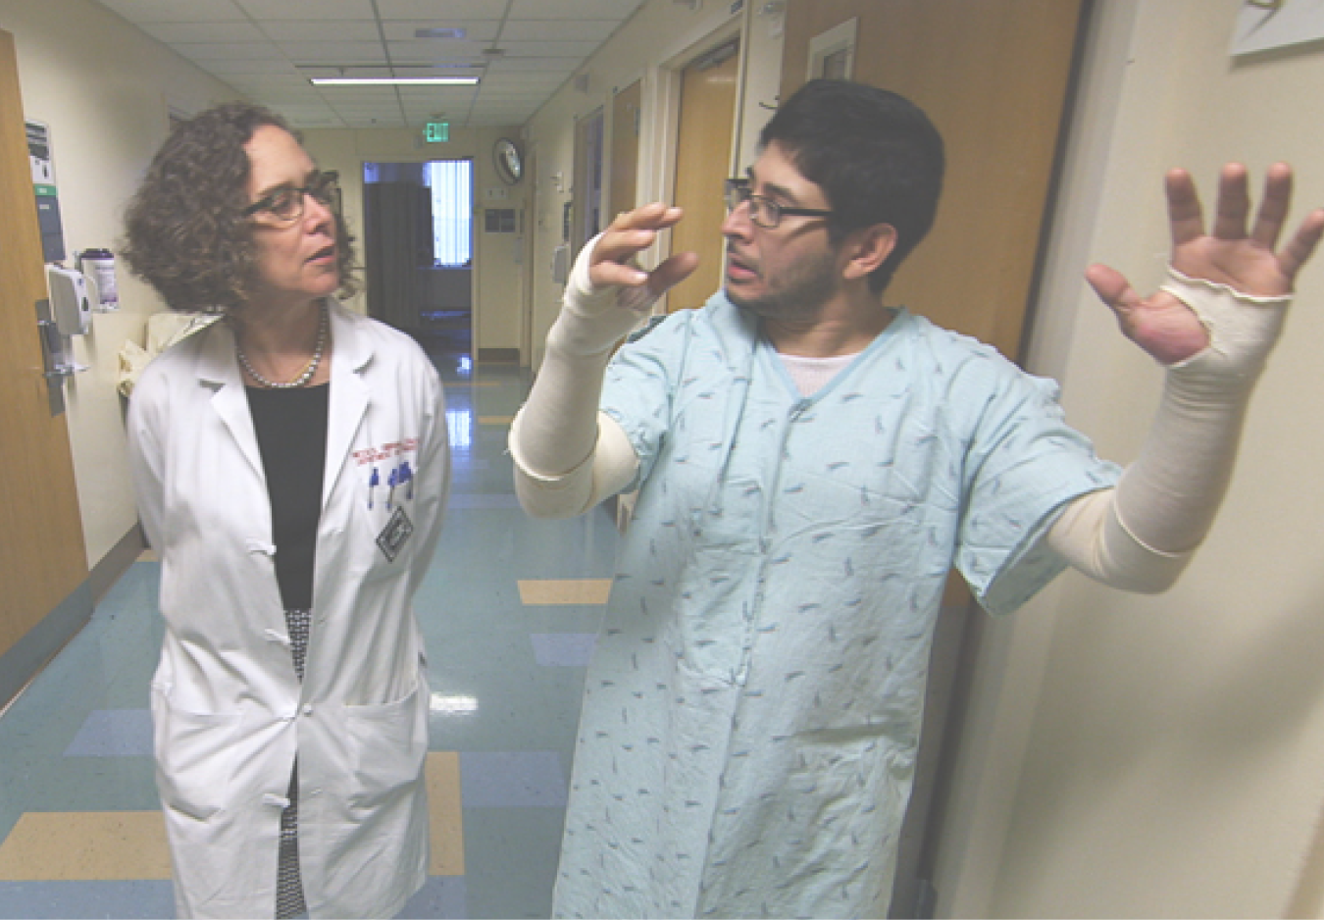
Visit MSKTC website
Spinal Cord Injury
msktc.org/sci
Traumatic Brain Injury
msktc.org/tbi
Burn Injury
msktc.org/burn

