Slide 1
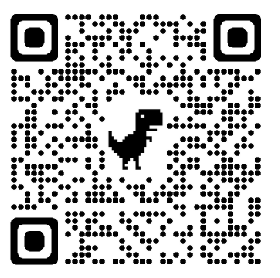
Model Systems Knowledge Translation Center Burn Injury Resource Inventory
Model Systems Knowledge Translation Center
4th Edition
Feburary 2023

Slide 2
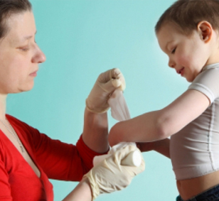
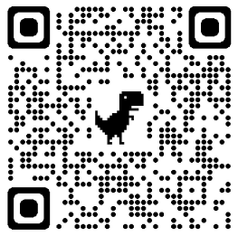
About Burn Model Systems Database
The Burn Model Systems (BMS) program, sponsored by the National Institute on Disability, Independent Living, and Rehabilitation Research (NIDILRRR), Administration for Community Living, U.S. Department of Health and Human Services, supports innovative projects and research in the delivery, demonstration, and evaluation of medical, rehabilitation, vocational, and other services designed to meet the needs of individuals with burn injury.
NIDILRR awards Burn Model Systems grants to institutions that are national leaders in medical research and patient care; these institutions provide the highest level of comprehensive specialty services from the point of injury through eventual re-entry into full community life.
There are 4 currently-funded Burn Model System Centers.
Each Burn Model System contributes to the Burn Model System National Data and Statistical Center, participates in independent and collaborative research, and provides information and resources to individuals with burn injury; their families, caregivers, and friends; health care professionals; and the general public.

Slide 3
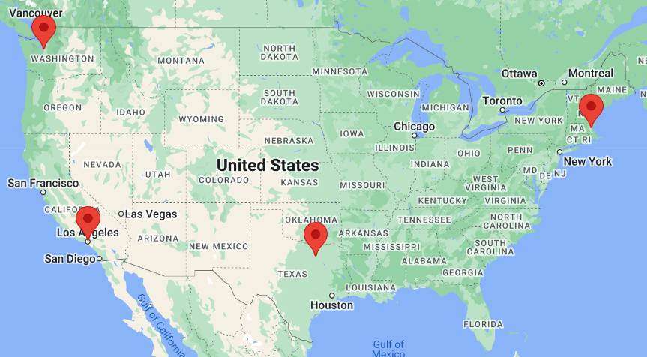
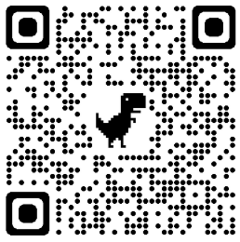
Current Burn Model Systems Centers

Slide 4
About BMS Model Systems Database
The BMS National Database is a prospective, longitudinal, multicenter research study that examines functional and psychosocial outcomes of burn survivors.
It consists of common data elements from a unique, well-characterized population of individuals with moderate to severe burn injury.
As of January 2022, the database contained information for 4,474 adults (18 years of age and older at the time of burn) and 2,349 children (17 years of age and younger at the time of burn).
The BMS National Database includes data on pre-injury, injury, acute care, rehabilitation, and outcomes at 6, 12, and 24 months as well as every 5 years post-injury.
Visit the Burn Model Systems Database: http://burndata.washington.edu/.

Slide 5
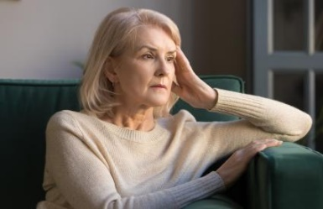
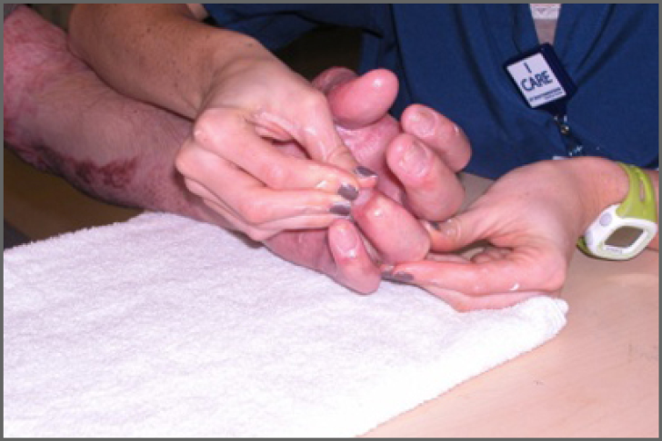
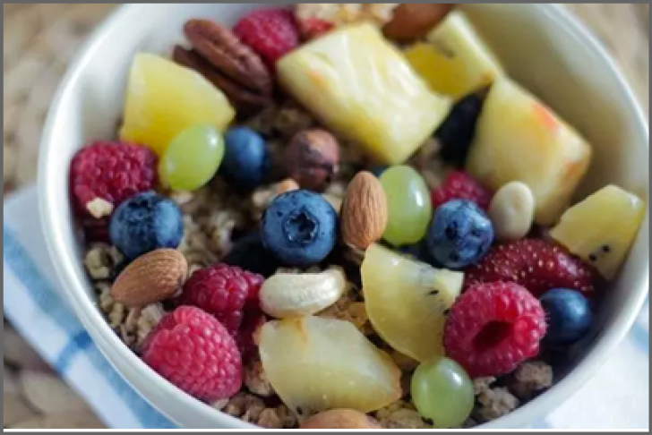
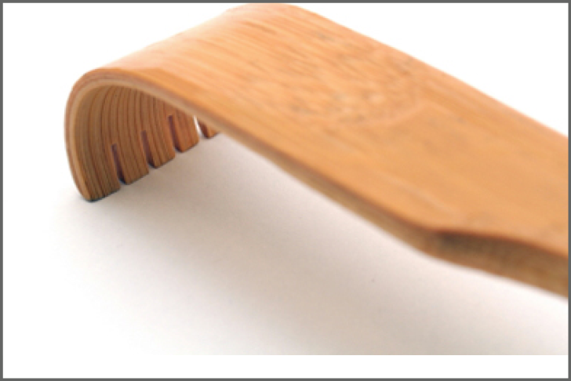
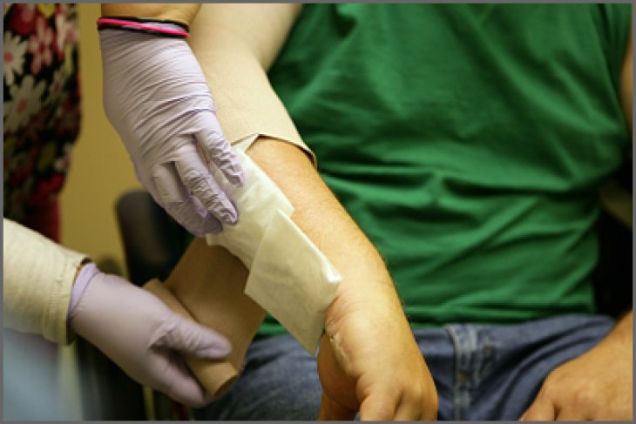
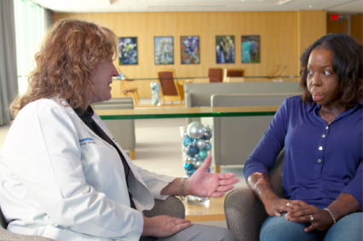
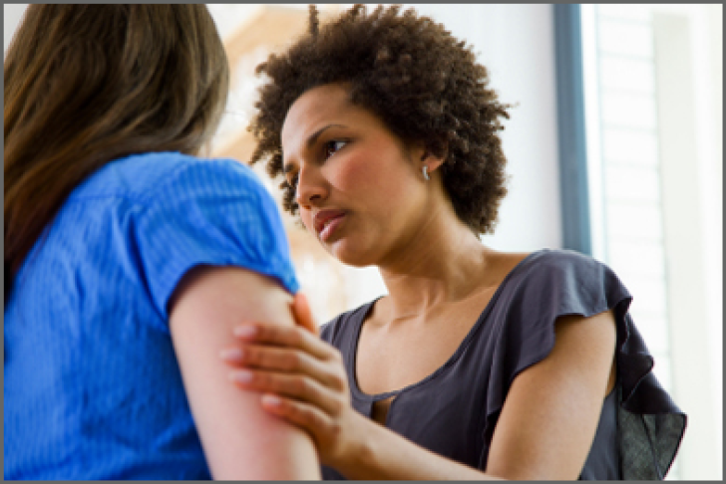
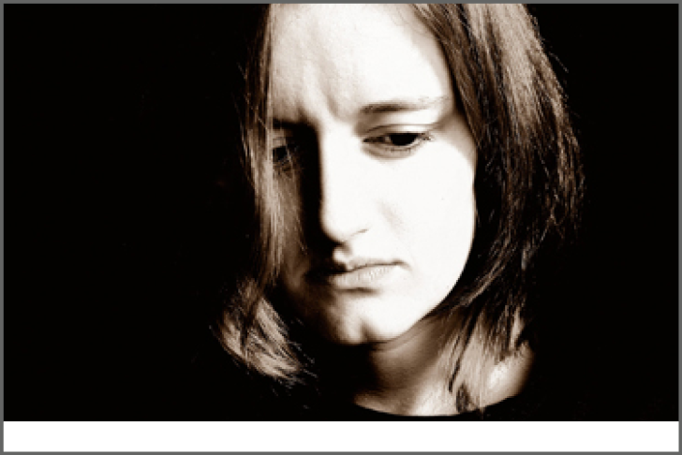
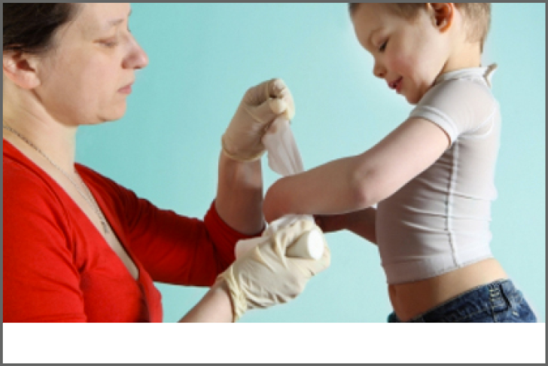
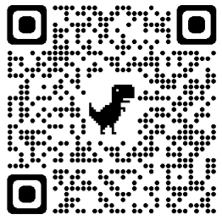
Living with Burn Injury
ALL TOPICS
Delirium
Employment After Burn Injury
Exercise After Burn Injury
Healthy Eating-Adults
Itchy Skin After
Burn Injury
Managing Pain
Outpatient Opioid Management for Adult Burn Survivors
Healthy Eating-Kids
Psychological
Distress
PTSD
Resilience
Return to School

Slide 6
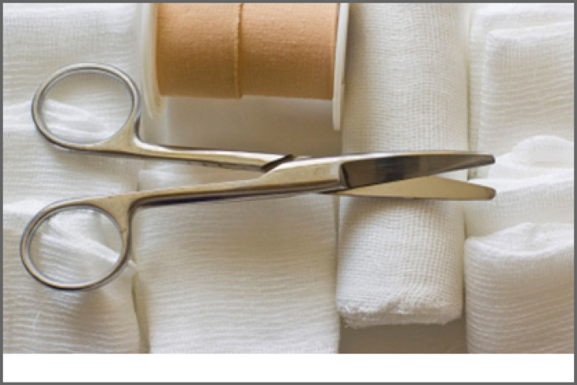
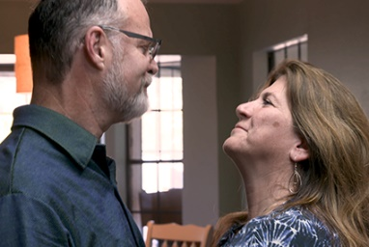
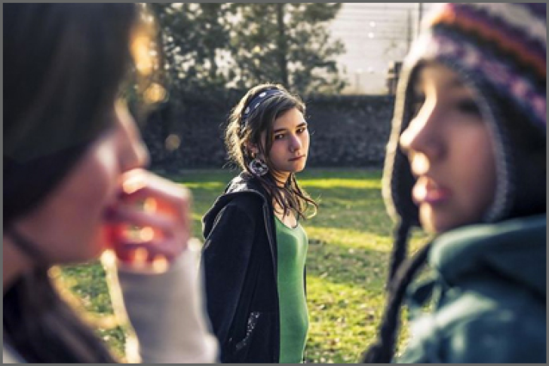
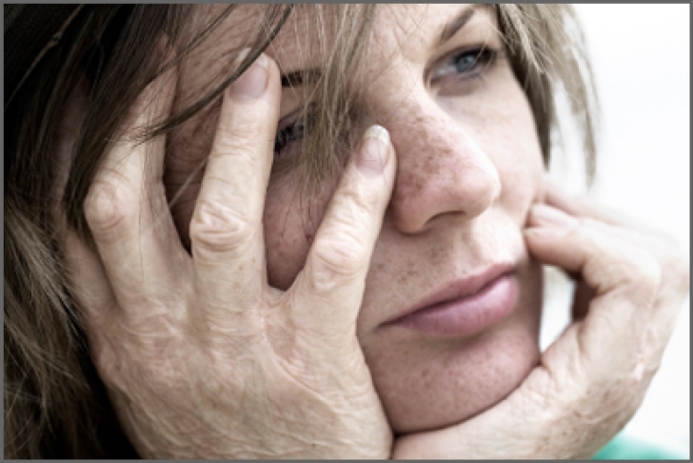
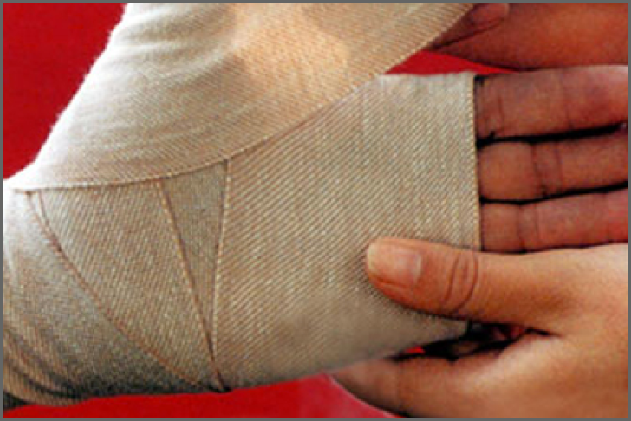
Living with Burn Injury
ALL TOPICS
Scar Management
Sexuality and Intimacy
Sleep Problems
Social Interaction After Burn Injury
Sun Protection After
Burn Injury
Understanding and Improving Body Image After Burn Injury
Understanding
Burn Injury
Wound Care
Understanding and Improving Body Image After Burn Injury

Slide 7
Burn Injury Resources
https://msktc.org/burn/burn-resources

Slide 8
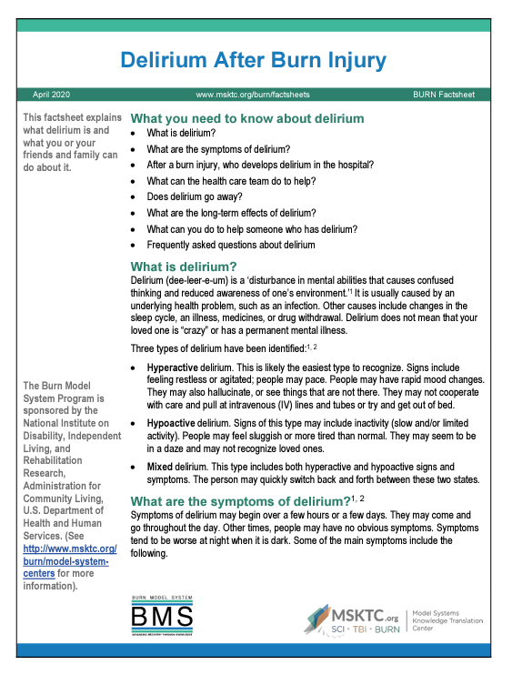
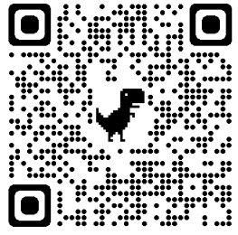
Delirium After Burn Injury
https://msktc.org/burn/burn-topics/delirium-after-burn-injury
• Delirium After Burn Injury

Slide 9
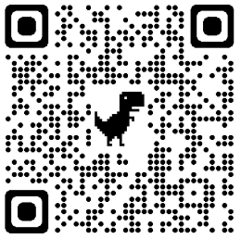
Employment After Burn Injury
https://msktc.org/burn-topics/employment-after-burn-injury
Accommodations Employers Might Make
BMS Research On Barriers to Returning To Work
Employment After Burn Injury
How Ben Responds to Strangers' Questions
Increasing Awareness About People With Burn Injuries
Keys to A Successful Return to Work Plan
Psychological Issues Burn Injury Patients Face
Returning to Work Can Help
Some Common Mistakes Employers Make
The Importance of Staying Active
What Burn Patients Go Through
What Co-Workers & Employers Can Do to Help Workers Return
What Patients Can Do As They Return to Work
When to Go Back To Work
Employment After Burn Injury
Employment After Burn Injury
Employment After Burn Injury
Employment After Burn Injury

Slide 10
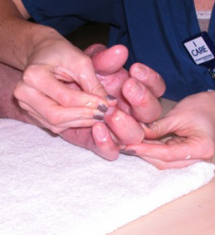
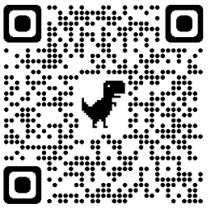
Exercise After Burn Injury
https://msktc.org/burn-topics/exercise-after-burn-injury
Why Exercise Is Critical After Burn Injury
Why Exercise May Be Hard After Burn Injury
A Caregiver's Perspective
Cardio After Burn Injury
Coming to Terms with Your Scars
Competitive Athletes After Burn
Exercise After Burn Injury
Exercise and Autonomy
Exercise and Contractures
Exercising After Amputation from Burn Injury
Getting Back to Yoga Class
Muji Karim and Exercising with Prosthetic Limbs
The Benefits of Yoga for People with Burn Injury
The Importance of Family Support
The LIBRE Project
The Value of Peer Support
Thriving Long Term
Tips for Exercising After Burn Injury
Transition Home
Exercise After Burn Injury
Exercise After Burn Injury
Exercise After Burn Injury
Exercise After Burn Injury
Exercise After Burn Injury

Slide 11
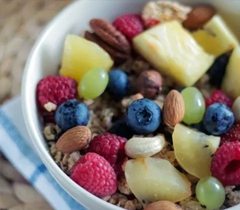
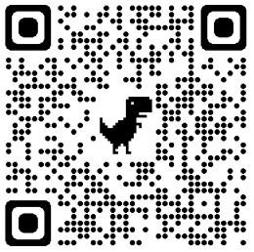
Health Eating After Burn – For Adults
https://msktc.org/burn-topics/healthy-eating-adults
• Healthy Eating After Burn Injury – For Adults
• Healthy Eating After Burn Injury – For Adults

Slide 12
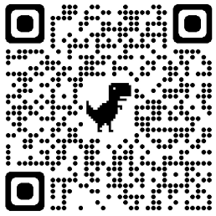
Health Eating After Burn – For Kids
https://msktc.org/burn-topics/healthy-eating-kids
• Healthy Eating For Kids with Burn Injury

Slide 13
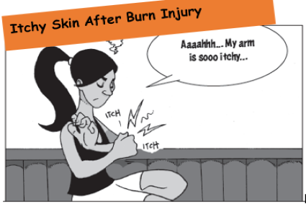
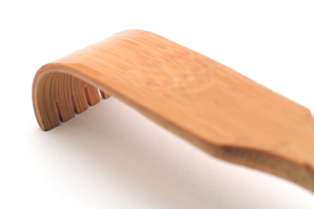
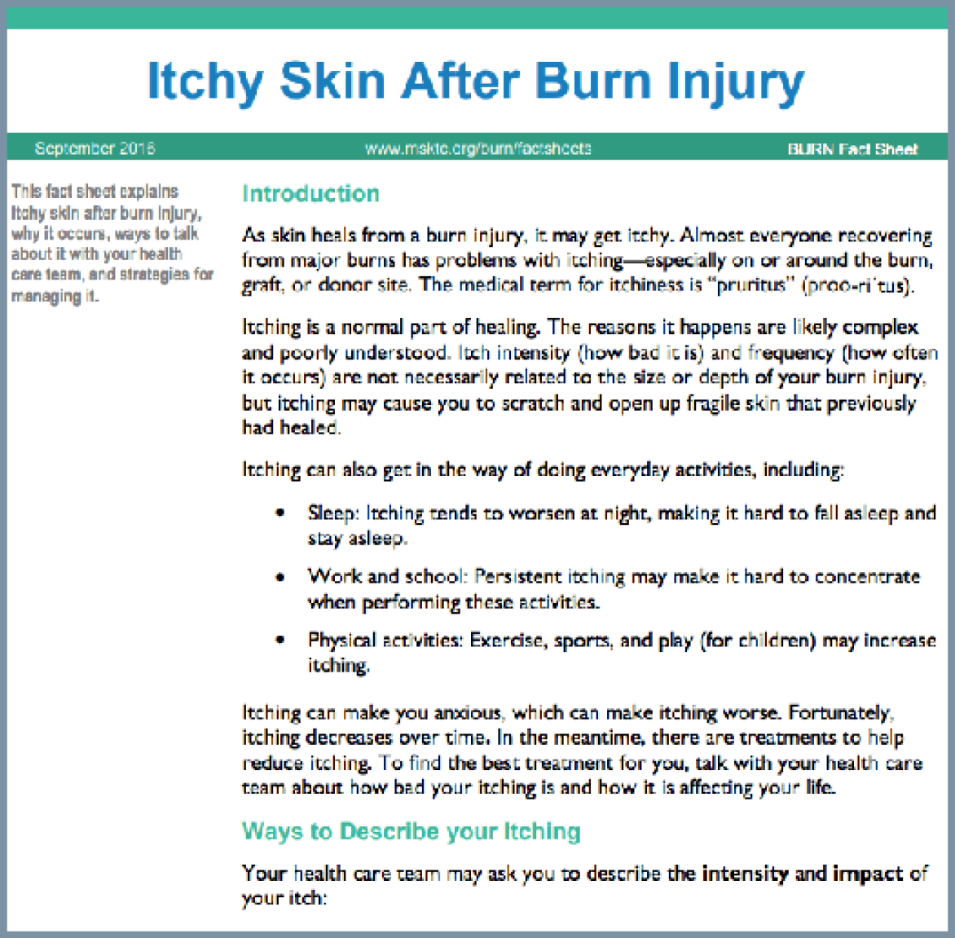
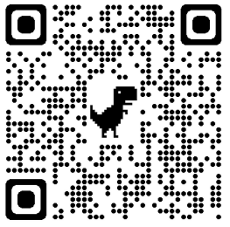
Itchy Skin After Burn Injury
https://msktc.org/burn-topics/itchy-skin-after-burn-injury
• Itchy Skin After Burn Injury
• Itchy Skin After Burn Injury
• Itchy Skin After Burn Injury
• Itchy Skin After Burn Injury

Slide 14
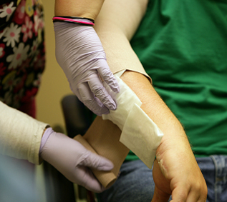
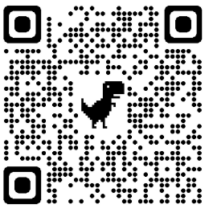
Managing Pain After Burn Injury
https://msktc.org/burn-topics/managing-pain
• Managing Pain After Burn Injury
• Managing Pain After Burn Injury

Slide 15
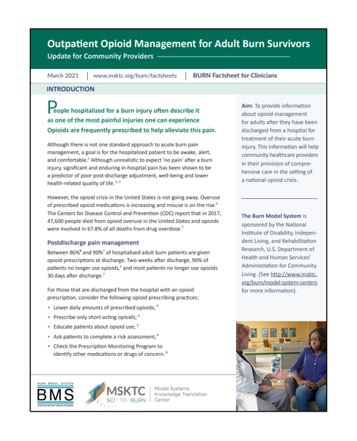
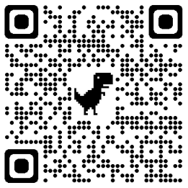
Outpatient Opioid Management for Adult Burn Survivors
https://msktc.org/burn-topics/outpatient-opioid-management-adult-burn-survivors
• Outpatient Opioid Management for Adult Burn Survivors

Slide 16
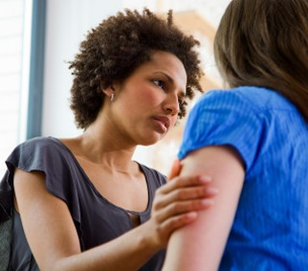
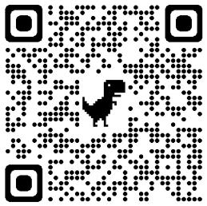
Psychological Distress After Burn
https://msktc.org/burn-topics/psychological-distress
• Psychological Distress After Burn Injury
• Psychological Distress After Burn Injury

Slide 17
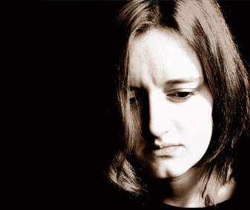
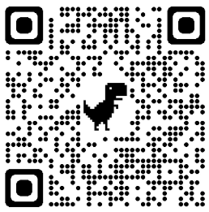
PTSD After Burn Injury
https://msktc.org/burn-topics/ptsd
• Post-Traumatic Stress Disorder (PTSD) After Burn Injury

Slide 18
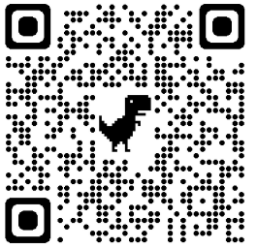
Resilience After Burn Injury
https://msktc.org/burn-topics/resilience
• Help Your Child Recover- Build Your Child's Resilience After Burn Injury

Slide 19
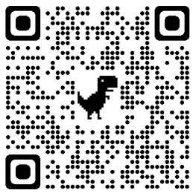
Return to School After Burn Injury
https://msktc.org/burn-topics/return-school
• Going Back to School After a Major Burn Injury

Slide 20
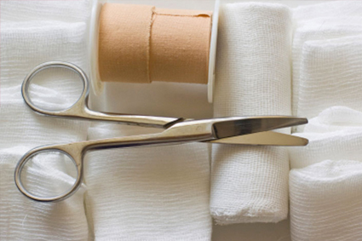
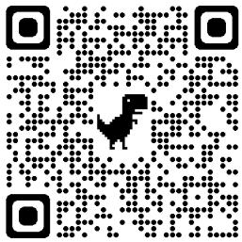
Scar Management After Burn Injury
https://msktc.org/burn-topics/scar-management
• Scar Management After Burn Injury
• Scar Management After Burn Injury

Slide 21
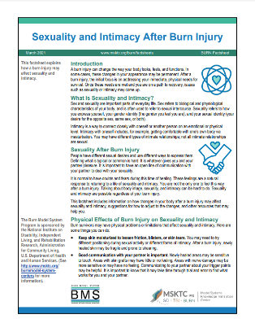
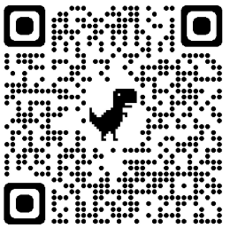
Sexuality and Intimacy After Burn Injury
https://msktc.org/burn-topics/sexuality-and-intimacy
Breaking the Taboo
Caregiving’s Impact on Intimacy
Challenges to Sexuality
Dating and Hidden Burns
Physical Factors
Intimacy and Changes in Skin Sensation
Learn to Love Your New Body
Myths About Sex After Burn
Returning to Sex After Burn
Scar Management & Sexuality
Sex is not Just Intercourse
Sexuality & Intimacy After Burn
Supporting Emotional Intimacy
• Sexuality and Intimacy After Burn Injury
• Sexuality and Intimacy After Burn Injury
• Sexuality and Intimacy After Burn Injury

Slide 22
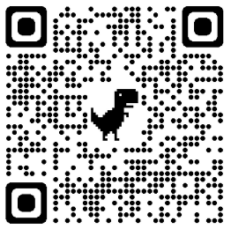
Sleep Problems After Burn Injury
https://msktc.org/burn-topics/sleep-problems
• Sleep Problems After Burn Injury

Slide 23
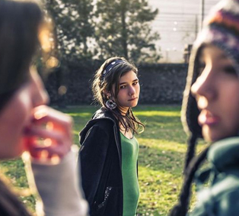
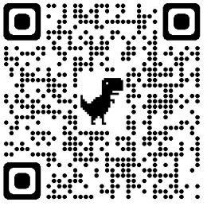
Social Interaction After Burn
https://msktc.org/burn-topics/social-interaction-after-burn-injury
• Social Interaction After Burn Injury
• Social Interaction After Burn Injury

Slide 24
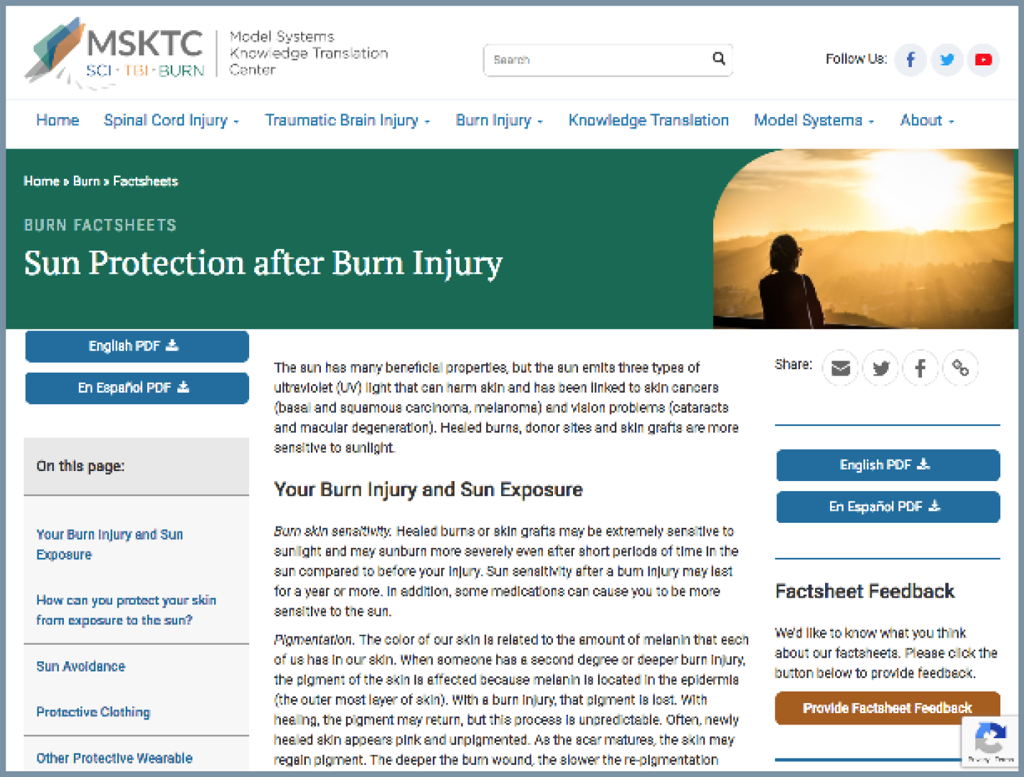
Sun Protection After Burn Injury
https://msktc.org/burn-topics/sun-protection-after-burn-injury
• Sun Protection After Burn Injury
• Sun Protection After Burn Injury

Slide 25
Understanding and Improving Body Image
https://msktc.org/burn-topics/understanding-and-improving-body-image-after-burn-injury
• Understanding and Improving Body Image After Burn Injury
• Understanding and Improving Body Image After Burn Injury
• Understanding and Improving Body Image After Burn Injury

Slide 26
Understanding Burn Injury
https://msktc.org/burn-topics/understanding-burn-injury
• Understanding a Burn Injury
• Understanding a Burn Injury
• Understanding a Burn Injury

Slide 27
Wound Care After Burn Injury
https://msktc.org/burn-topics/wound-care
• Wound Care After Burn Injury
• Wound Care After Burn Injury

Slide 28
Visit MSKTC website
Spinal Cord Injury
msktc.org/sci
Traumatic Brain Injury
msktc.org/tbi
Burn Injury
msktc.org/burn

Slide 29
Disclaimer
Disclaimer: This information is not meant to replace the advice of a medical professional. You should consult your health care provider about specific medical concerns or treatment. The contents of this resource were developed under grants (90DP0082 and 90DPKT0009) from the National Institute on Disability, Independent Living, and Rehabilitation Research (NIDILRR). NIDILRR is a Center within the Administration for Community Living (ACL), U.S. Department of Health and Human Services (HHS). The contents of this resource do not necessarily represent the policy of NIDILRR, ACL, or HHS, and you should not assume endorsement by the federal government.
Copyright © 2023 Model Systems Knowledge Translation Center (MSKTC). May be reproduced and distributed freely with appropriate attribution. Prior permission must be obtained for inclusion in fee-based materials.

