Slide 1

Using AI to Write Alt Text
Presenter: Amanda Seagroves, MPH (MSKTC Dissemination Lead)

Slide 2

Virtual Meeting/
Conference Recording Notice
The American Institutes for Research® (AIR®) allows for the recording of audio, visuals, participants, and other information sent, verbalized, or utilized during business-related meetings. By joining a meeting, you automatically consent to such recordings. Any participant who prefers to participate via audio only should disable their video camera so only their audio will be captured. Video and/or audio recordings of any AIR session shall not be transmitted to an external third party without the permission of AIR.
In addition, AIR does not permit participation in AIR meetings through the use of AI bots such as Otter.ai or other AI platforms to record or transcribe conversations for AIR meetings, webinars, or virtual events in lieu of in-person attendance, unless requested as a reasonable accommodation. Any participants who attempt to use AI software for meeting participation will be denied admission, or their session will be terminated once it becomes apparent such software is in use

Slide 3
Today’s Session Covers…
  Why Alt Text Matters
  What AI Can (and Can’t) Do for Alt Text
  Practical Tips for Reviewing & Refining AI Alt Text
  AI-Generated Alt Text in Action

Slide 4




Why Alt Text Matters
Alternative text, also known as alt text, is descriptive text that conveys the meaning of an image in digital content.
- Section508.gov
Screen Readers
Broken Images
SEO
Legal

Slide 5
What AI Can and Can’t Do
Strengths | Limits
Identifies visible elements Fast and consistent Helpful for scale | Lacks context and intent Misses what matters most Can make assumptions

Slide 6

How to Review & Refine AI Alt Text
Accuracy | Are people, objects, and actions described correctly?
Purpose | Why is this image included? What does the user need to know to understand the content?
Clarity & Brevity | Use plain language. One or two sentences is usually enough.
Inclusivity | Avoid assumptions. Describe only what’s observable. Don’t guess emotions, identities, or abilities.
Best Practices | Skip phrases like ‘image of’ or ‘picture of.’ If the image is decorative, it may not need alt text at all.

Slide 7
Why Prompt Quality Matters
  AI output reflects your input
  Context improves accuracy
  Clear prompts reduce bias and rework

Slide 8
Sample Prompts
General Alt Text Prompt | Write concise, accessible alt text for this image. Focus on the key information the user needs to understand the image in context. Avoid assumptions and unnecessary visual detail.
Prompt for Informational Graphics or Infographics | Generate alt text that summarizes the main message of this infographic. Prioritize the most important data or takeaway rather than listing every visual detail.
Prompt for Charts, Graphs, or Data Visuals | Write alt text that explains what this chart shows and the key trend or insight. Do not list every data point—focus on what the chart communicates.

Slide 9
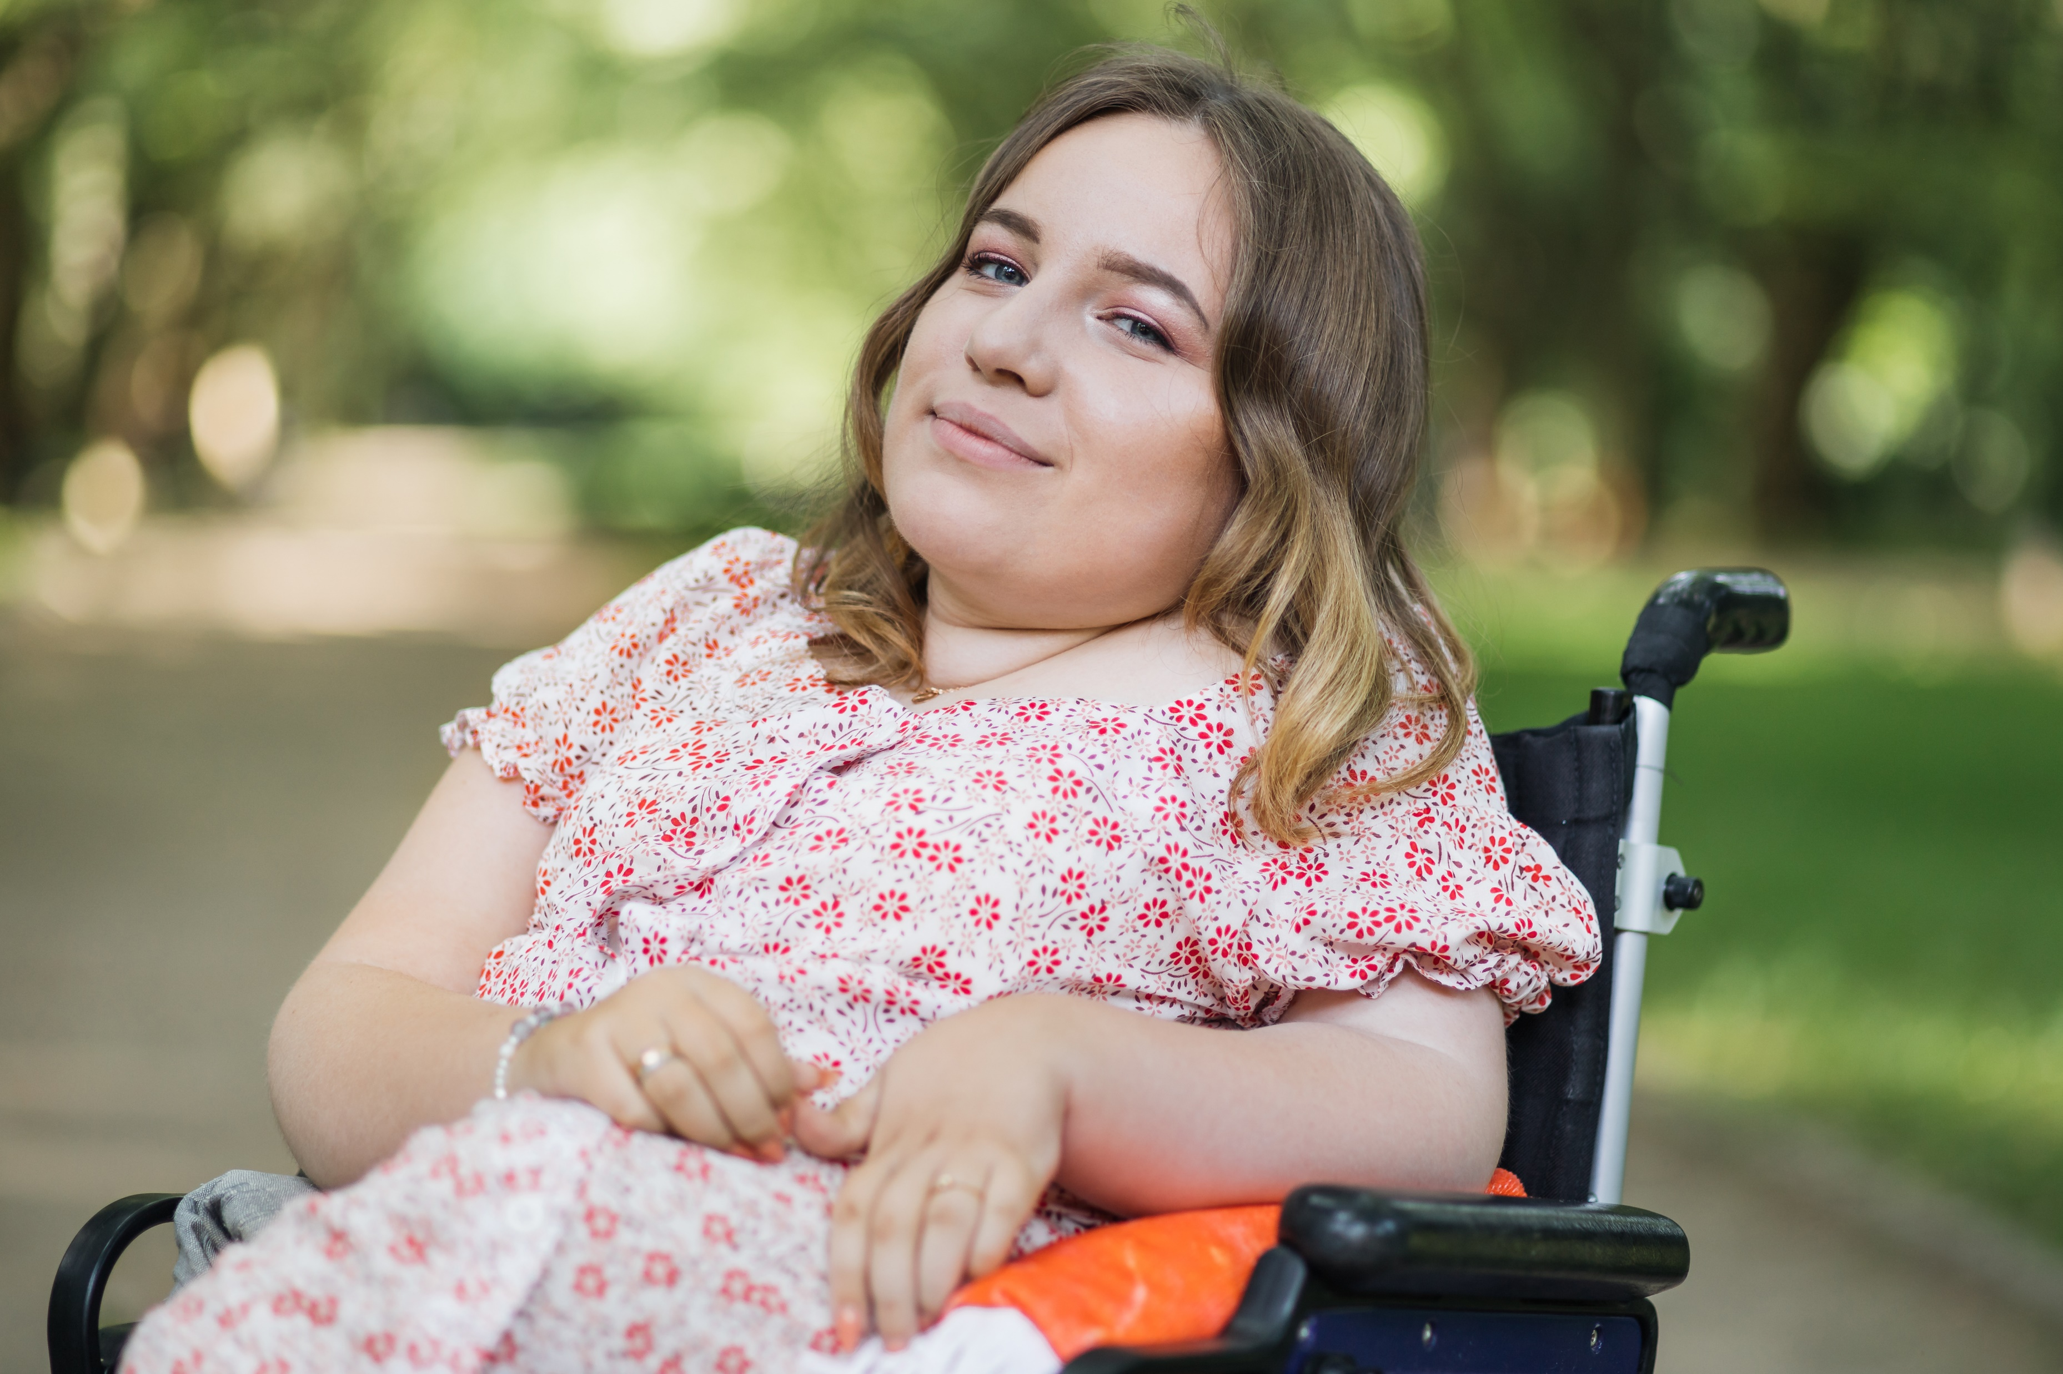
AI-Generated Alt Text in Action
Prompt: Write concise, accessible alt text for this image. Focus on the key information the user needs to understand the image in context. Avoid assumptions and unnecessary visual detail.

Slide 10
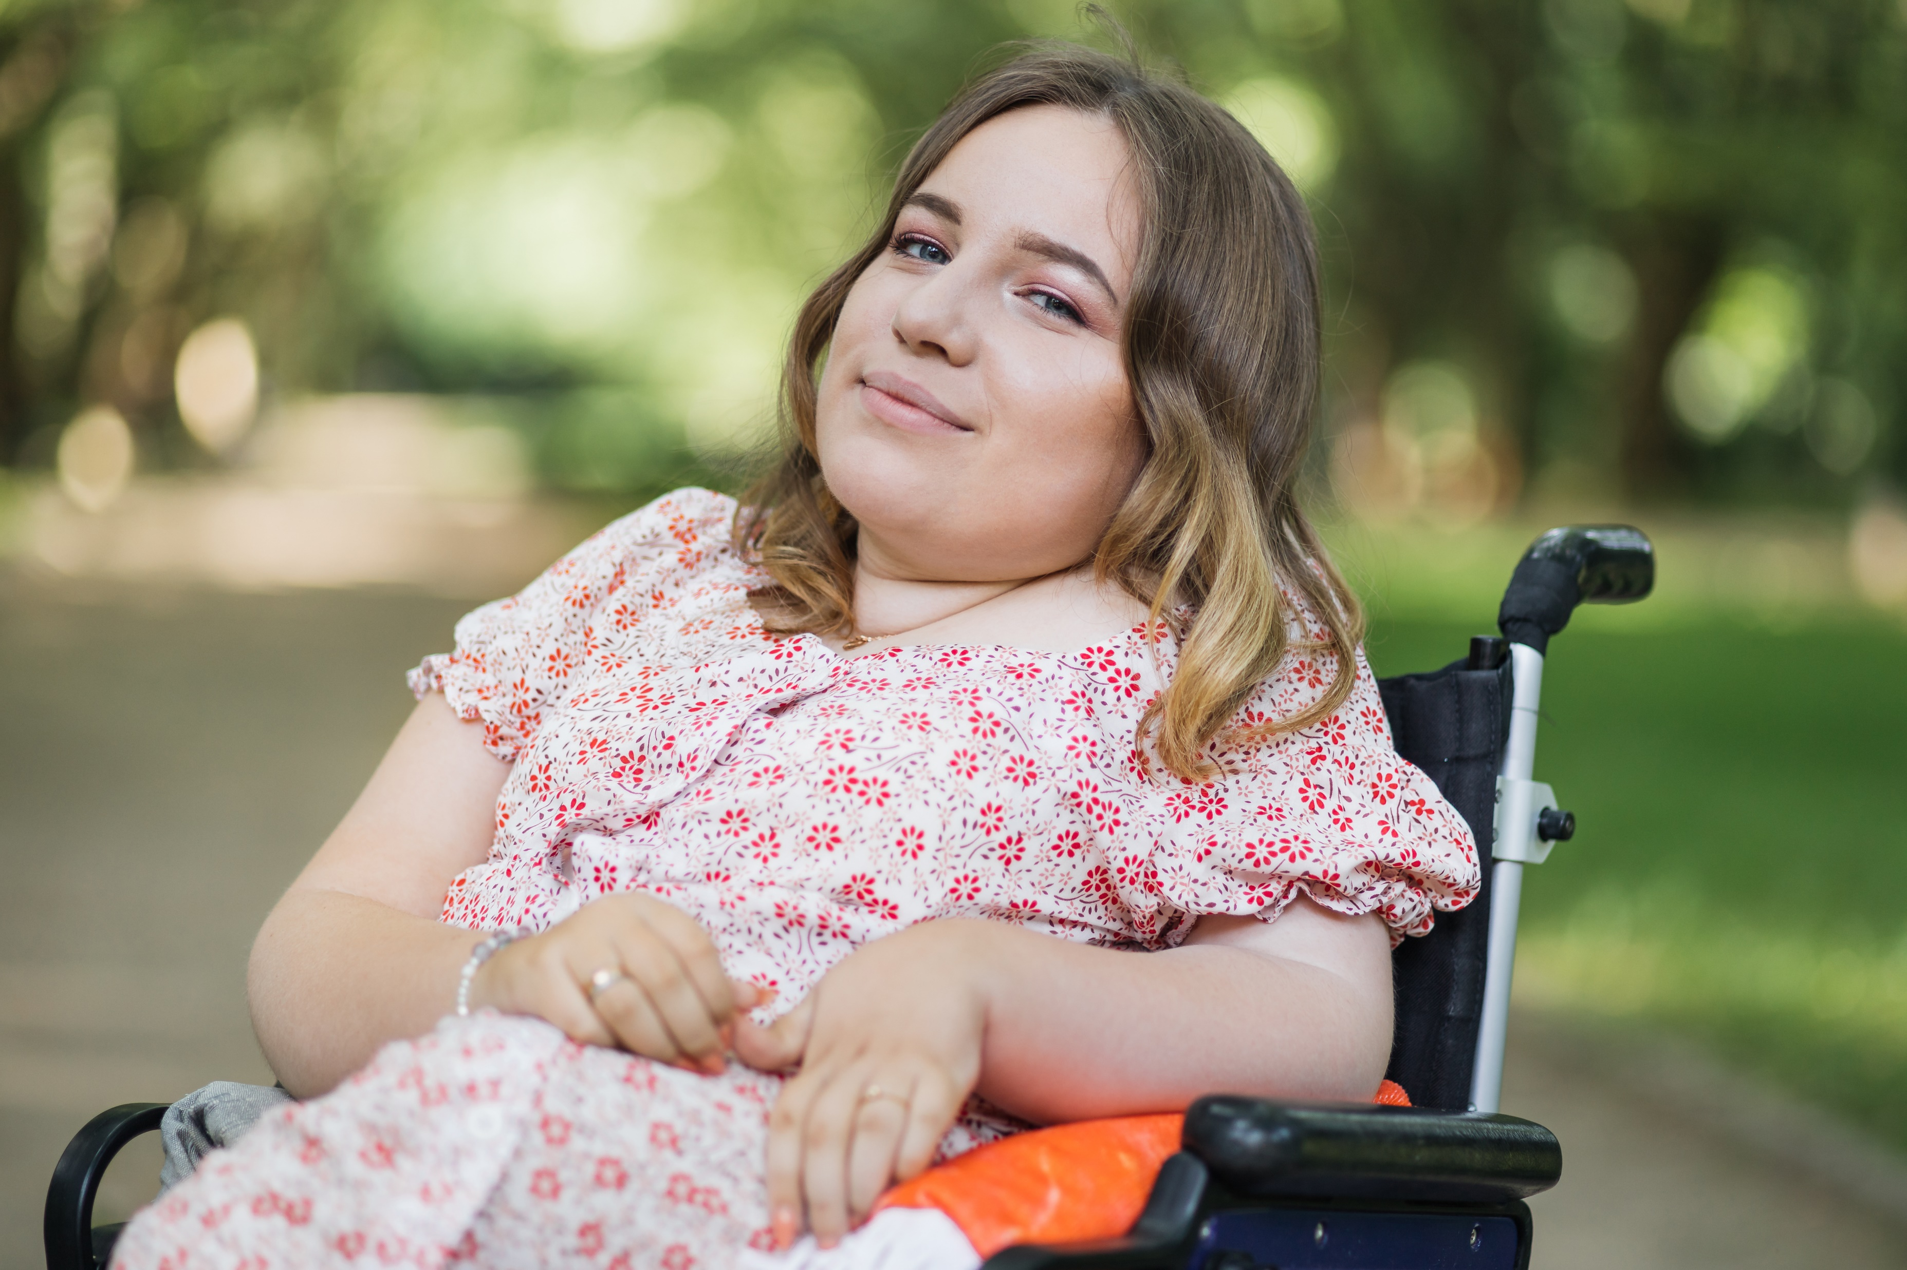

AI-Generated Alt Text in Action
AI Generated Alt Text
A young person sitting in a wheelchair outdoors on a sunlit path, wearing a patterned dress with trees in the background.

Slide 11
AI-Generated Alt Text in Action
Human Generated Alt Text
Photograph of a young lady in a floral dress with a physical disability posing in a wheelchair.

Slide 12
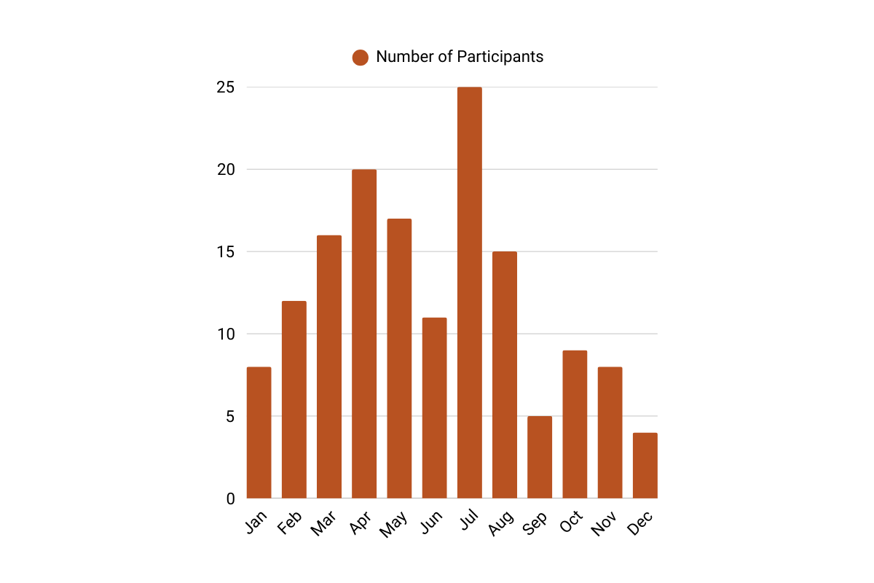
AI-Generated Alt Text in Action
Prompt: Write alt text that explains what this chart shows and the key trend or insight. Do not list every data point—focus on what the chart communicates.

Slide 13
AI-Generated Alt Text in Action
AI Generated Alt Text
A bar chart showing monthly participant numbers. Participation rises steadily from January through midsummer, peaks sharply in July, and then declines through the fall, with the lowest levels at the end of the year.

Slide 14
AI-Generated Alt Text in Action
Human Generated Alt Text
Bar graph showing the number of participants in each month, in which the number increases toward the middle of the year and decreases toward the end of the year. The number of participants begins with 8 participants in January, increases to a high of 25 participants in July, and decreases to 4 participants in December.

Slide 15

AI-Generated Alt Text in Action
Prompt: Generate alt text that summarizes the main message of this infographic. Prioritize the most important data or takeaway rather than listing every visual detail.

Slide 16
AI-Generated Alt Text in Action
AI Generated Alt Text
Graphic for a workshop titled ‘Examining Traumatic Brain Injury as a Chronic Condition,’ held virtually March 11–12, 2025, featuring TBI Model Systems investigators. Includes a 3D image of a human brain.

Slide 17
AI-Generated Alt Text in Action
Human Generated Alt Text
Flyer for a workshop titled “Examining traumatic brain injury as a chronic condition.” The virtual workshop will be held March 11-12, 2025, and it will feature TBI Model Systems Investigators John Corrigan, Angelle Sander, Jeanne Hoffman, Charles Bombardier, Shannon Juengst, Risa Nakase-Richardson, and Flora Hammond.

Slide 18

Recap
AI can help us write alt text faster, but it can’t replace human judgment.
The most important part of accessible alt text—context, relevance, and inclusivity—still comes from you.
If you remember one thing, let it be this: good alt text isn’t about describing everything—it’s about describing what matters.

Slide 19
Amanda Seagroves, MPH
Dissemination Lead
MSKTC@air.org
The contents of this presentation were developed under grant number 90DPKT0009 from the National Institute on Disability, Independent Living, and Rehabilitation Research (NIDILRR). NIDILRR is a Center within the Administration for Community Living (ACL), Department of Health and Human Services (HHS). The contents of this presentation do not necessarily represent the policy of NIDILRR, ACL, HHS, and you should not assume endorsement by the federal government.

Slide 20

The contents of this presentation were developed under grant number 90DPKT0009 from the National Institute on Disability, Independent Living, and Rehabilitation Research (NIDILRR). NIDILRR is a Center within the Administration for Community Living (ACL), Department of Health and Human Services (HHS). The contents of this presentation do not necessarily represent the policy of NIDILRR, ACL, HHS, and you should not assume endorsement by the federal government.

Slide 21
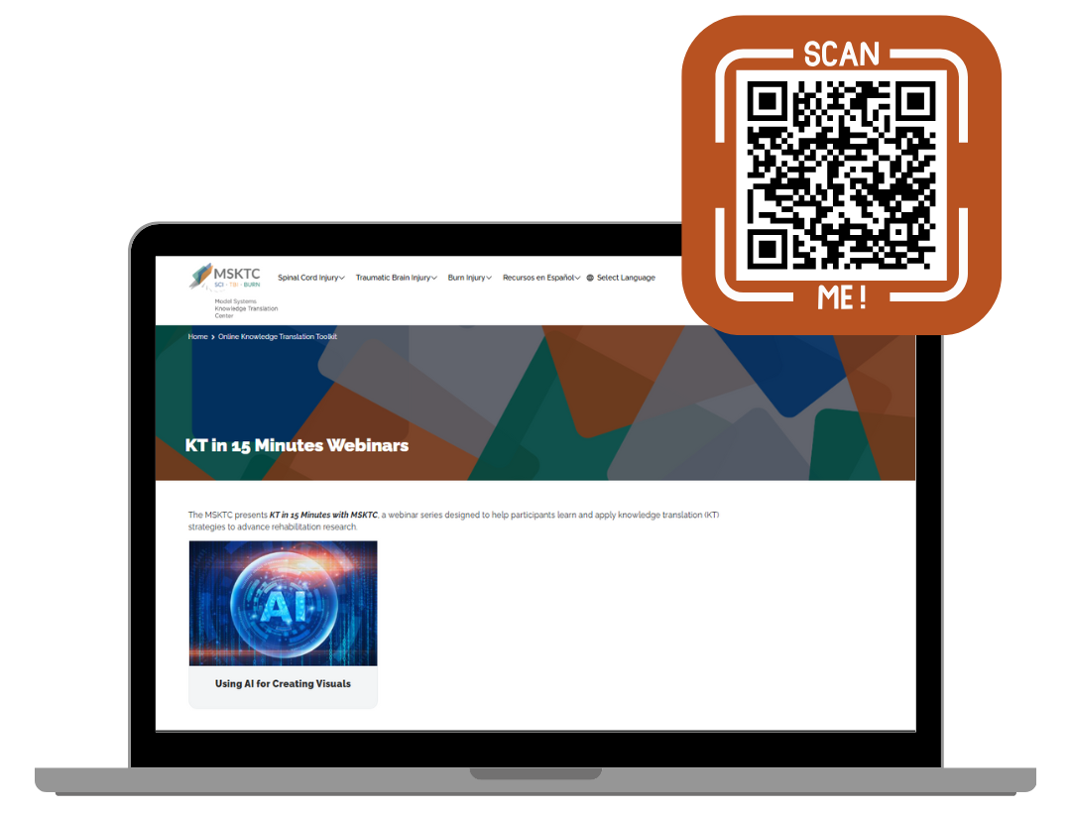
The contents of this presentation were developed under grant number 90DPKT0009 from the National Institute on Disability, Independent Living, and Rehabilitation Research (NIDILRR). NIDILRR is a Center within the Administration for Community Living (ACL), Department of Health and Human Services (HHS). The contents of this presentation do not necessarily represent the policy of NIDILRR, ACL, HHS, and you should not assume endorsement by the federal government.

