Slide 1

Using AI for Creating Visuals
Presenter: Amanda Seagroves, MPH

Slide 2

Virtual Meeting/
Conference Recording Notice
The American Institutes for Research® (AIR®) allows for the recording of audio, visuals, participants, and other information sent, verbalized, or utilized during business-related meetings. By joining a meeting, you automatically consent to such recordings. Any participant who prefers to participate via audio only should disable their video camera so only their audio will be captured. Video and/or audio recordings of any AIR session shall not be transmitted to an external third party without the permission of AIR.
In addition, AIR does not permit participation in AIR meetings through the use of AI bots such as Otter.ai or other AI platforms to record or transcribe conversations for AIR meetings, webinars, or virtual events in lieu of in-person attendance, unless requested as a reasonable accommodation. Any participants who attempt to use AI software for meeting participation will be denied admission, or their session will be terminated once it becomes apparent such software is in use

Slide 3
Important Reminder
Always check your organization’s policies regarding AI use and approved AI software or tools

Slide 4


How AI Can Help
​ | ​
Idea Generation ​ | Design Assistance ​
​

Slide 5

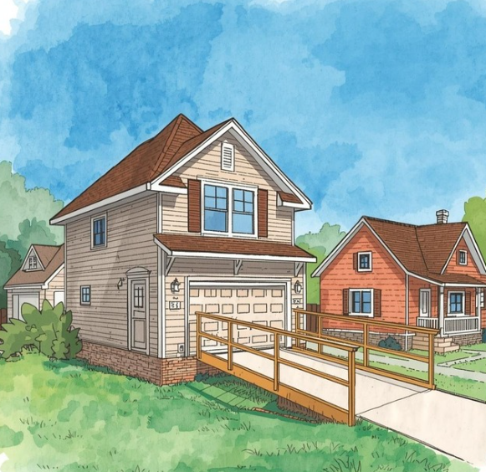
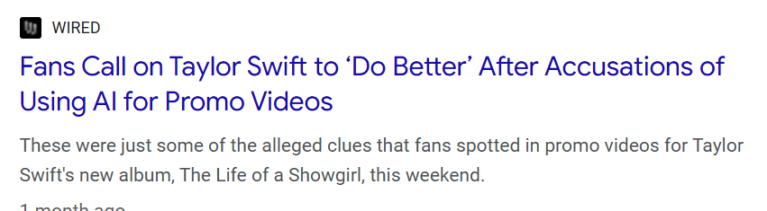
Pros & Cons of
Using AI for Visuals
Pros | Cons
Speed Easy to use without design training Easy to produce multiple versions for testing and simple mockups | Accuracy risks Accessibility gaps Diversity and inclusion gaps Could be time consuming to make edits AI reservations
“House with ramp illustration”

Slide 6




Demonstration
Brainstorming
Visuals
Creating
Visuals

Slide 7

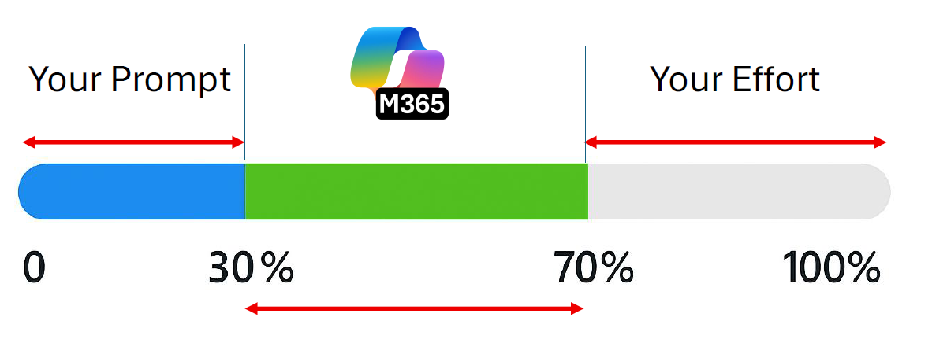
Prompt for Visual Brainstorming:
Help brainstorm creative and effective design ideas for a flyer to recruit participants for a study on traumatic brain injury. The flyer should appeal to adults aged 18-40, and it needs to convey professionalism, trustworthiness, and approachability. Focus on the following: Layout Ideas: Should the flyer have a grid structure, or a more freeform design? How can we balance text and imagery? Images or Icons: Should the flyer feature images of people, such as someone talking to a provider or maybe having a head injury at a sports event? Or could abstract graphics (like dots, lines) be effective? Layout Hierarchy: What order should the information appear? How can we make the most important details (compensation, age range, and contact info) stand out? Call to Action: What’s the most effective way to visually highlight the "Sign up today" call to action?

Slide 8

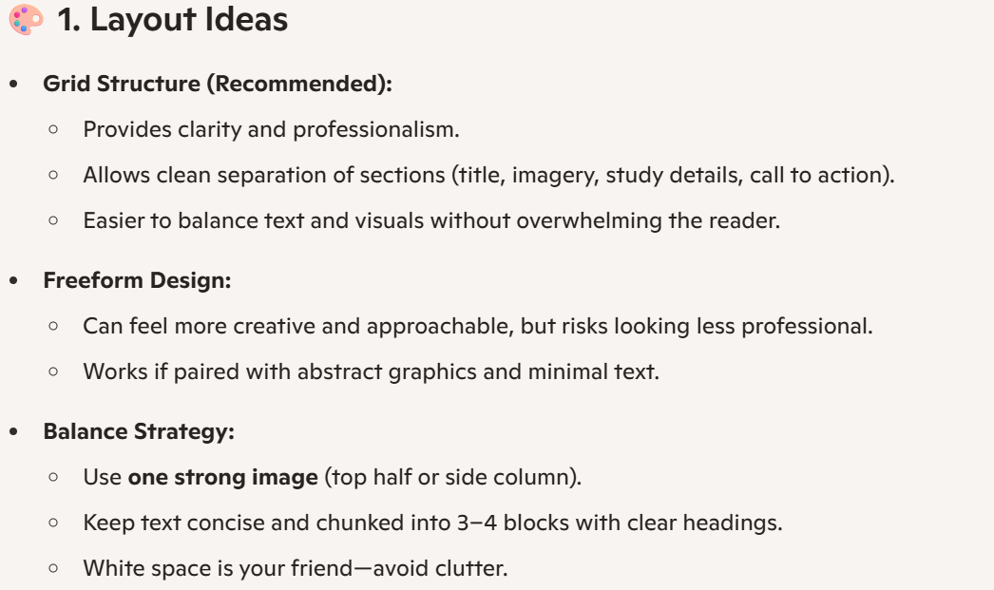

Slide 9

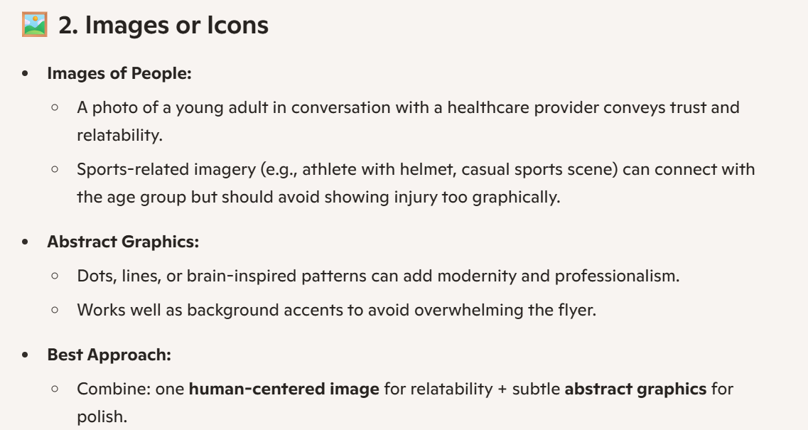

Slide 10
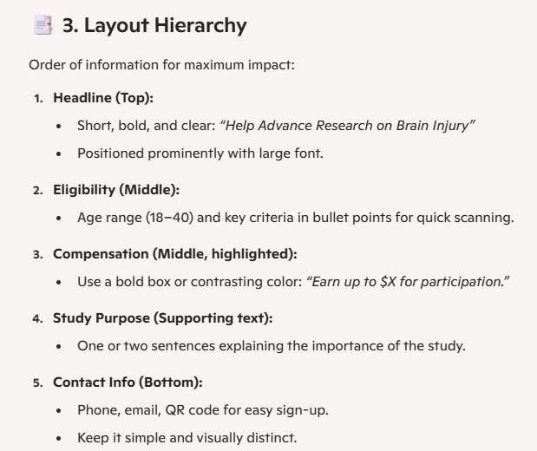

Slide 11
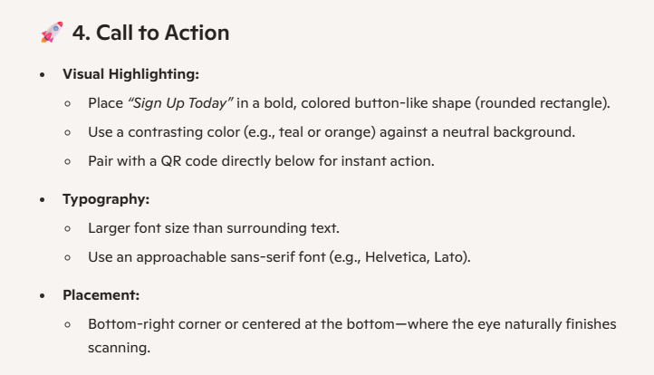

Slide 12



Slide 13

Prompt for Creating Designs:
Create a cohesive set of modern, flat-design icons related to evaluation and metrics, using MSKTC’s brand color palette (#b85221, #00427f, #006955). Each icon should have a clean, minimalistic style, with simple shapes and balanced color use. Generate several icon concepts that represent: Data analysis or metrics dashboard Bar chart or line graph Performance evaluation Rating or feedback (e.g., stars, checkmarks, or thumbs up) KPI or progress tracking Report or analytics document Survey or questionnaire The icons should have consistent line weight, proportions, and corner rounding. Use a transparent or neutral background and ensure they look cohesive as a set.

Slide 14
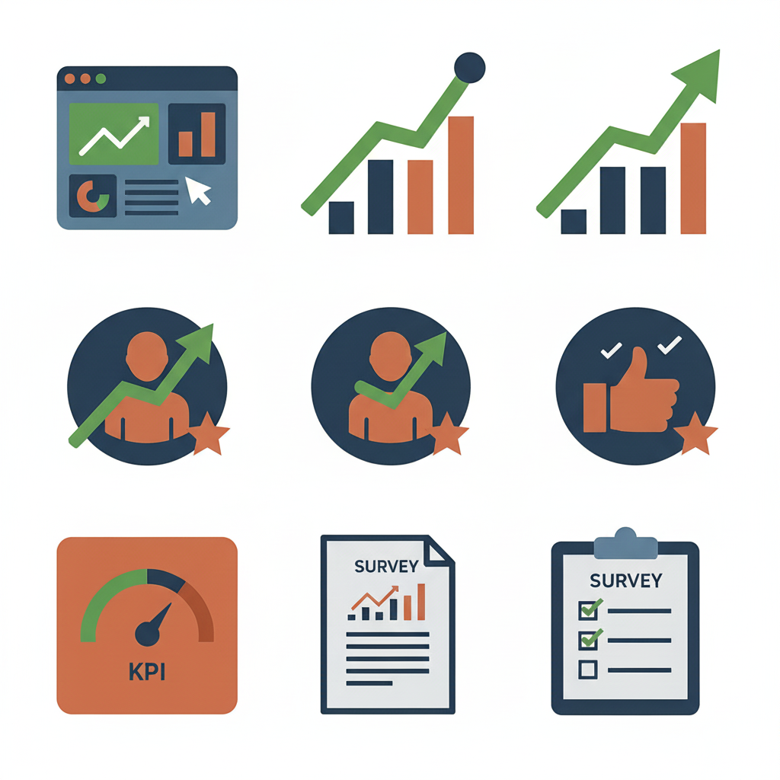

Slide 15
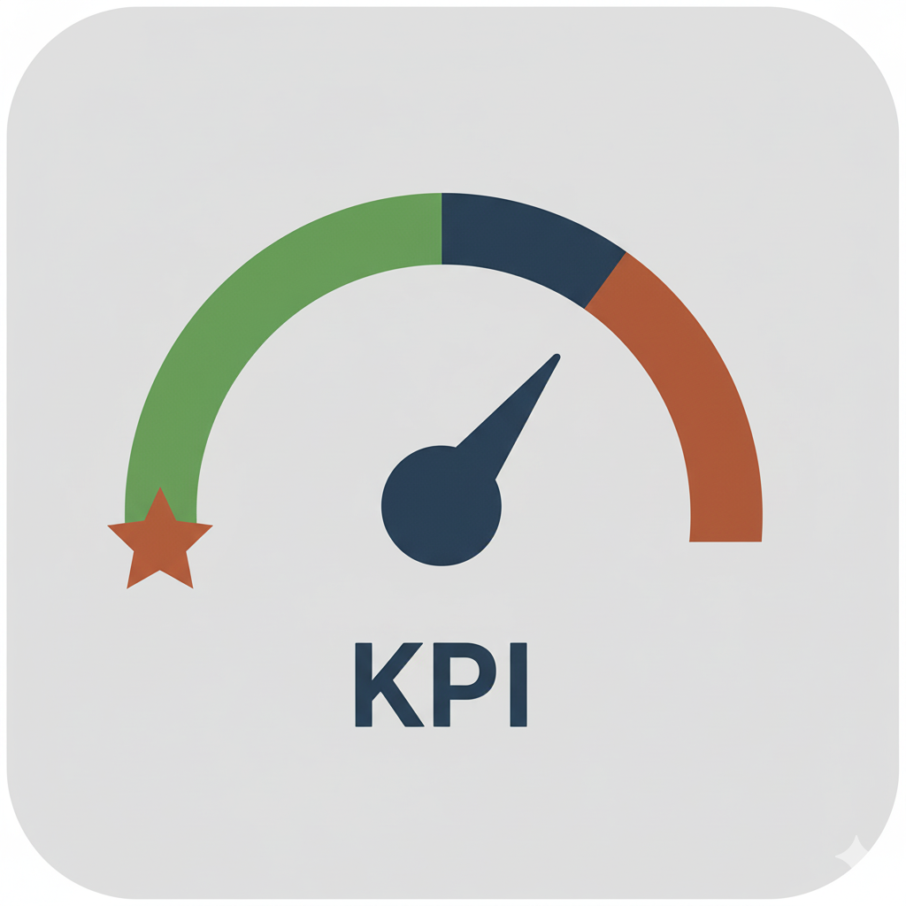
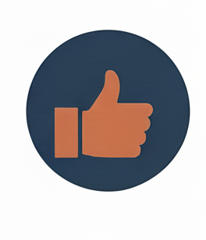
Before
After
Prompt: Can you modify the KPI icon so the background is a light gray?
Prompt: Can you modify the far right middle icon and remove the check marks and star?

Slide 16



Amanda Seagroves, MPH
MSKTC Dissemination Lead
MSKTC@air.org
The contents of this presentation were developed under grant number 90DPKT0009 from the National Institute on Disability, Independent Living, and Rehabilitation Research (NIDILRR). NIDILRR is a Center within the Administration for Community Living (ACL), Department of Health and Human Services (HHS). The contents of this presentation do not necessarily represent the policy of NIDILRR, ACL, HHS, and you should not assume endorsement by the federal government.

