Slide 1
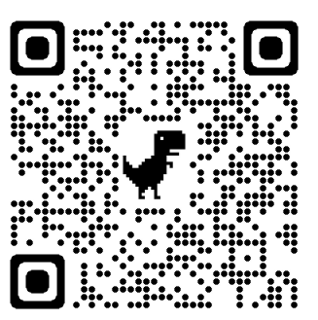
Model Systems Knowledge Translation Center Traumatic Brain Injury Resource Inventory
Model Systems Knowledge Translation Center
5th Edition
December 2023

Slide 2
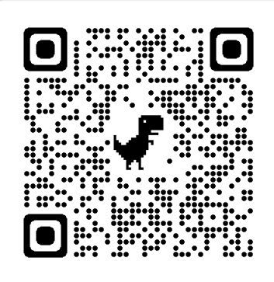
About TBI Model System Program
The Traumatic Brain Injury (TBI) Model System program, sponsored by the National Institute on Disability, Independent Living, and Rehabilitation Research (NIDILRR), Administration for Community Living, U.S. Department of Health and Human Services, supports innovative projects and research in the delivery, demonstration, and evaluation of medical, rehabilitation, vocational, and other services designed to meet the needs of individuals with TBI.
NIDILRR awards TBI Model Systems grants to institutions that are national leaders in medical research and patient care; these institutions provide the highest level of comprehensive specialty services from the point of injury through eventual re-entry into full community life.
There are 16 currently-funded TBI Model System Centers.
Each TBI Model System contributes to the Traumatic Brain Injury Model Systems National Data and Statistical Center, participates in independent and collaborative research, and provides information and resources to individuals with TBI; their families, caregivers, and friends; health care professionals; and the general public.

Slide 3
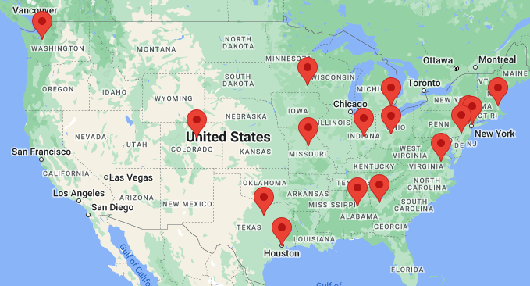
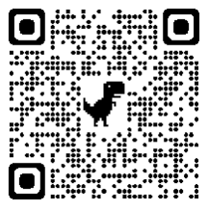
Current TBI Model System Centers
https://msktc.org/tbi/model-system-centers

Slide 4
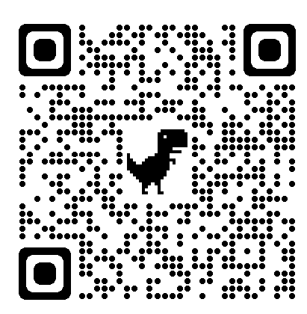
About TBI Model Systems Database
A prospective, longitudinal database that examines the course of recovery and outcomes following the delivery of coordinated acute neurotrauma and inpatient rehabilitative care to people with TBI.
The primary purpose of the TBIMS database is to advance medical rehabilitation by increasing the rigor and efficiency of scientific efforts to longitudinally assess the experience of individuals with TBI.
As of March 2022, the database contained information on 19,045 persons with TBI.
It is the largest TBI longitudinal database in the world.
It includes data on preinjury, injury, acute care, rehabilitation, and outcomes at 1, 2, and 5 years post-injury and every 5 years with information on persons, so far, up to 30 years post-injury.
Learn more about the TBI Model Systems Database at: https://www.tbindsc.org/.

Slide 5
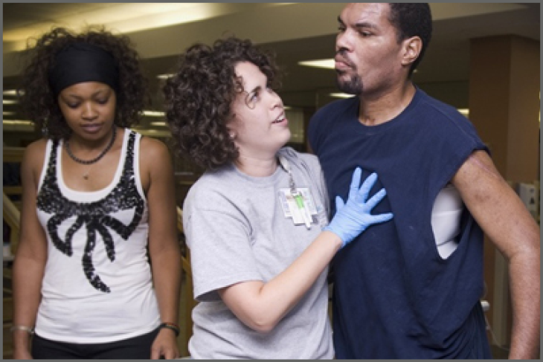
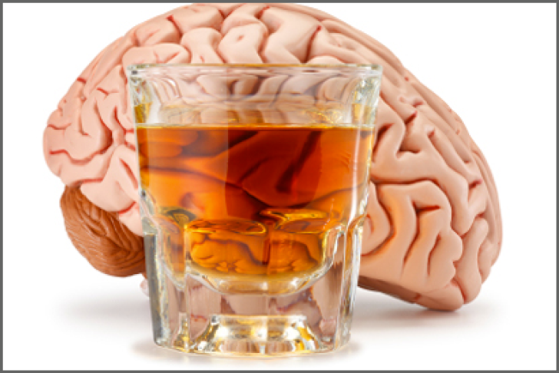
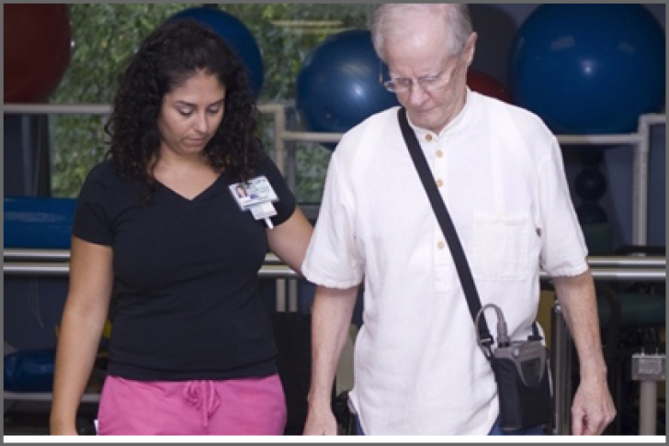
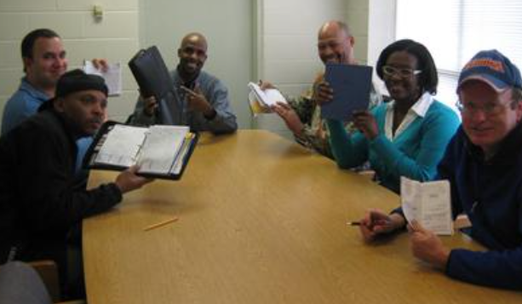
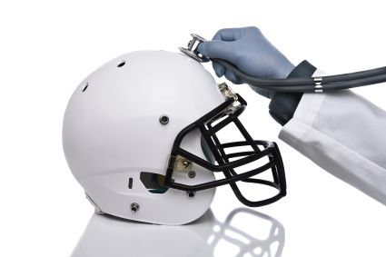
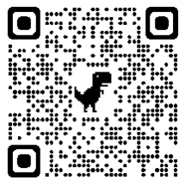
Living with Traumatic Brain Injury (TBI)
https://msktc.org/tbi
ALL TOPICS
Acute Inpatient Rehabilitation
Alcohol and TBI
Balance Problems
Being a Parent with TBI
Change in Memory After TBI
Chronic Pain & TBI
Cognitive Problems
Concussion Recovery
Disorders of Consciousness
Driving
Emotional Problems
After TBI
Fatigue & TBI

Slide 6
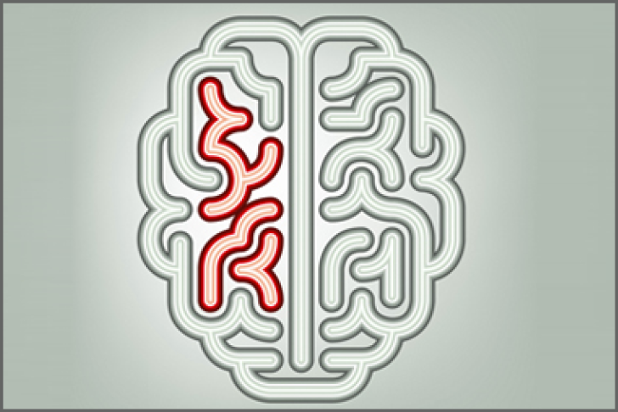
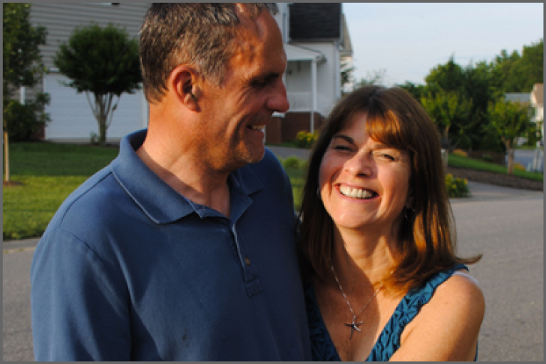
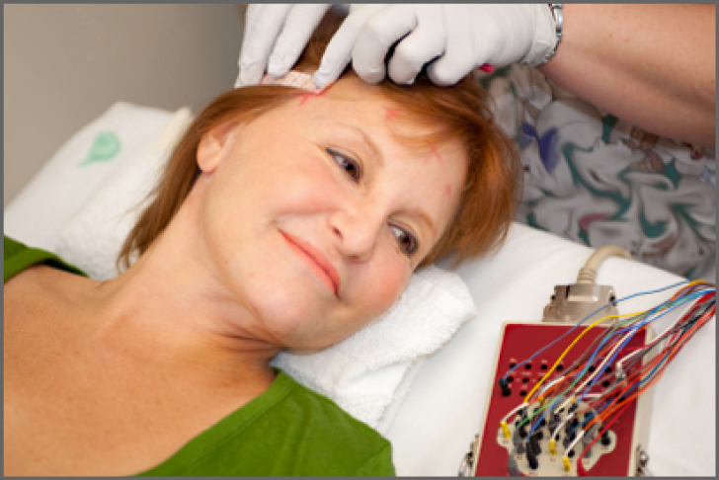
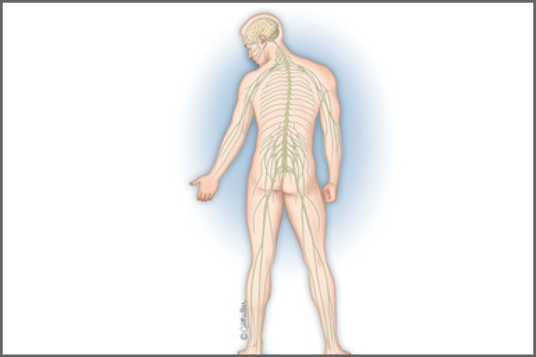
Living with Traumatic Brain Injury (TBI)
https://msktc.org/tbi
ALL TOPICS
Headaches
Irritability, Anger, and Aggression After TBI
Loss of Smell or Taste
After TBI
Relationships After TBI
Obstructive Sleep Apnea
Relationships After TBI
Returning to School
Seizures
Severe TBI
Sexuality After TBI
Sleep & TBI
Social Skills After TBI
Spasticity & TBI

Slide 7
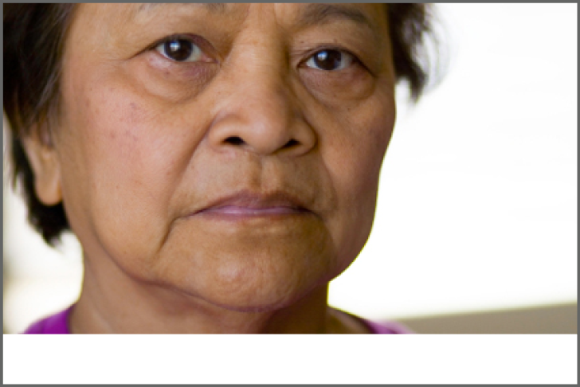
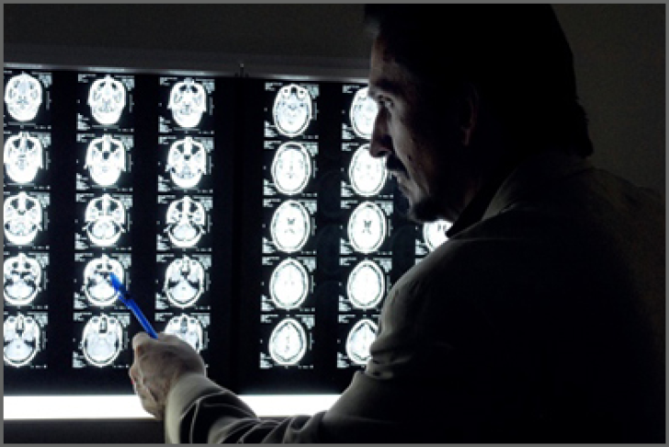
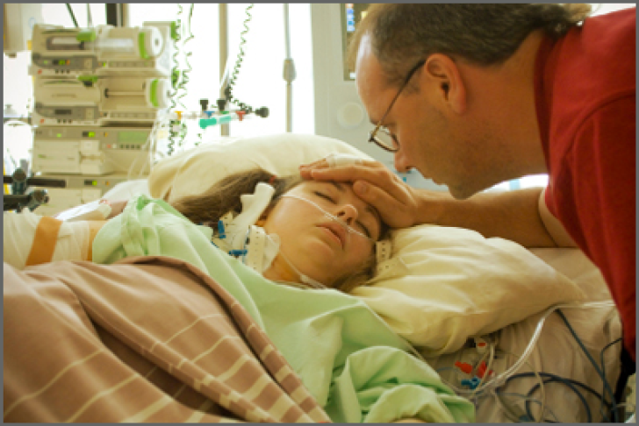
Living with Traumatic Brain Injury (TBI)
https://msktc.org/tbi
ALL TOPICS
Staying Healthy After TBI
Stress Management for TBI Caregivers
TBI & Depression
QR code goes to: https://msktc.org/tbi
Understanding Behavior Changes after TBI
Understanding TBI
Vegetative State
Vision Problems
Voting Tips after TBI

Slide 8
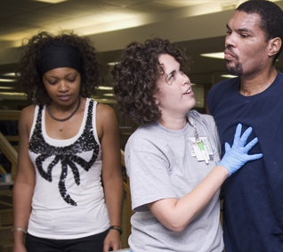
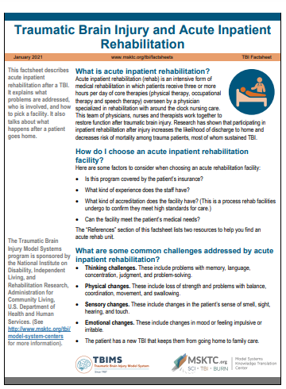
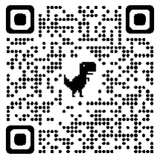
Acute Inpatient Rehabilitation
https://msktc.org/tbi-topics/acute-inpatient-rehabilitation
• TBI and Acute Inpatient Rehabilitation

Slide 9
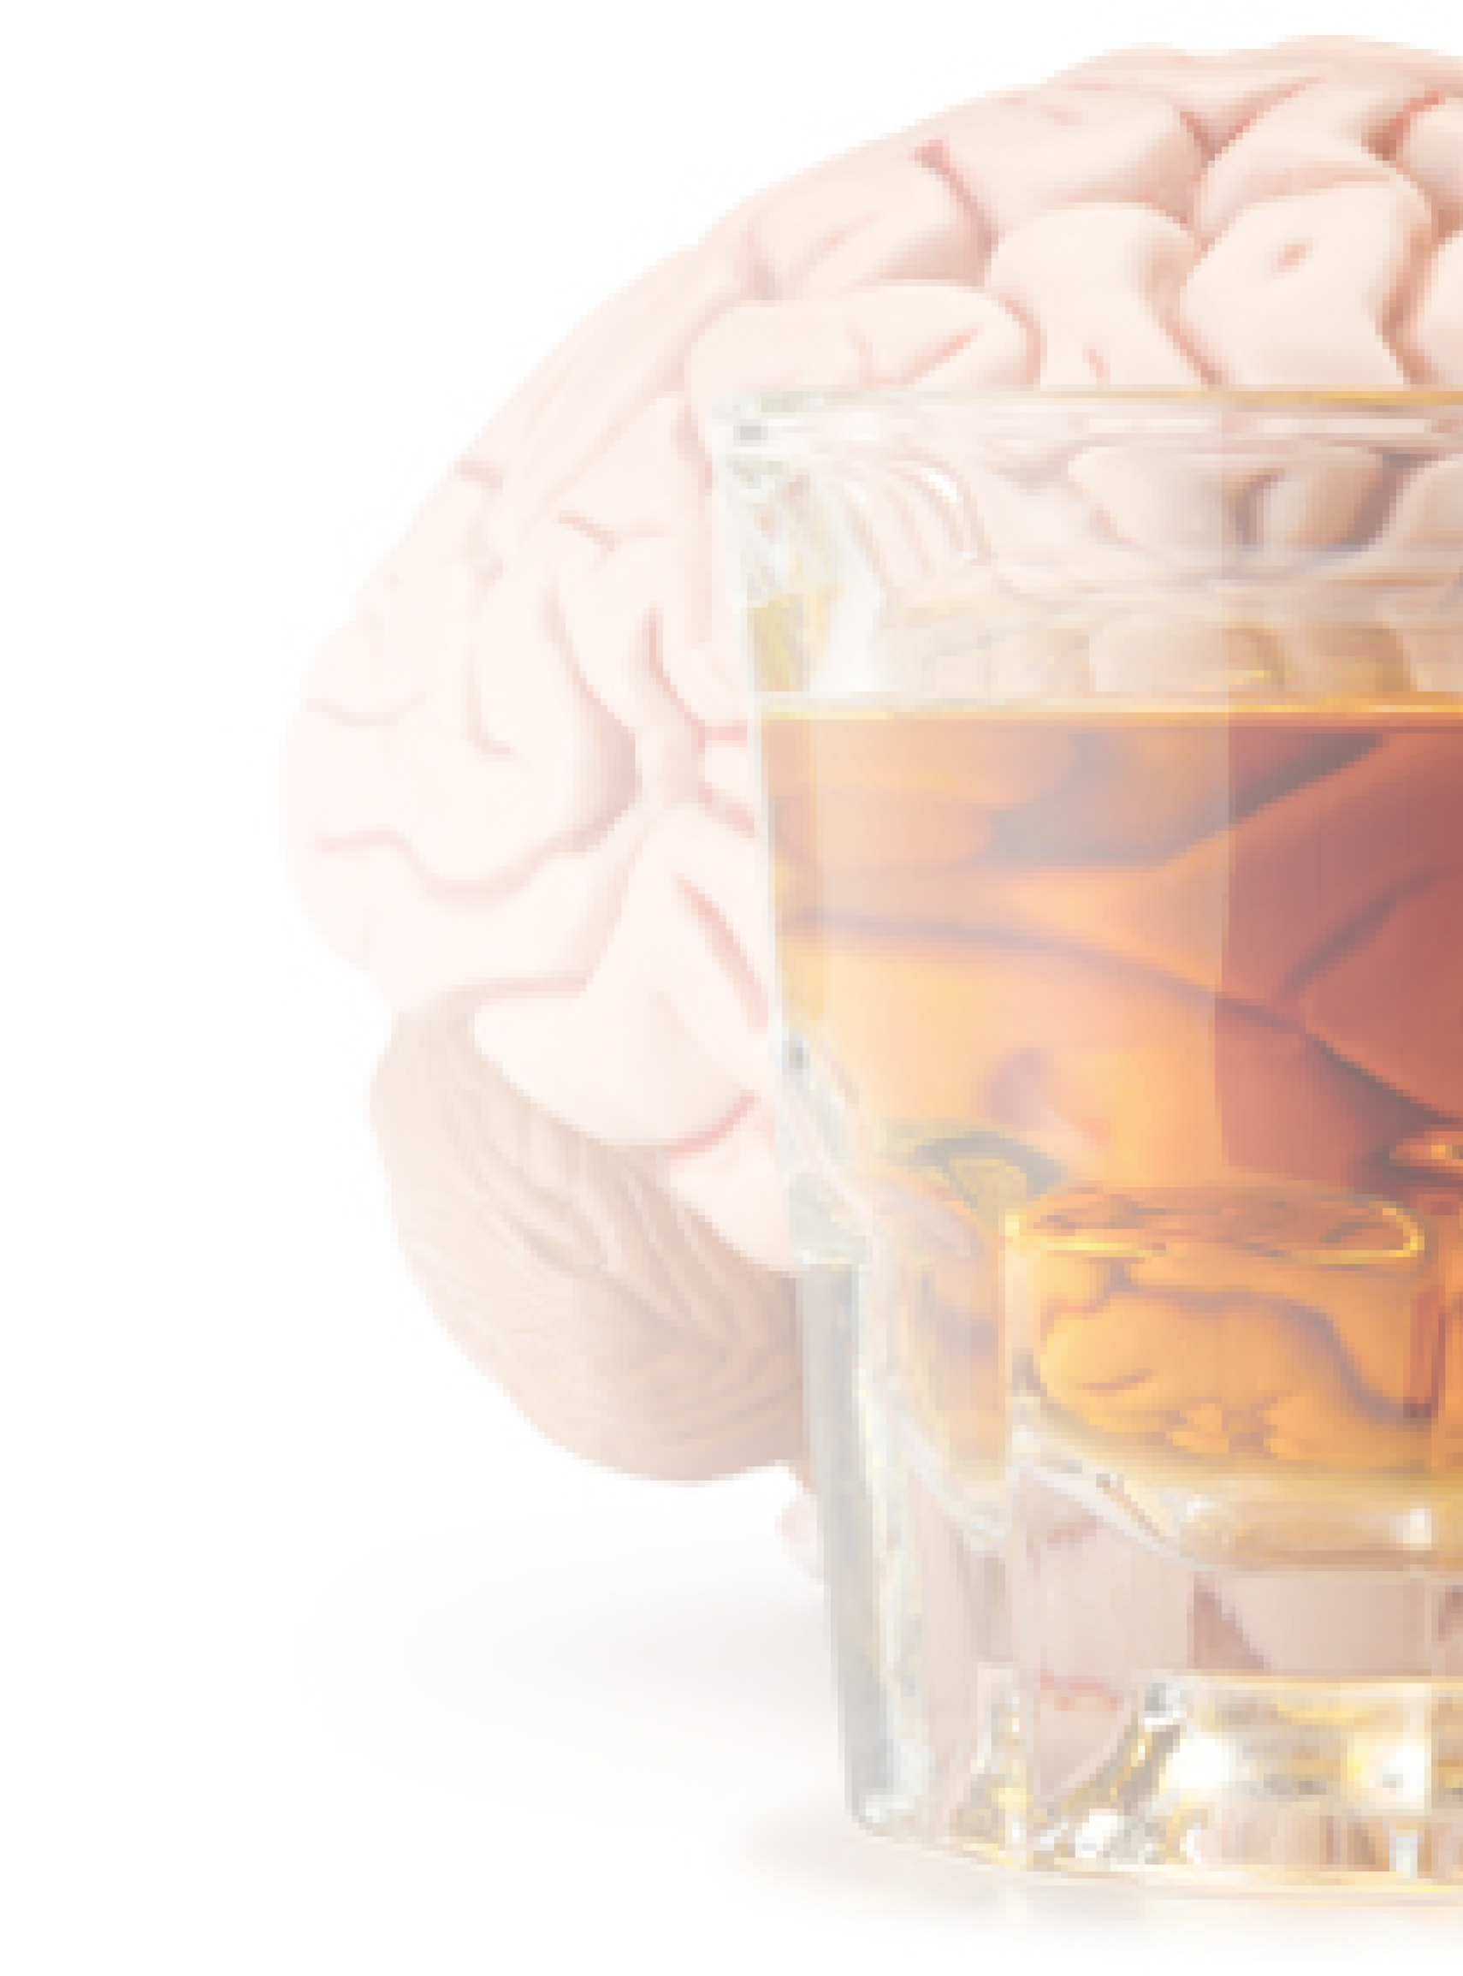
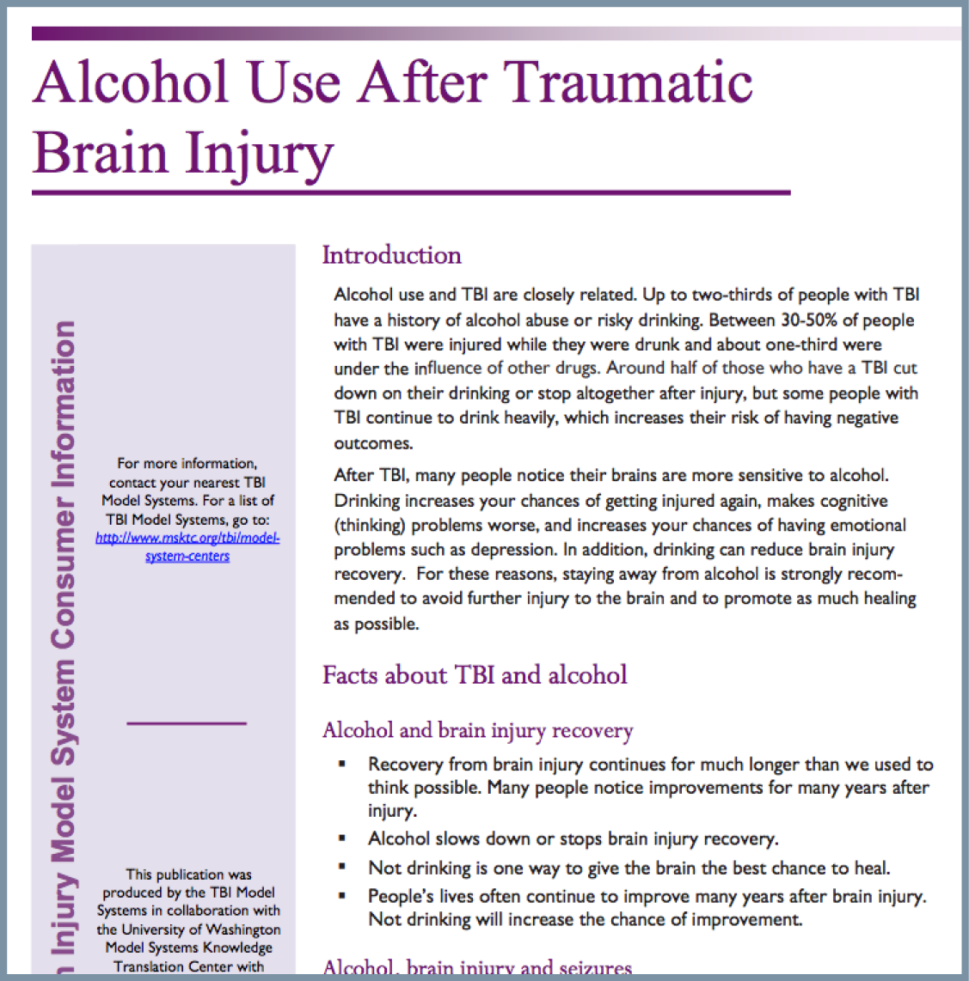
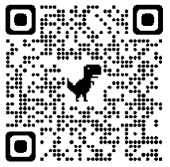
Alcohol & TBI
https://msktc.org/tbi-topics/alcohol-tbi
• Alcohol Use after TBI
• Alcohol Use after TBI

Slide 10
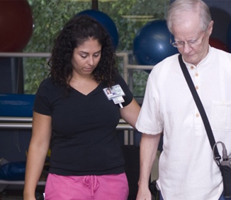
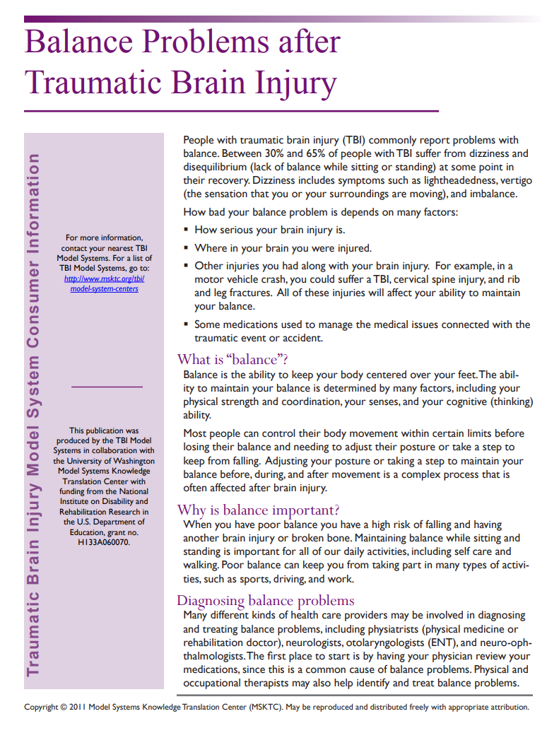
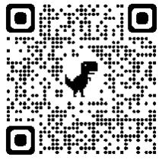
Balance Problems After TBI
https://msktc.org/tbi-topics/balance-problems-tbi
• Balance Problems after TBI

Slide 11
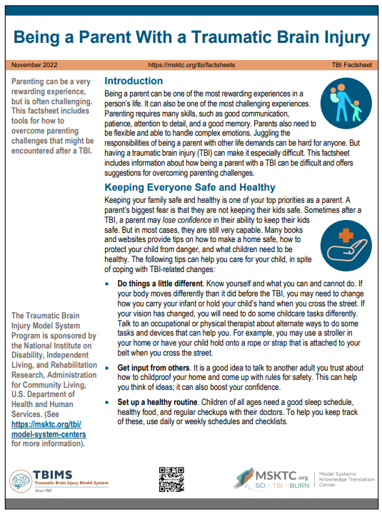
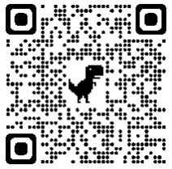
Being a Parent With a TBI
https://msktc.org/tbi/tbi-topics/being-parent-traumatic-brain-injury
• Being a Parent With a TBI

Slide 12
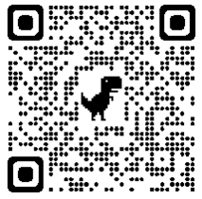
Change in Memory After TBI
https://msktc.org/tbi-topics/change-memory-after-tbi
Advice for Families and Caregivers
Changes in Memory After TBI
Cognitive Rehabilitation for Memory Problems After TBI
Developing Awareness of Memory Issues
Emotional Impact of Memory Problems
Importance of Family Support with Memory Strategies
Initially Resistant to Memory Strategies
It's not just the injury that matters but the brain that is injured.
Learning a New Memory Strategy in Multiple Settings
Low-Tech and No-Tech Strategies for Memory Support
Make Sure It Is a Memory Problem
Medication and Memory Problems After TBI
Memory Is Not a Single Thing
Memory Issues Impacting Other Health Problems
Memory Problems and Returning to Work After TBI
Memory Problems Causing Conflict Within Families
Memory Strategies Don’t Weaken Your Memory
Pillboxes as Memory Supports: Individualizing
Primary Care Providers and Memory Problems After TBI
Remembering the Time Before the Injury
Smartphones as Memory Supports
Social Impact of Memory Problems
The Challenge of Remembering Memory Strategies
The Neurology of Memory Problems
Uncertainty About Recovering Memory Function
When Strategies Don’t Work
Memory & Moderate and Severe TBI
Hot Topic
Changes in Memory After TBI
Memory and Moderate to Severe TBI
Podcasts
The Neurology of Memory Problems After TBI
Memory and Traumatic Brain Injury
Initially Resistant to Memory Strategies
Medication and memory Problems After TBI
Make Sure It Is a Memory Problem
Advice for Family Members

Slide 13
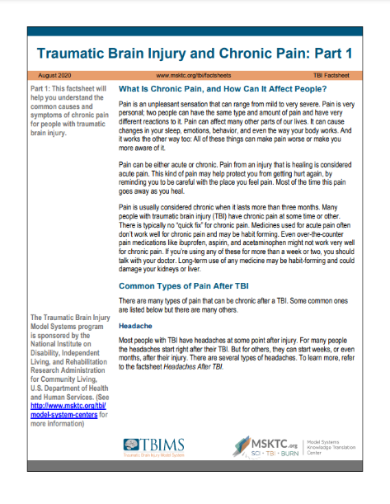
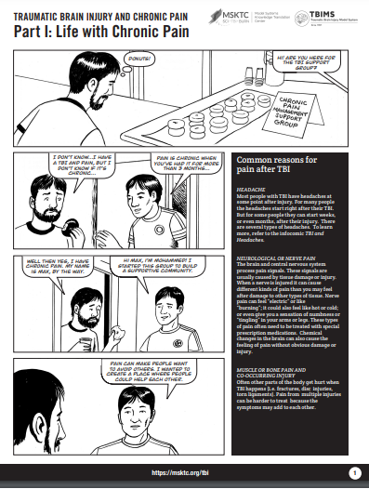
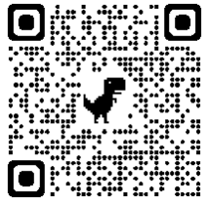
Chronic Pain & TBI
https://msktc.org/tbi-topics/chronic-pain-tbi
• Traumatic Brain Injury and Chronic Pain (2 Parts)
Infocomic
• Traumatic Brain Injury and Chronic Pain (4 Parts)

Slide 14
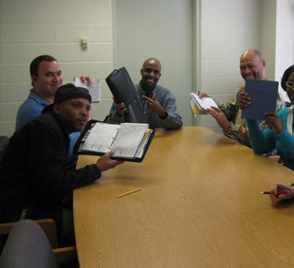
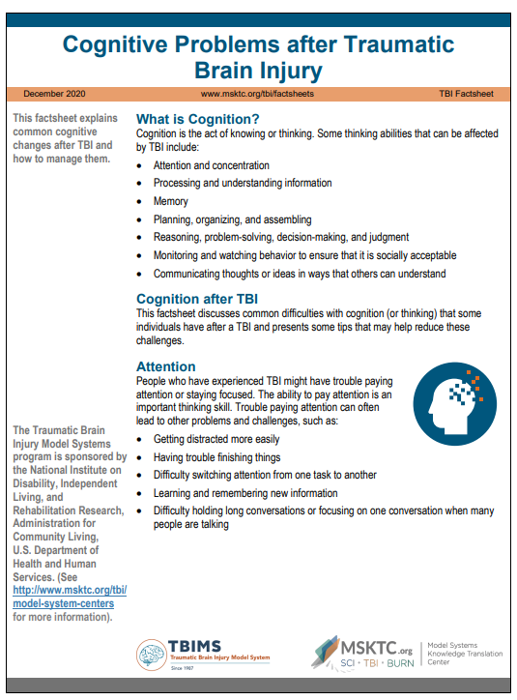
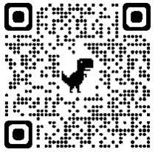
Cognitive Problems After TBI
https://msktc.org/tbi-topics/cognitive-problems
• Cognitive Problems after TBI

Slide 15
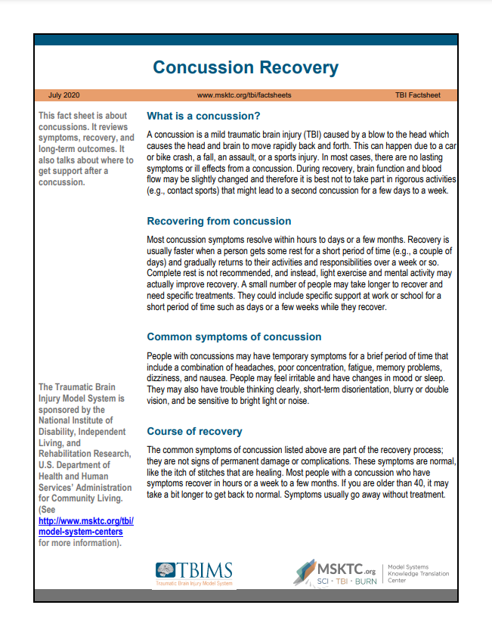
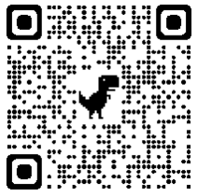
Concussion Recovery
https://msktc.org/tbi-topics/concussion-recovery
• Concussion Recovery

Slide 16
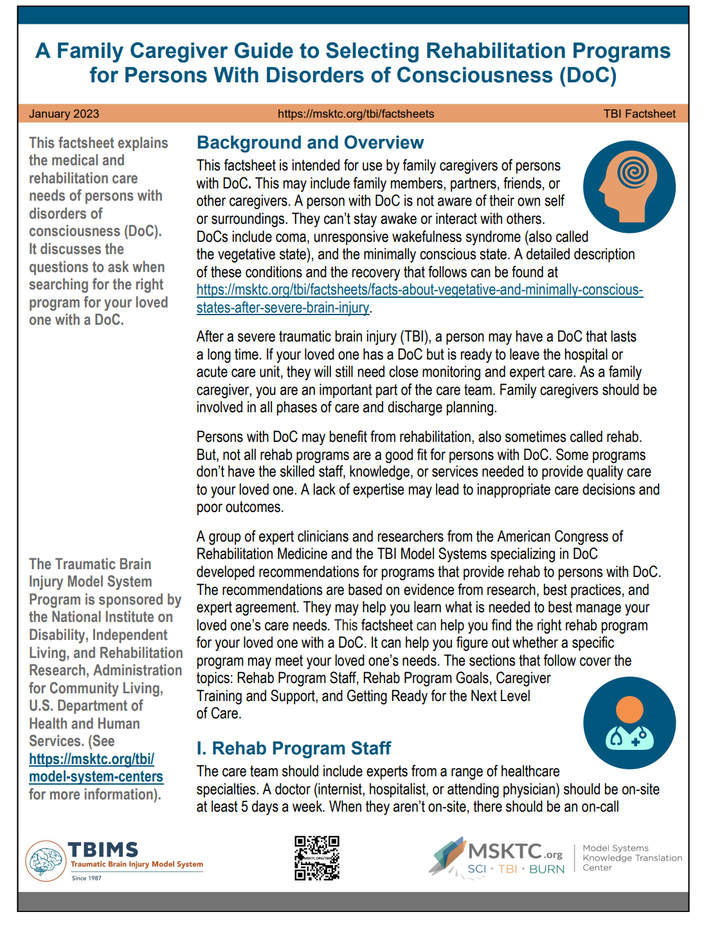
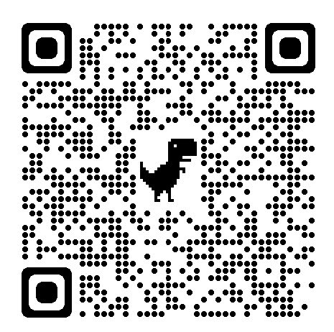
Disorders of Consciousness
https://msktc.org/tbi/tbi-topics/rehabilitation-programs-persons-disorders-consciousness-doc
• A Family Caregiver Guide to Selecting Rehabilitation Programs for Persons With Disorders of Consciousness (DoC)

Slide 17
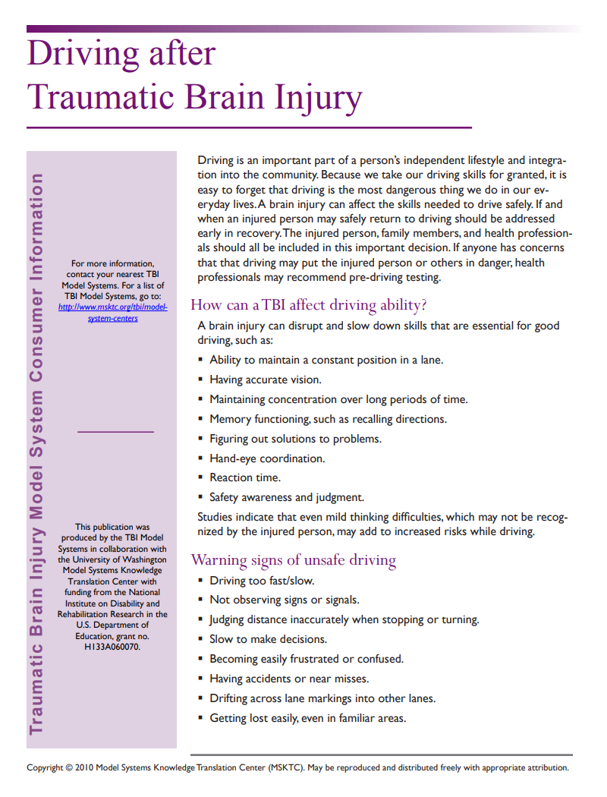
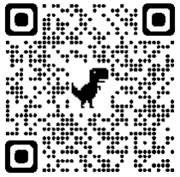
Driving After TBI
https://msktc.org/tbi-topics/driving
• Driving After TBI

Slide 18
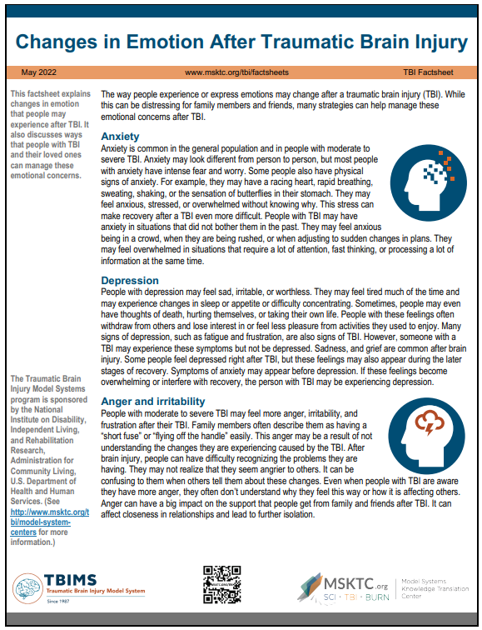
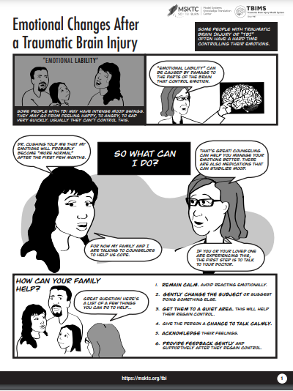
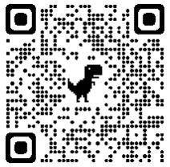
Emotional Problems After TBI
https://msktc.org/tbi-topics/emotional-problems-after-tbi
• Emotional Problems After TBI
• Emotional Problems After TBI
Infocomic
• Emotional Problems After TBI

Slide 19
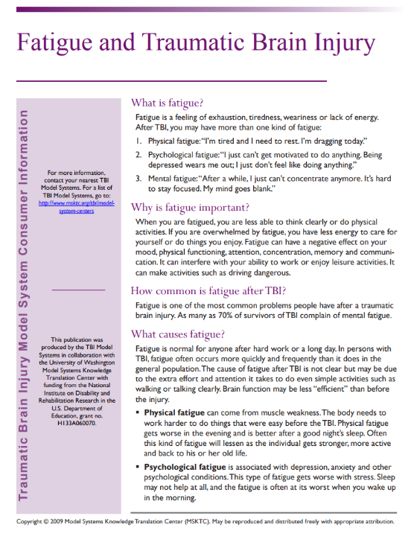
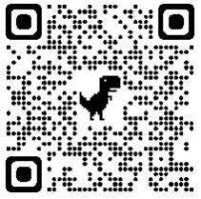
Fatigue and TBI
https://msktc.org/tbi-topics/fatigue-tbi
• Fatigue and TBI
• Fatigue and TBI

Slide 20
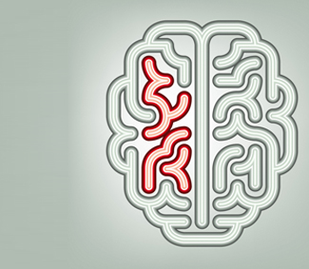
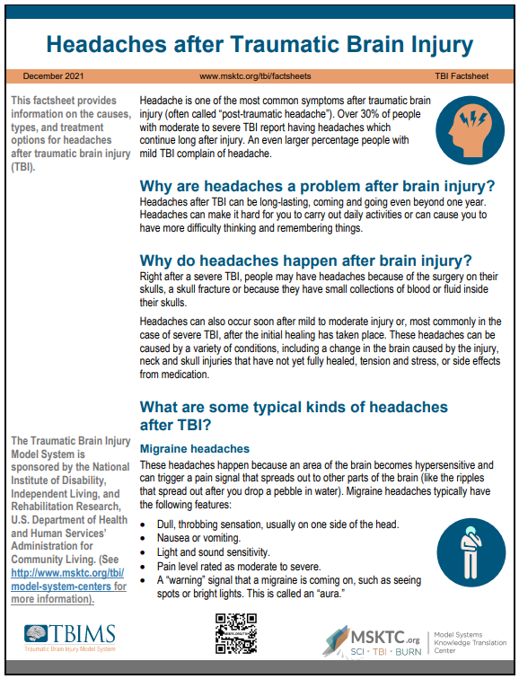
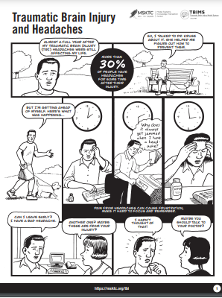
Headaches After TBI
https://msktc.org/tbi-topics/headaches
• Headaches After TBI
Infocomic
• TBI and Headaches

Slide 21
Irritability, Anger, and Aggression After TBI
https://msktc.org/tbi-topics/irritability-anger-and-aggression-after-tbi
• Understanding and Coping With Irritability, Anger, and Aggression After TBI

Slide 22
Loss of Smell or Taste After TBI
https://msktc.org/tbi-topics/loss-smell-or-taste-after-tbi
• Loss of Smell or Taste After TBI

Slide 23
Obstructive Sleep Apnea
https://msktc.org/tbi/tbi-topics/obstructive-sleep-apnea
• Obstructive Sleep Apnea after TBI

Slide 24
Relationships After TBI
https://msktc.org/tbi-topics/relationships-after-tbi
Ambiguous Loss
Don’t Let this Horrible Accident Destroy Your Marriage
Getting Back on the Bike
His Divot
How Family Roles Change After TBI
How to find Help
Impact of Coupled Relationship on Recovery
Insight Into His Cognitive and Physical Changes
Intimacy after TBI
Parenting after TBI in the Family
Recognizing the Positives
Relationships After TBI
The Brain Injury Family Intervention Feelings Checklist
Thoughts on Going to a Relationship Counselor
Treating Each Other with Love
What Couples Counseling is Like from the Couples’ Perspective
What Couples Counseling is Like from the Therapist's Perspective
Relationships After TBI
Hot Topic
Relationships After TBI
Couples' Relationships after TBI
Podcasts
Relationships after TBI
How to Find Help
Recognizing the Positives
Getting Back on the Bike and the Surfboard
The Brain Injury Family Intervention Feelings Checklist
Parenting After a TBI in the Family
How Family Roles Change After TBI

Slide 25
Returning to School After TBI
https://msktc.org/tbi-topics/returning-school
• Returning to School After TBI

Slide 26
Seizures After TBI
https://msktc.org/tbi-topics/seizures
• Seizures After TBI

Slide 27
Severe TBI
https://msktc.org/tbi-topics/severe-tbi
• Severe TBI: What to Expect in the
Trauma Center, Hospital, and Beyond

Slide 28
Sexuality After TBI
https://msktc.org/tbi-topics/sexuality-after-tbi
• Sexuality After TBI
• Sexuality After TBI

Slide 29
Sleep and TBI
https://msktc.org/tbi-topics/sleep-tbi
• Sleep and TBI
• Sleep and TBI
Infographics
• TBI and Sleep

Slide 30
Social Skills After TBI
https://msktc.org/tbi-topics/social-skills-after-tbi
• Social Skills After TBI

Slide 31
Spasticity and TBI
https://msktc.org/tbi-topics/spasticity-tbi
• Spasticity and TBI
• Spasticity and TBI

Slide 32
Staying Healthy After TBI
https://msktc.org/tbi/factsheets/staying-healthy-after-tbi
• Staying Healthy After TBI

Slide 33
Stress Management for TBI Caregivers
https://msktc.org/tbi-topics/stress-management-tbi-caregivers
• Stress Management for TBI Caregivers

Slide 34
Behavior Changes after TBI
https://msktc.org/tbi/factsheets/understanding-behavior-changes-after-tbi
• Behavior Changes after TBI

Slide 35
TBI and Depression
https://msktc.org/tbi-topics/tbi-depression
Why it’s Critical to Treat Depression in People with TBI
Why it’s Important to Make Adjustments to CBT
Activity Can Help Alleviate Depression
Adjustments to Therapy
Antidepressant Medications
Depression vs. Situational Sadness
Get Back to Doing Enjoyable Things to Combat Depression
How Does Cognitive Behavioral Therapy Work?
How Does Vocational Rehab Help with Depression?
How Prevalent is Depression?
Importance of a Support System
Importance of Recreational Therapy in Returning to Activity
Stigma of Depression as a Barrier
TBI & Depression
Team Approach to Treating TBI & Depression
What are the Best Treatments for Depression with TBI?
What is Depression?
What is Vocational Rehab?
Why Do Good People Get Depression after TBI?
Why is it Important to Treat Depression in People with TBI?
Depression after TBI
Hot Topic
TBI and Depression
Depression after TBI
Podcasts
How Does Cognitive Behavioral Therapy Work?
Adjustments to Therapy for TBI Patients
Activity Can Help Alleviate Depression
Depression After TBI
Recovery Is a Full Time Job
Importance of a Support System
Get Back to Doing Enjoyable Things to Combat Depression

Slide 36
Understanding TBI
https://msktc.org/tbi-topics/understanding-tbi
Understanding TBI (4 parts)
Infocomic
Understanding TBI (3 parts)
Podcasts
Understanding TBI

Slide 37
Vegetative and Minimally Conscious State
https://msktc.org/tbi-topics/vegetative-states
• Vegetative and Minimally Conscious States After Severe TBI

Slide 38
Vision Problems After TBI
https://msktc.org/tbi-topics/vision-problems
• Vision Problems and TBI

Slide 39
Voting Tips after TBI
https://msktc.org/tbi-topics/voting-tips-after-tbi
• Voting Tips for People Living with Traumatic Brain Injury

Slide 40
TBI Resources at MSKTC.org/TBI

Slide 41
Visit the MSKTC website
Spinal Cord Injury
msktc.org/sci
Traumatic Brain Injury
msktc.org/tbi
Burn Injury
msktc.org/burn

Slide 42
Disclaimer
Disclaimer: This information is not meant to replace the advice of a medical professional. You should consult your health care provider about specific medical concerns or treatment. The contents of this resource were developed under grants (90DP0082 and 90DPKT0009) from the National Institute on Disability, Independent Living, and Rehabilitation Research (NIDILRR). NIDILRR is a Center within the Administration for Community Living (ACL), U.S. Department of Health and Human Services (HHS). The contents of this resource do not necessarily represent the policy of NIDILRR, ACL, or HHS, and you should not assume endorsement by the federal government.
Copyright © 2023 Model Systems Knowledge Translation Center (MSKTC). May be reproduced and distributed freely with appropriate attribution. Prior permission must be obtained for inclusion in fee-based materials.

