Slide 1
Model Systems Knowledge Translation Center Spinal Cord Injury Resource Inventory
Model Systems Knowledge Translation Center
September 2019

Slide 2
About SCI Model Systems
The Spinal Cord Injury (SCI) Model Systems program, sponsored by the National Institute on Disability, Independent Living, and Rehabilitation Research (NIDILRR), Administration for Community Living, U.S. Department of Health and Human Services, supports innovative projects and research in the delivery, demonstration, and evaluation of medical, rehabilitation, vocational and other services to meet the needs of individuals with SCI.
NIDILRR awards SCI Model Systems grants to institutions that are national leaders in medical research and patient care and provide the highest level of comprehensive specialty services, from the point of injury through rehabilitation and re-entry into full community life.
There are 14 currently-funded SCI Model System Centers.
Each SCI Model System Center contributes data to the National SCI Statistical Center, participates in independent and collaborative research, and provides information and resources to individuals with SCI, their family and caregivers, health care professionals, and the general public.

Slide 3
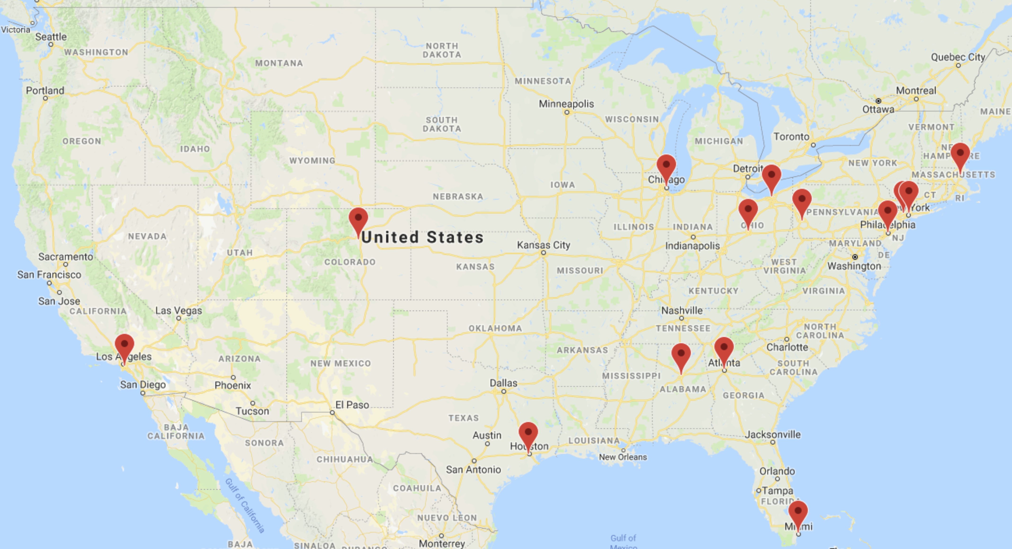
Current SCI Model System Centers
https://msktc.org/sci/model-system-centers

Slide 4
About SCI Model Systems Database
The National SCI Model Systems Database – established in 1973 – captures data from an estimated 6% of new SCI cases in the U.S.
29 federally-funded SCI Model Systems have contributed data.
As of September 2019, the database contained information on 34,130 persons with SCI.
It is the world’s largest and longest active SCI research database.
It is the world’s most extensive source of available information about the characteristics and life course of individuals with SCI.
To assure comparability of data, rigid scientific criteria have been established for the collection, management, and analysis of information entered into the database.
Visit the SCI Model Systems Database: https://www.nscisc.uab.edu/.

Slide 5
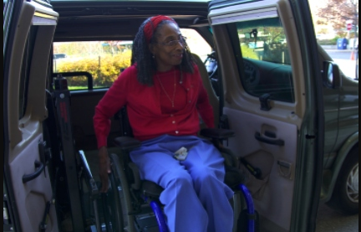
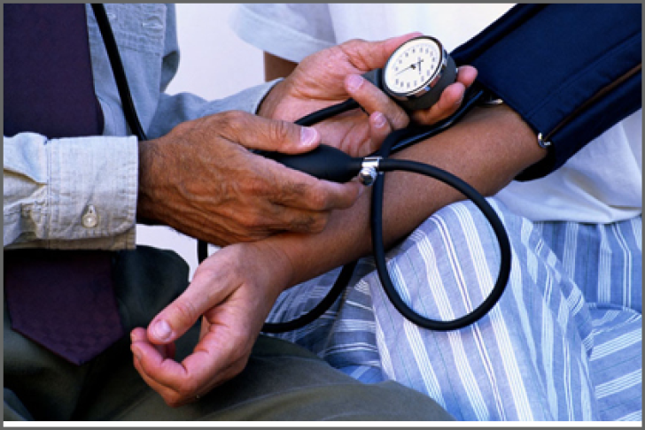
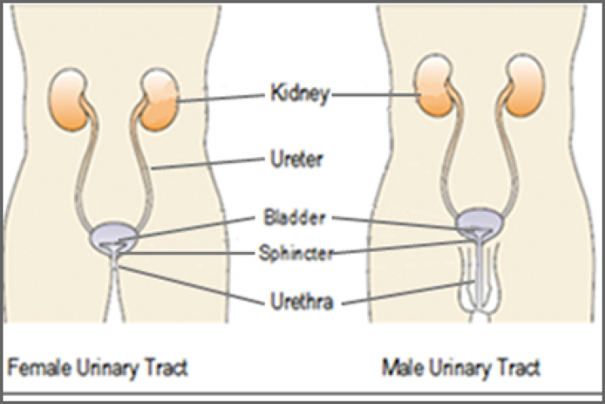
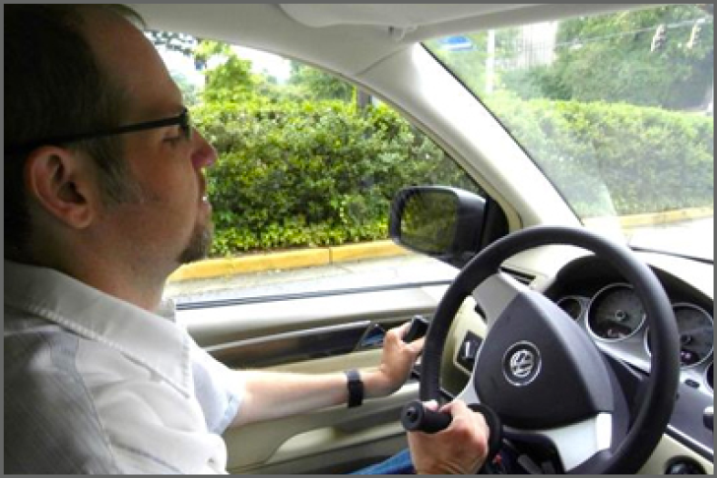
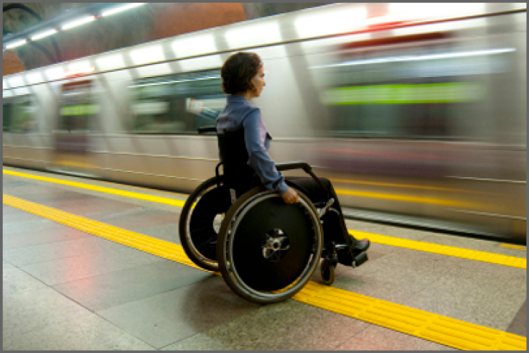
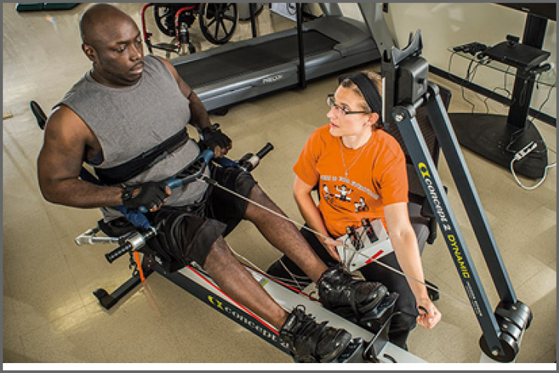
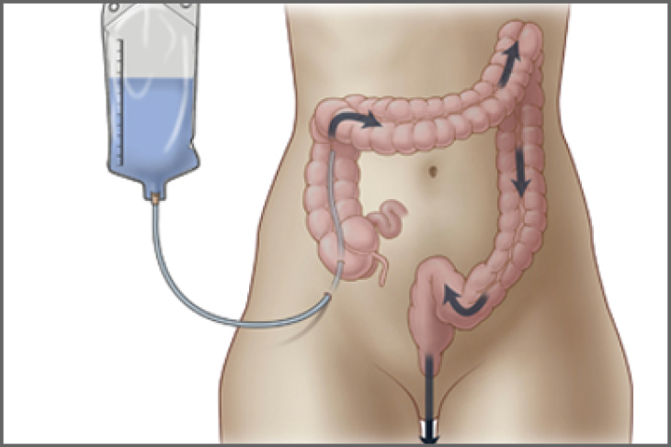
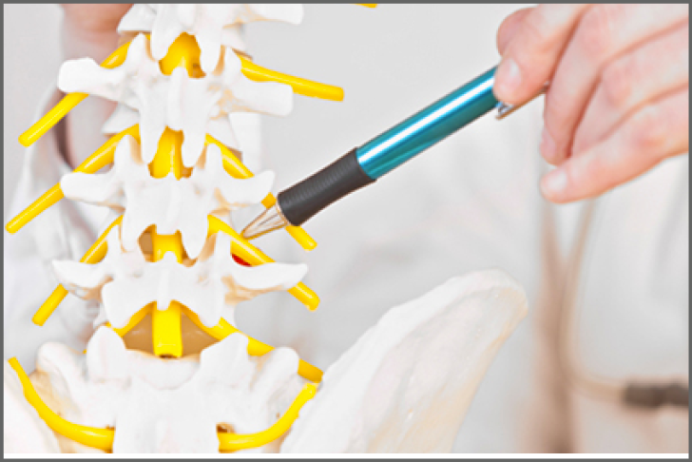
Living with Spinal Cord Injury (SCI)
https://msktc.org/sci
ALL TOPICS
Adjusting to Life
Aging and SCI
Autonomic Dysreflexia
Bladder Management
Depression and SCI
Driving after SCI
Employment after SCI
Exercise and Fitness after SCI
Gait Training and SCI
Managing Bowel Function
Managing Pain after SCI
Pregnancy and SCI

Slide 6
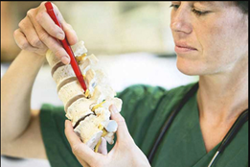
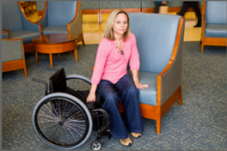
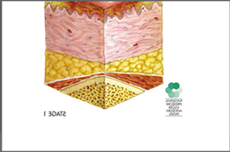
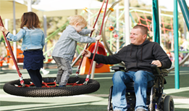
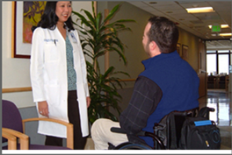
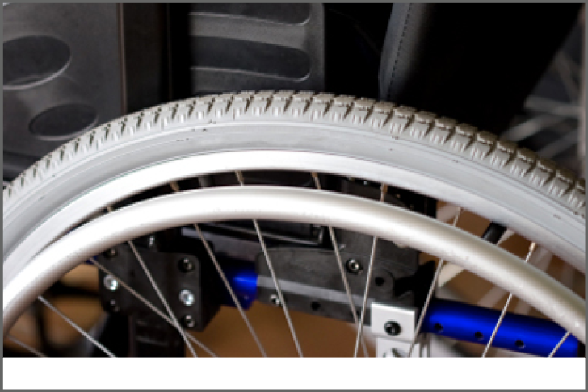
Living with Spinal Cord Injury (SCI)
https://msktc.org/sci
ALL TOPICS
Autonomic Dysreflexia
Adjusting to Life
Spasticity and SCI
Wheelchair Information

Slide 7
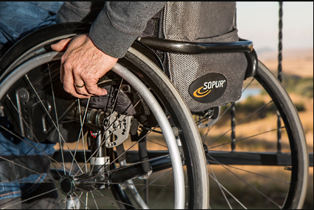
Spinal Cord Injury Resources
https://msktc.org/sci/sci-resources

Slide 8
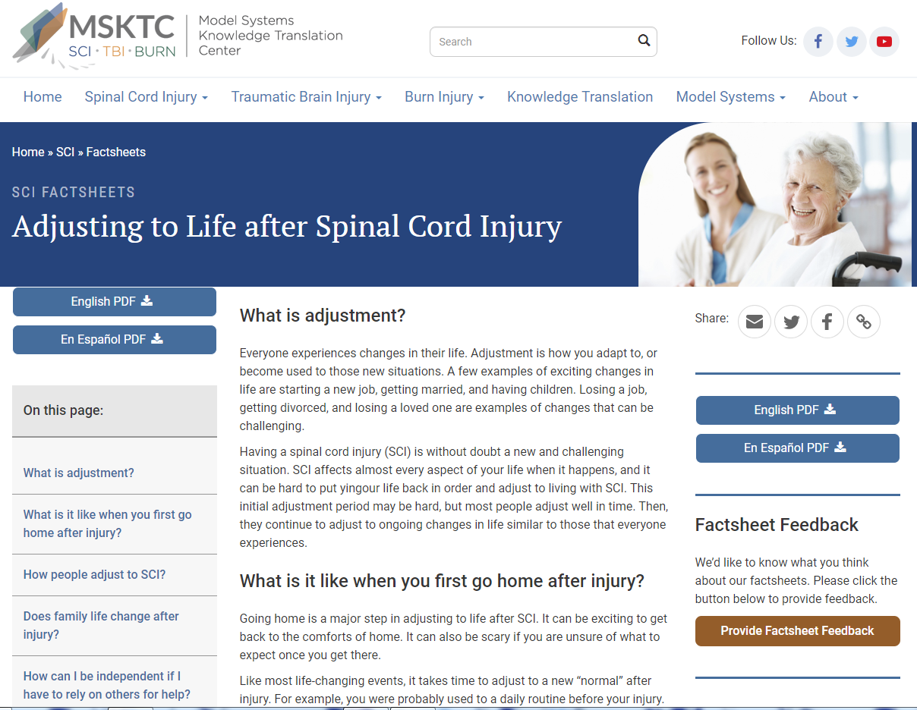
Adjusting to Life after SCI
https://msktc.org/sci-topics/adjusting-life
• Adjusting to Life after SCI

Slide 9
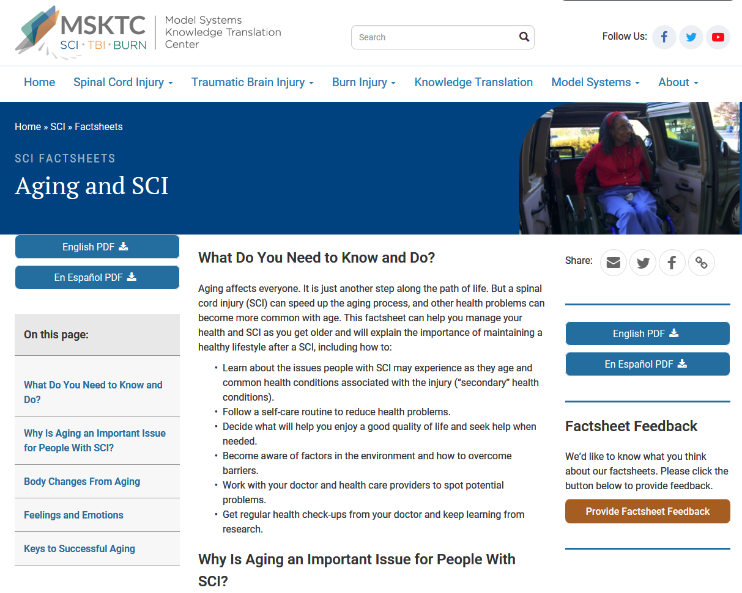
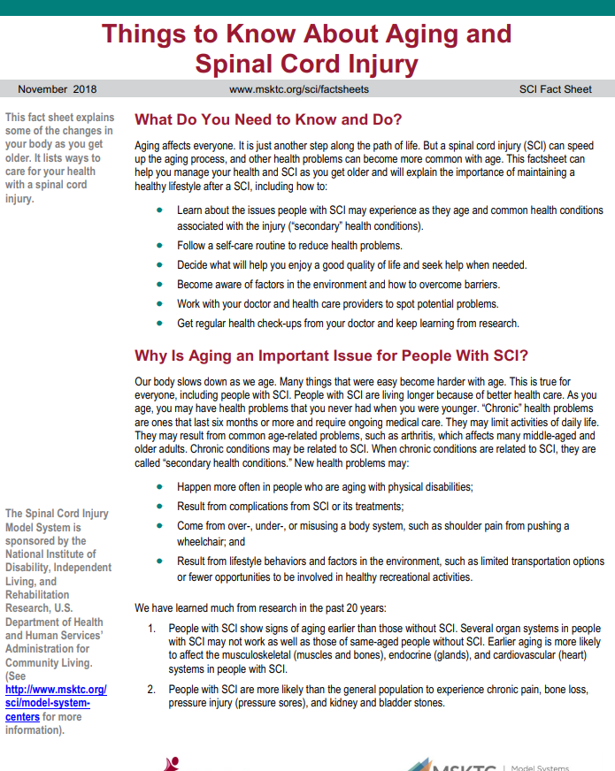
Aging and SCI
https://msktc.org/sci-topics/aging-sci
• Things to Know About Aging and SCI

Slide 10
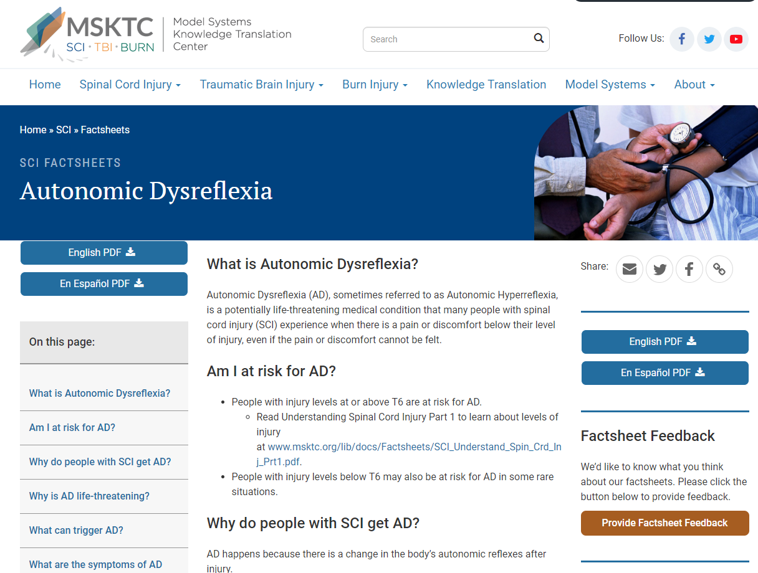
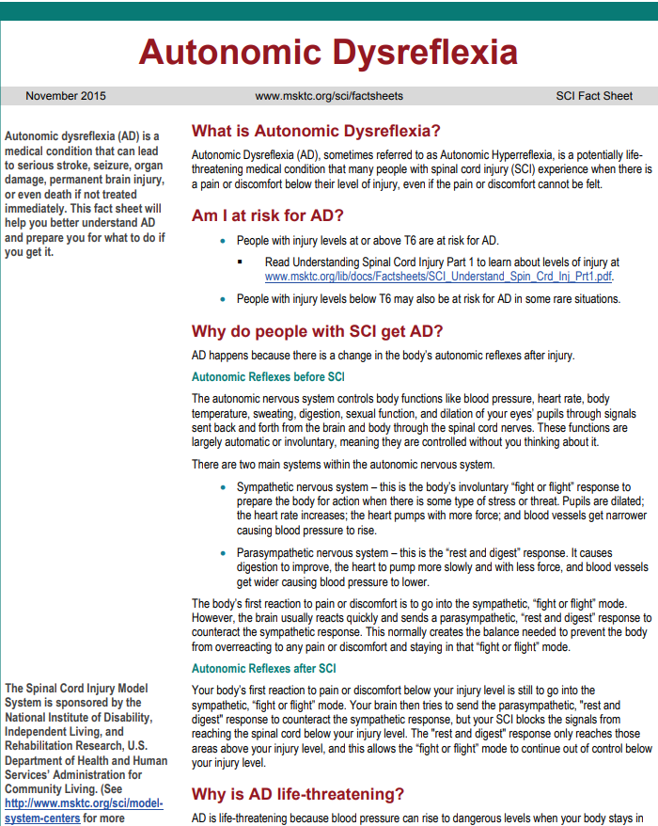
Autonomic Dysreflexia
https://msktc.org/sci-topics/autonomic-dysreflexia
• Autonomic Dysreflexia

Slide 11
Bladder Management
https://msktc.org/sci-topics/bladder-management
• Bladder Management Options Following SCI
• Surgical Alternatives for Bladder Management Following SCI

Slide 12
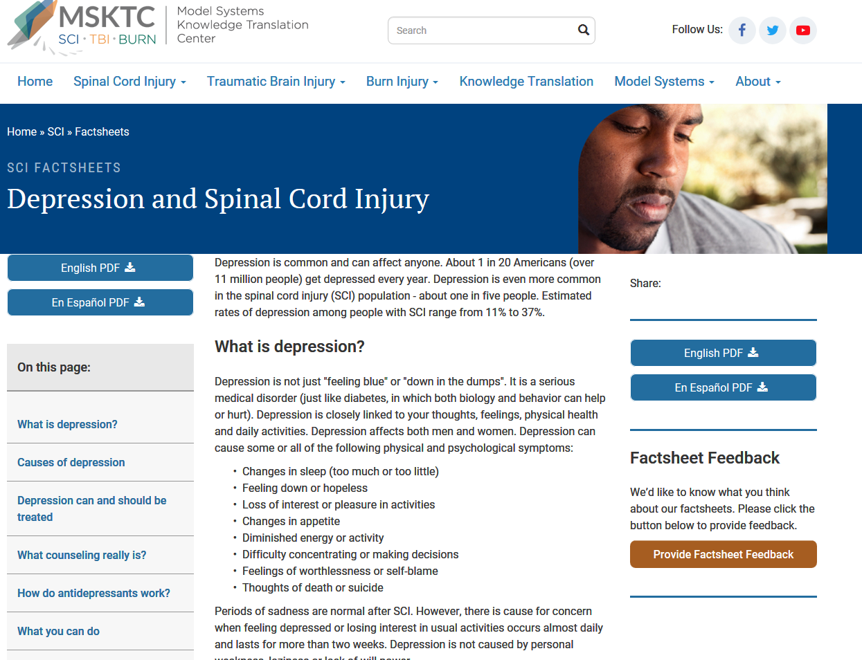
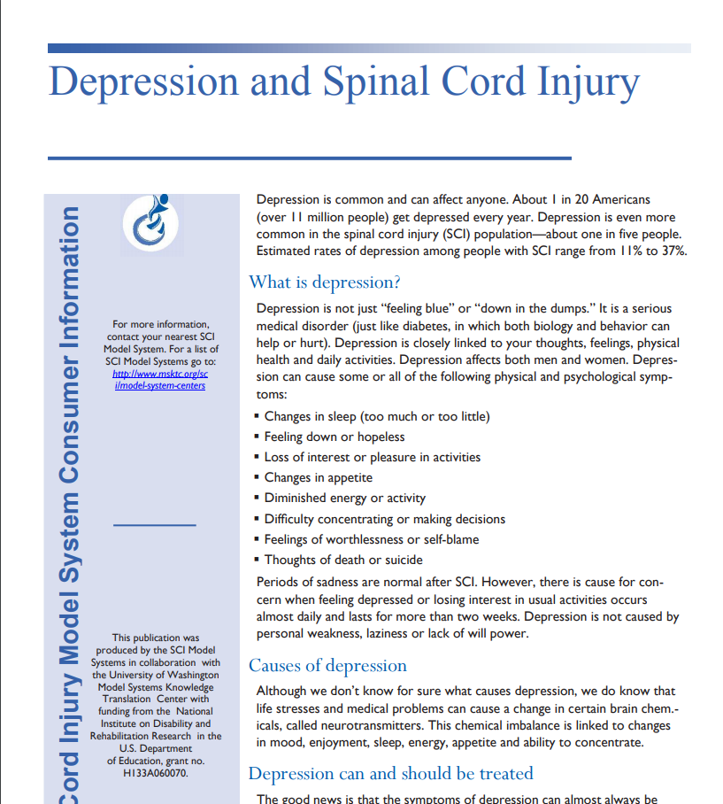
Depression and SCI
https://msktc.org/sci-topics/depression-sci
• Depression and SCI

Slide 13
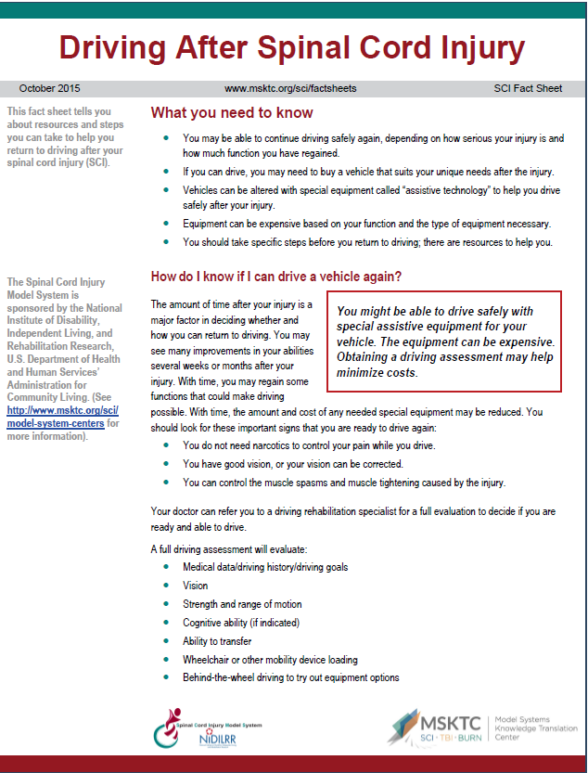
Driving after SCI
https://msktc.org/sci-topics/driving
• Driving after SCI

Slide 14
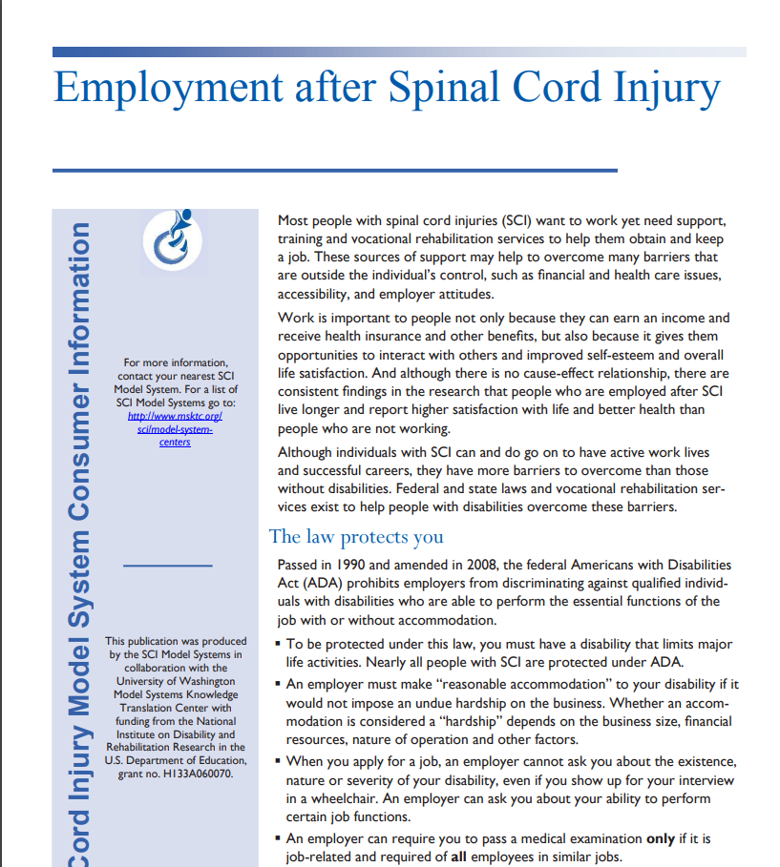
Employment after SCI
https://msktc.org/sci-topics/employment-after-sci
• Employment after SCI
• Employment after SCI

Slide 15
Exercise and Fitness after SCI
https://msktc.org/sci-topics/exercise-fitness-after-sci
• The Therapeutic Feeling of Fitness
• Things to Watch Out for When Starting an Exercise Routine
• Thinking about Exercise in a New Way
• Troubleshooting for a Better Exercise Routine
• Exercise & Fitness after SCI
• A Range of Fitness Activities
• About Hand Cycling
• About Wheelchair Rugby
• Accessing Adaptive Equipment
• Any Exercise is Better than No Exercise
• Breaking Down Barriers
• Collaborating on Accessibility
• Components of a Good Exercise Routine
• Exercise for People with High Levels of SCI
• Exercise, Health, & Happiness
• Exercising & Independence
• Horseback Riding with SCI
• Peer Support & Exercise
• Meeting Other People with SCI through Sports
• Peer Support & Exercise
• Strengthening & Protecting the Shoulders
• The Benefits of Team Sports
• Adaptive Sports & Recreation
• Exercise after SCI
• Exercise & Fitness after SCI
• Gait Training after SCI

Slide 16
Gait Training and SCI
https://msktc.org/sci/slideshows/gait-training-after-spinal-cord-injury
• SCI and Gait Training
• SCI and Gait Training

Slide 17
Managing Bowel Function
https://msktc.org/sci-topics/managing-bowel-function
• The Challenges of Maintaining a Good Diet for a Bowel Program
• Travel Challenges
• Troubleshooting and Seeking Help
• A Typical Bowel Program
• Analyzing Your Bowel Movements
• Barriers to Following a Bowel Program
• Colostomy as a Last Resort
• Dating and Sex
• Different Types of Independence
• Digital Stimulation and Evacuation by a Caregiver
• Don’t Let Your Bowels Control You
• Family Dynamics and Resilience
• Fecal Incontinence
• Fiber and Fluids
• Managing Bowel Function after SCI
• Medication, Techniques, and More
• Mental Challenges of a SCI
• Overcoming Embarrassment
• Research on the Causes of Constipation
• Technological Advanced Needed
• Bowel Function after SCI
• Managing Bowel Function after SCI
• Bowel Function after SCI

Slide 18
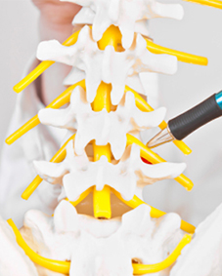
Managing Pain after SCI
https://msktc.org/sci-topics/managing-pain-after-spinal-cord-injury
• A New Standard of Care
• Asking About Pain
• Assessing Pain in People with SCI
• Coming to Terms with SCI
• Does Exercise Prevent or Reduce Pain in SCI patients
• Finding the Right Doctor
• Predicting Pain to Head It Off
• Shoulder Exercises for People with SCI
• Shoulder Pain and SCI
• The Impact of Pain
• Pain after SCI
• Managing Pain after SCI
• Pain after SCI

Slide 19
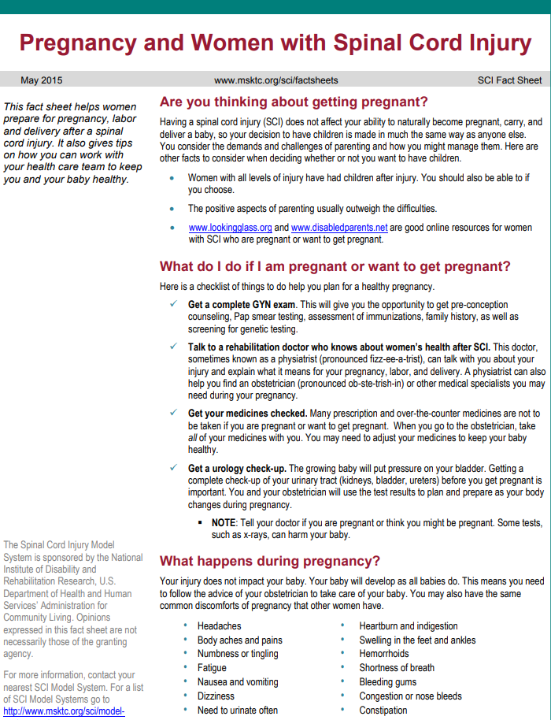
Pregnancy after SCI
https://msktc.org/sci-topics/pregnancy-sci
• Pregnancy and Women with SCI
• Pregnancy and Women with SCI

Slide 20
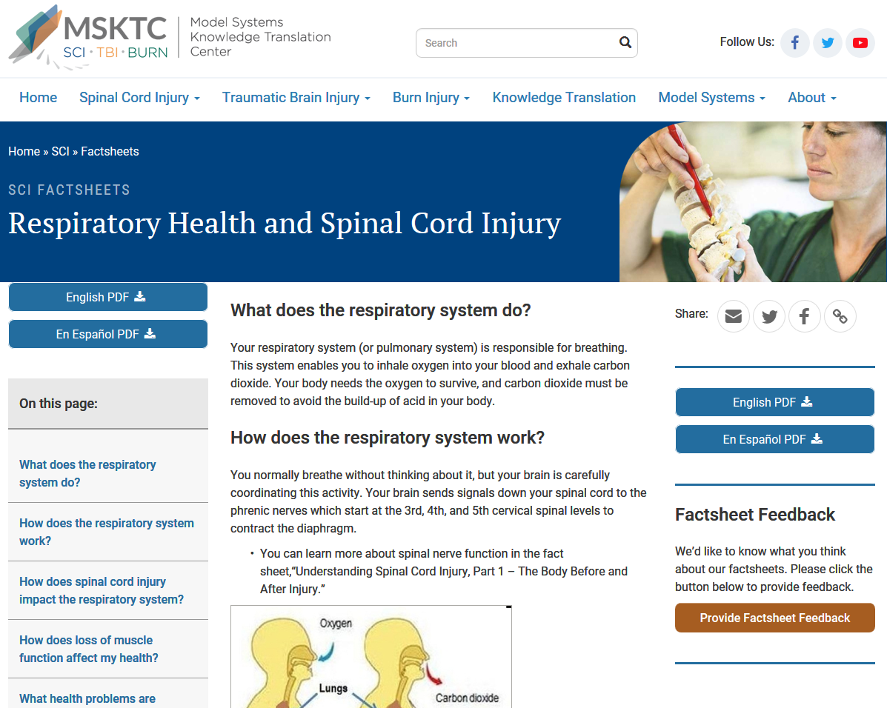
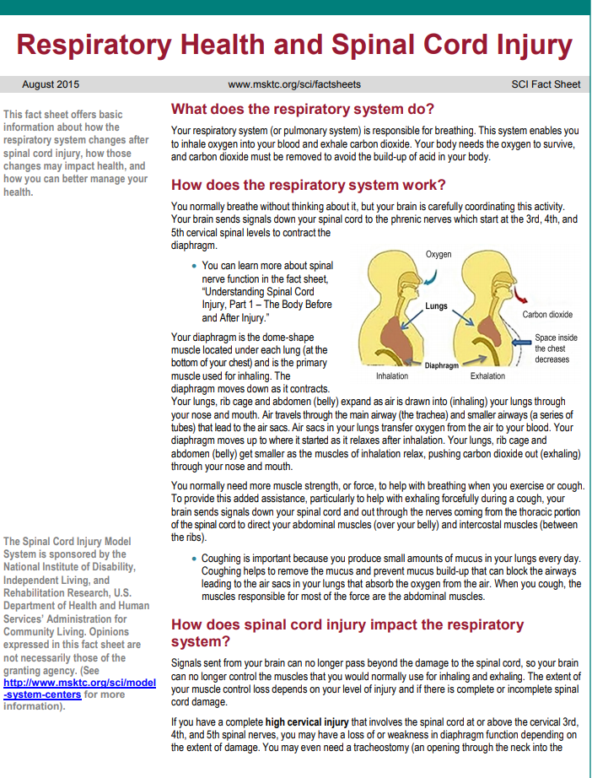
Respiratory Health and SCI
https://msktc.org/sci-topics/respiratory-health
• Respiratory Health and SCI

Slide 21
Safe Transfer Techniques
https://msktc.org/sci-topics/safe-transfer-techniques
• Safe Transfer Technique
• Safe Transfer Technique

Slide 22
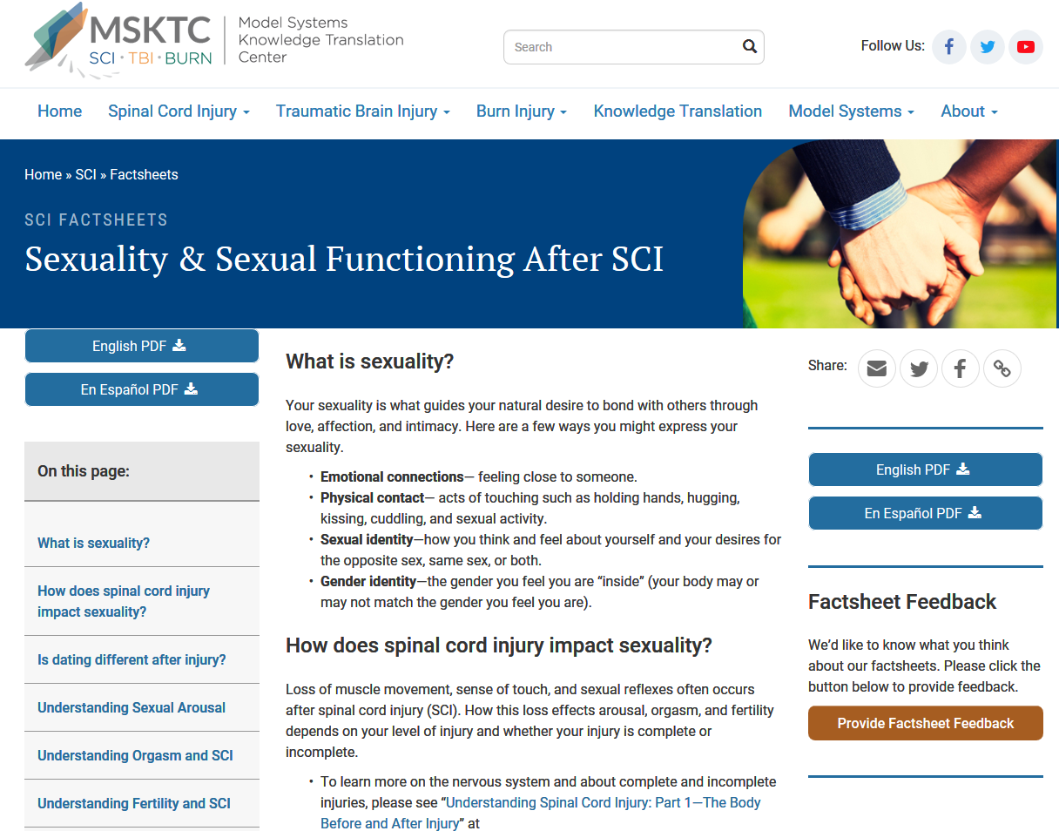
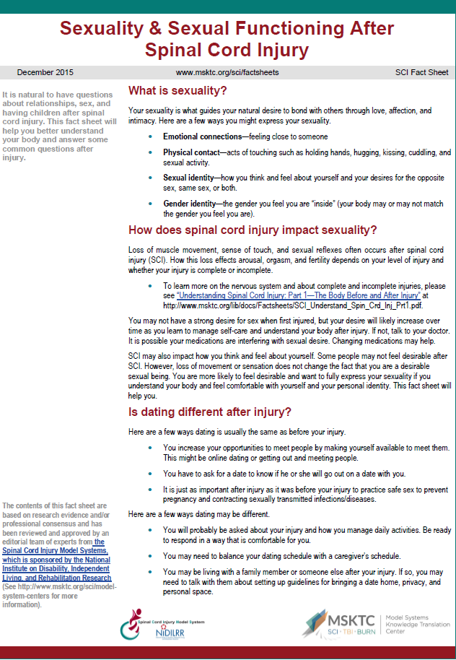
Sexuality and Sexual Functioning After SCI
https://msktc.org/sci-topics/sexuality
• Sexuality and Sexual Functioning After SCI

Slide 23
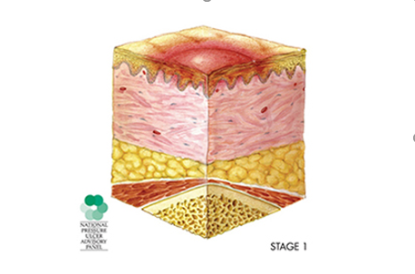
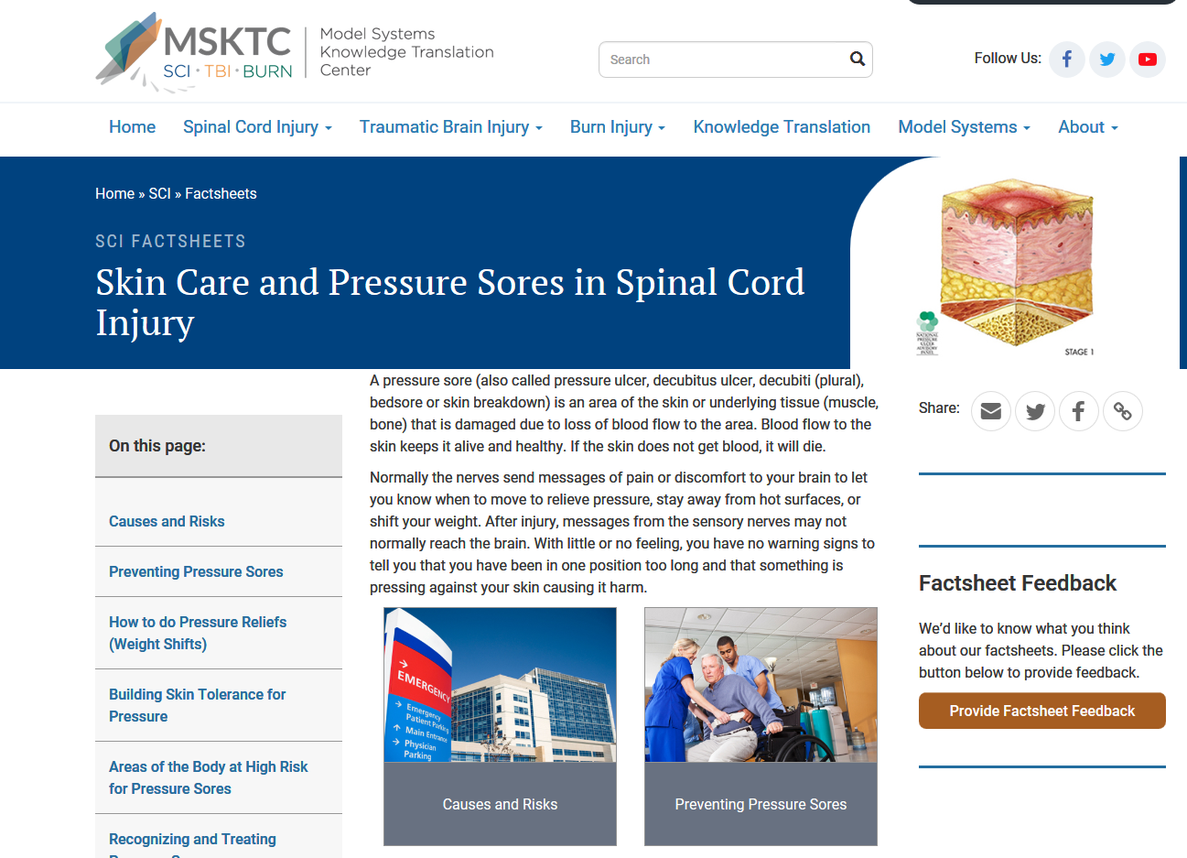
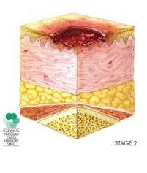
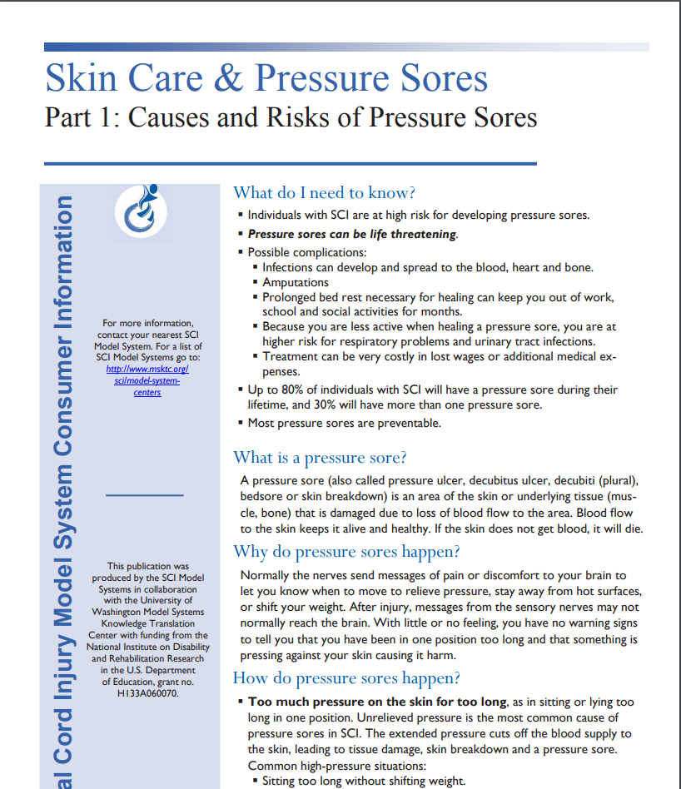
Skin Care and Pressure Sores
https://msktc.org/sci-topics/skin-care-pressure-sores
• Areas at High Risk for Developing Pressure Sores
• Building Skin Tolerance for Pressure
• Causes and Risks
• Preventing Pressure Sores
• Recognizing and Treating Pressure Sores
• Skin Care and Pressure Sores in SCI

Slide 24
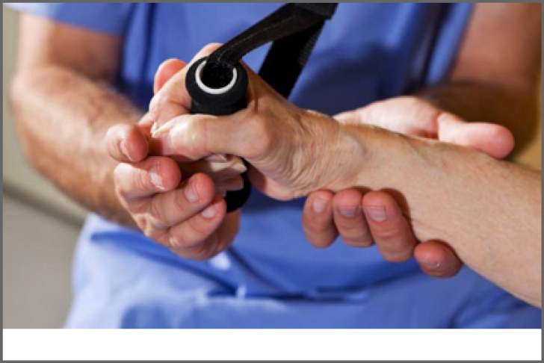
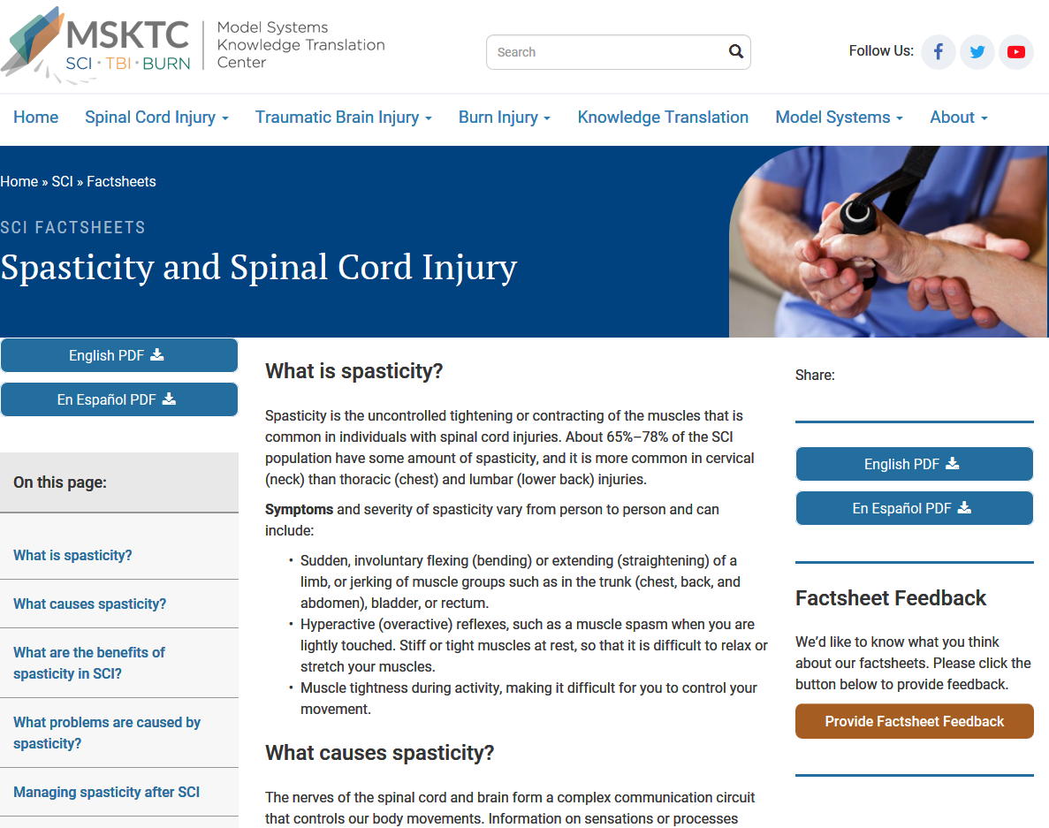
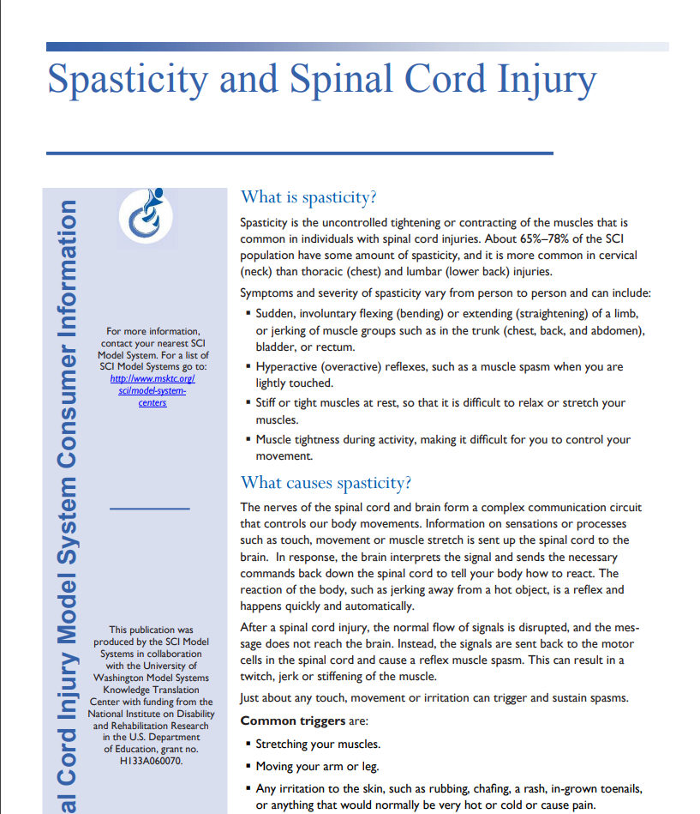
Spasticity and SCI
https://msktc.org/sci-topics/spasticity-sci
• Spasticity and SCI

Slide 25
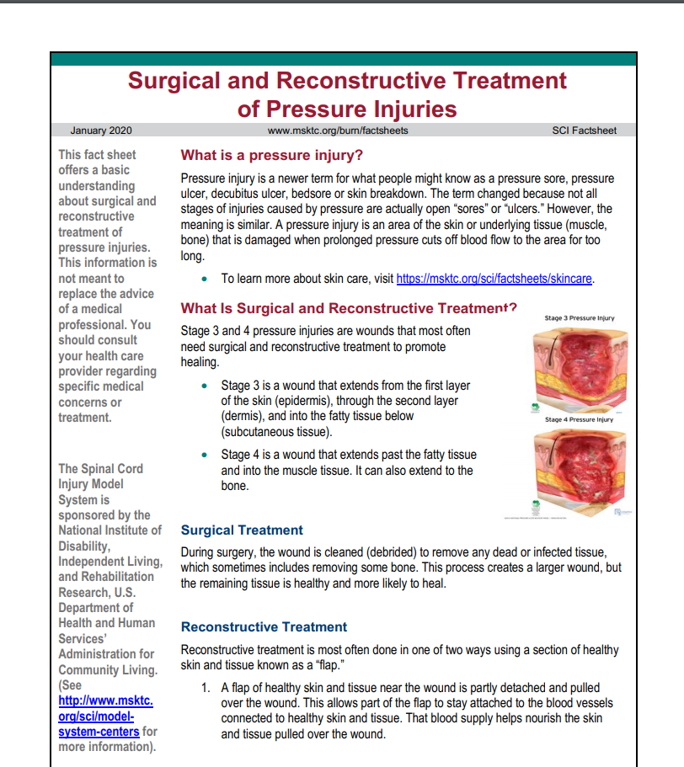
Surgical and Reconstructive Treatment of Pressure Injuries
https://msktc.org/sci-topics/surgical-and-reconstructive-treatment-pressure-injuries
• Surgical and Reconstructive Treatment of Pressure Injuries

Slide 26
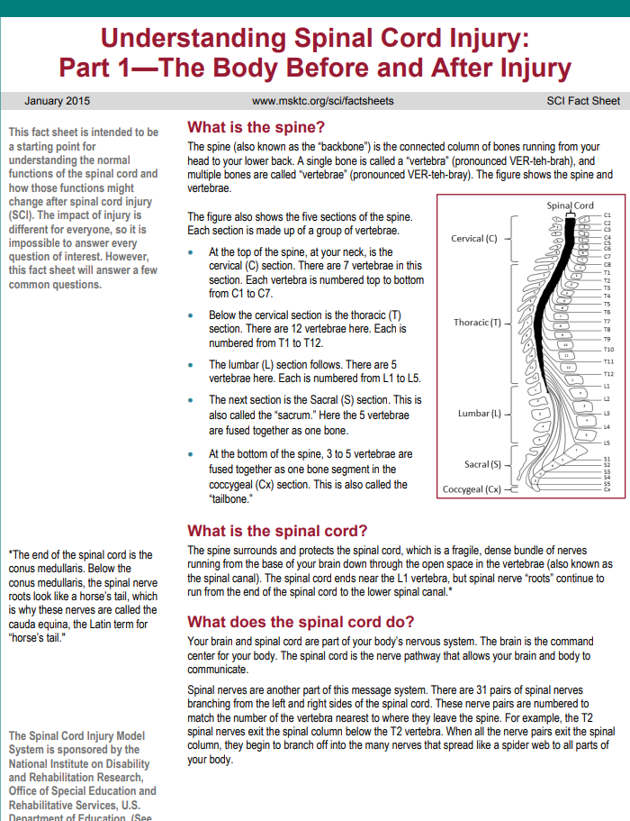
Understanding SCI
https://msktc.org/sci-topics/understanding-sci
• Understanding SCI: Part 1—The Body Before and After Injury
• Understanding SCI: Part 2—Recovery and Rehabilitation

Slide 27
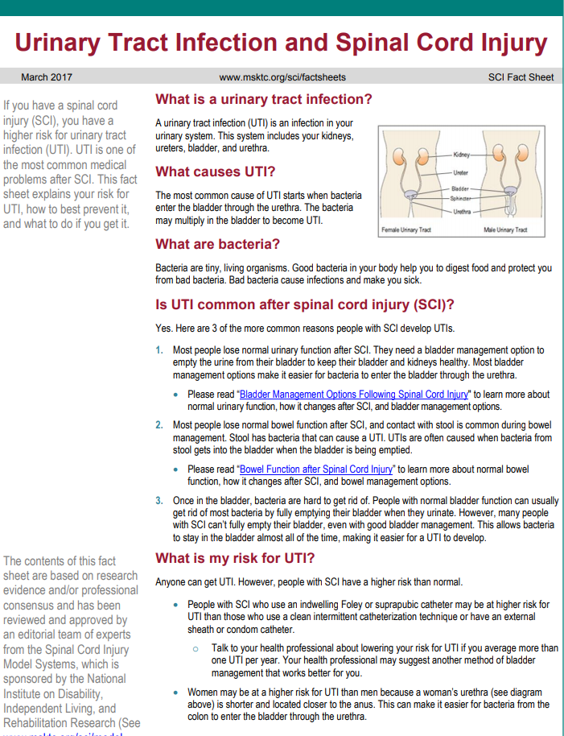
Urinary Tract Infection and SCI
https://msktc.org/sci-topics/urinary-tract-infection
• Urinary Tract Infection and SCI

Slide 28
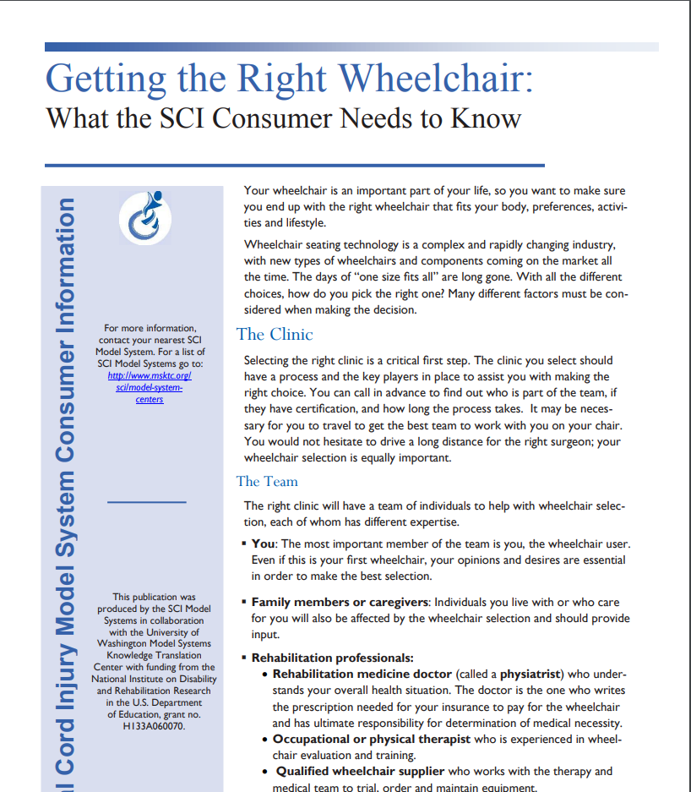
Wheelchair Information
https://msktc.org/sci-topics/wheelchair-information
• Getting the Right Wheelchair: What the SCI Consumer Needs to Know
• The Manual Wheelchair: What the SCI Consumer Needs to Know
• The Power Wheelchair: What the SCI Consumer Needs to Know

Slide 29
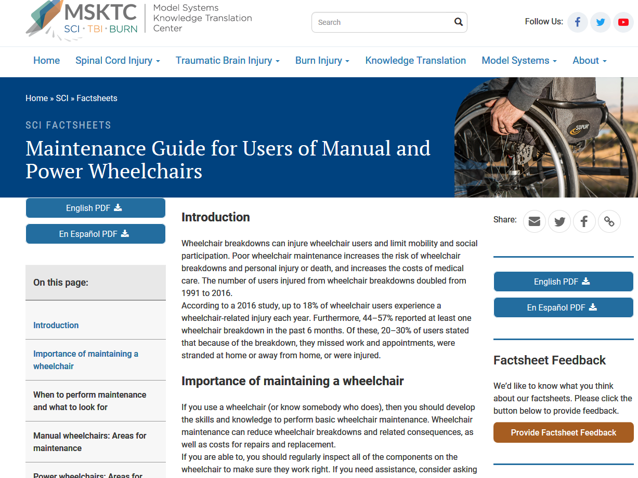
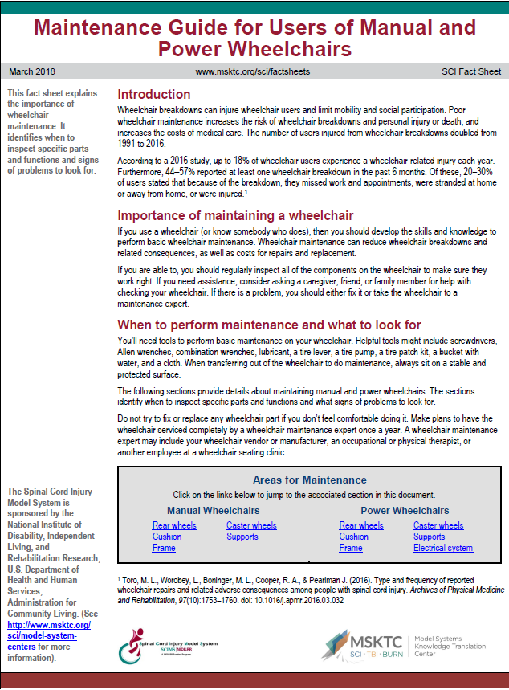
Maintenance Guide
https://msktc.org/sci/factsheets/maintenance-guide-users-manual-and-power-wheelchairs
• Maintenance Guide for Users of Manual and Power Wheelchairs

Slide 30
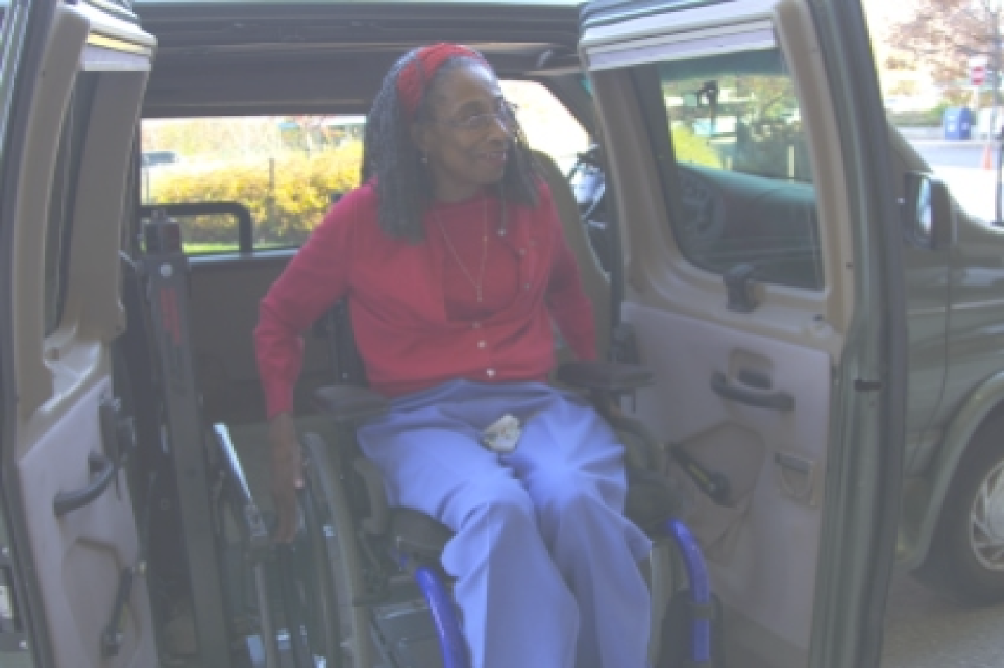
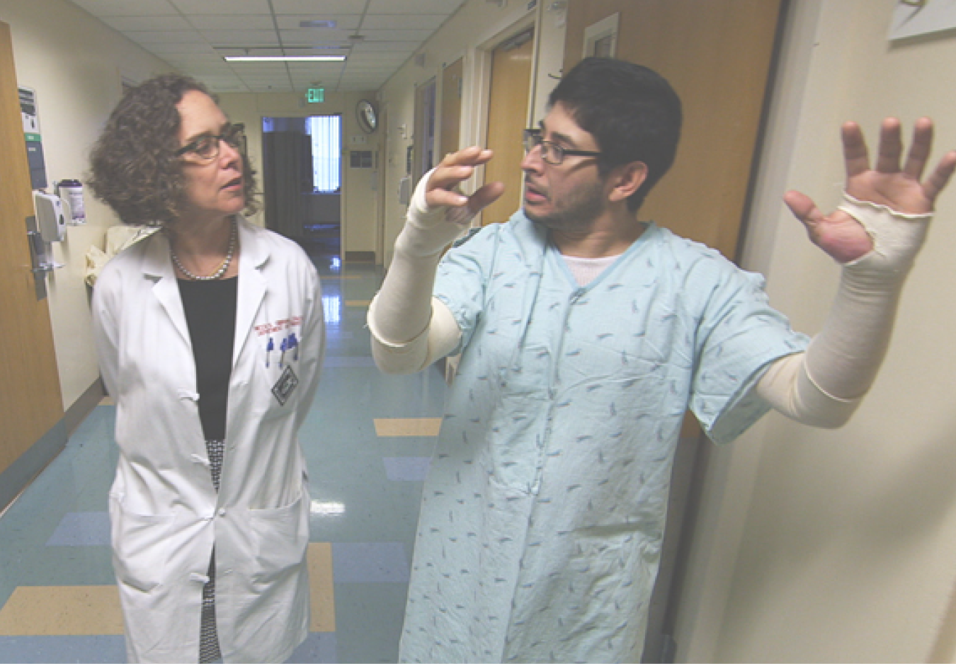
Visit the MSKTC Website
Spinal Cord Injury
msktc.org/sci
Traumatic Brain Injury
msktc.org/tbi
Burn Injury
msktc.org/burn

