Slide 1
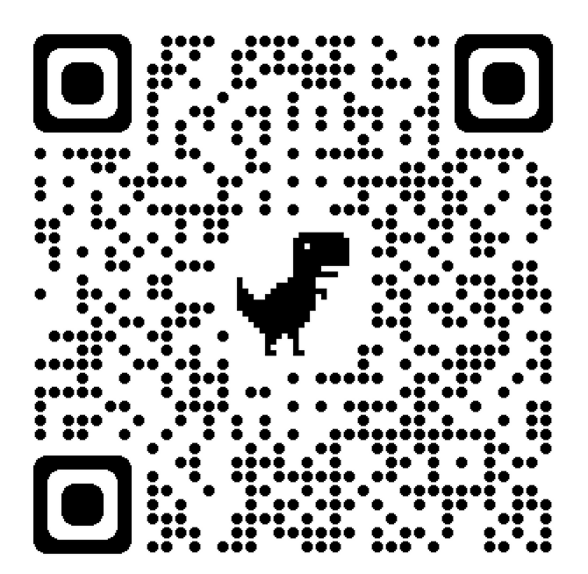
Model Systems Knowledge Translation Center Spinal Cord Injury Resource Inventory
Model Systems Knowledge Translation Center
7th Edition
March 2024

Slide 2
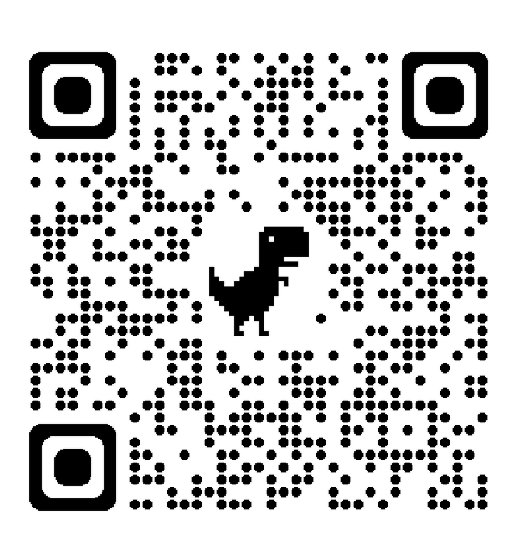
About SCI Model Systems
The Spinal Cord Injury (SCI) Model Systems program, sponsored by the National Institute on Disability, Independent Living, and Rehabilitation Research (NIDILRR), Administration for Community Living, U.S. Department of Health and Human Services, supports innovative projects and research in the delivery, demonstration, and evaluation of medical, rehabilitation, vocational and other services to meet the needs of individuals with SCI.
NIDILRR awards SCI Model Systems grants to institutions that are national leaders in medical research and patient care and provide the highest level of comprehensive specialty services, from the point of injury through rehabilitation and re-entry into full community life.
There are 18 currently-funded SCI Model System Centers.
Each SCI Model System Center contributes data to the National SCI Statistical Center, participates in independent and collaborative research, and provides information and resources to individuals with SCI, their family and caregivers, health care professionals, and the general public.

Slide 3
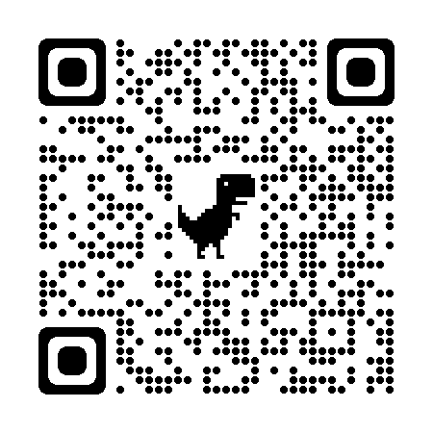
About the Model Systems Knowledge Translation Center (MSKTC)
The Model Systems Knowledge Translation Center (MSKTC) is a national center that provides free research-based resources to support people living with spinal cord injury (SCI) as well as traumatic brain injury and burn injury and those who support them.
The MSKTC works closely with the Spinal Cord Injury Model System (SCIMS) researchers as well people with lived experience to ensure the resources are research-based and user-friendly.
The MSKTC and the SCIMS are funded by NIDILRR.

Slide 4
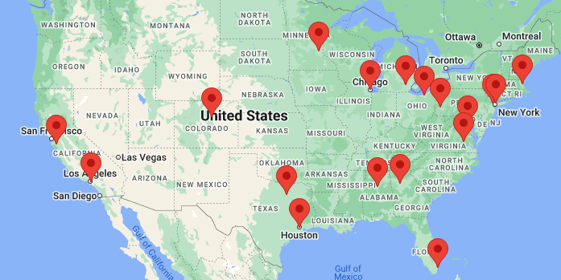
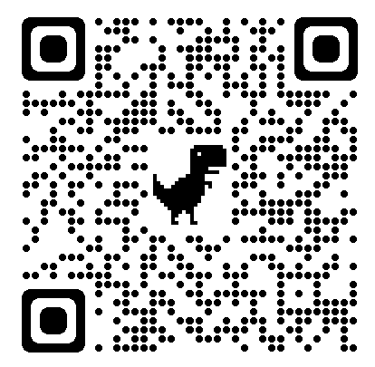
Current SCI Model System Centers
https://msktc.org/sci/model-system-centers

Slide 5
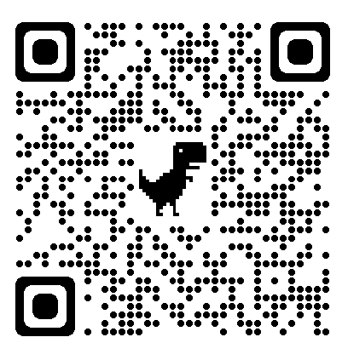
About SCI Model Systems Database
The National SCI Model Systems Database – established in 1973 – captures data from an estimated 6% of new SCI cases in the U.S.
32 federally-funded SCI Model Systems have contributed data.
As of June 2022, the database contained information on 51,000 persons with SCI.
It is the world’s largest and longest active SCI research database.
It is the world’s most extensive source of available information about the characteristics and life course of individuals with SCI.
To assure comparability of data, rigid scientific criteria have been established for the collection, management, and analysis of information entered into the database.
Visit the SCI Model Systems Database: https://www.nscisc.uab.edu/.

Slide 6
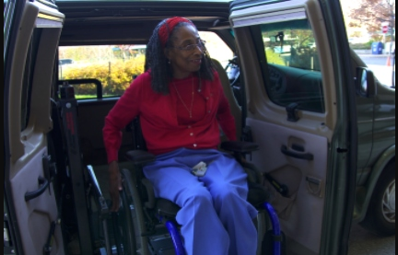
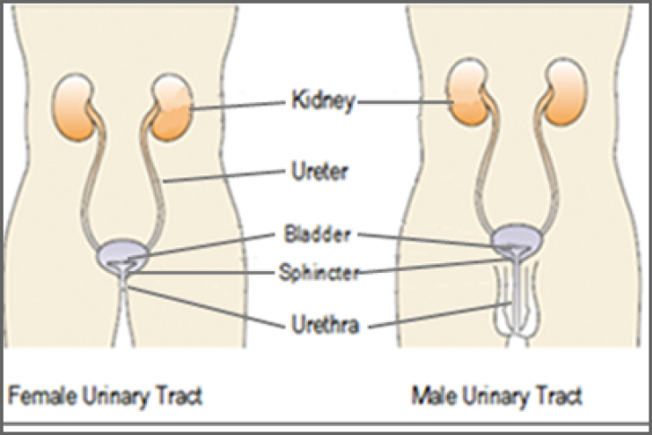
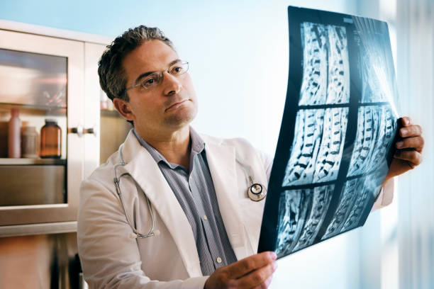
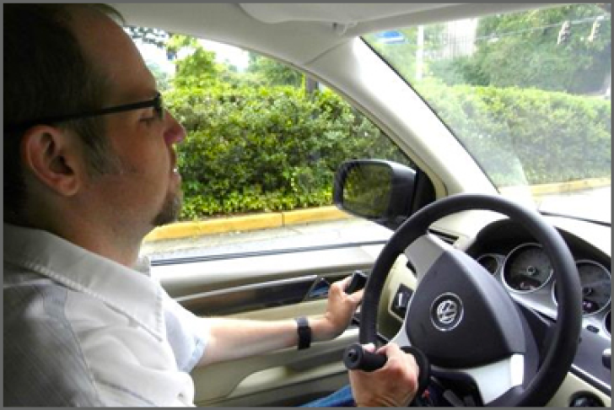
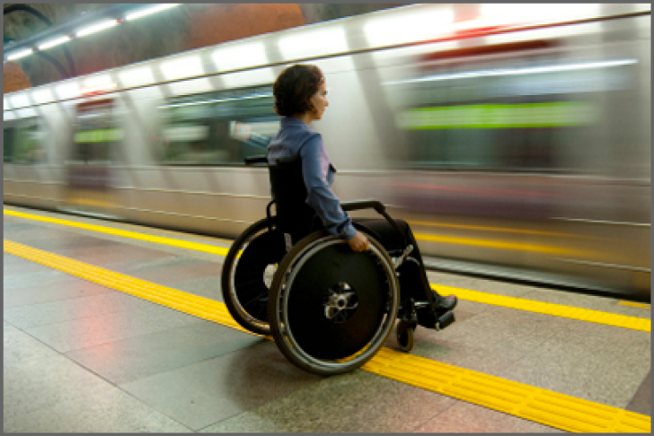
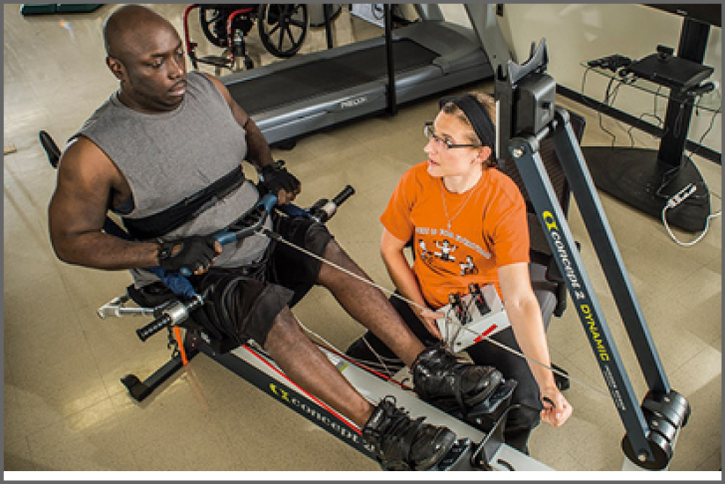
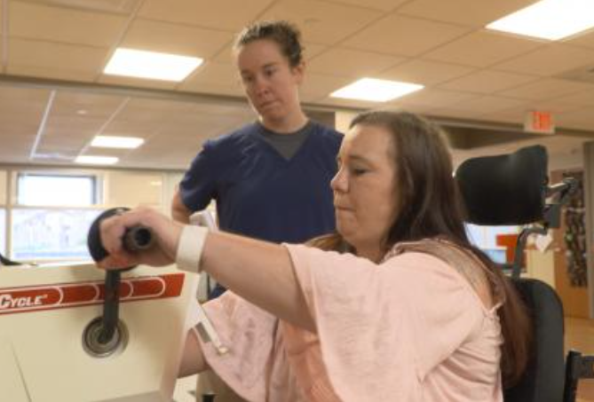
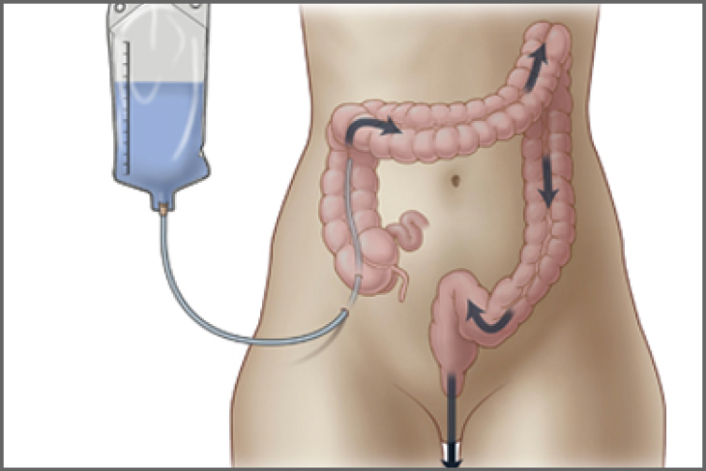
Living with Spinal Cord Injury (SCI)
https://msktc.org/sci
ALL TOPICS
Adjusting to Life
Aging and SCI
Autonomic Dysreflexia
Bladder Management
Bone Loss after SCI
Depression and SCI
Driving after SCI
Employment after SCI
Exercise and Fitness after SCI
Gait Training and SCI
Inpatient Rehab Services
Managing Bowel Function

Slide 7
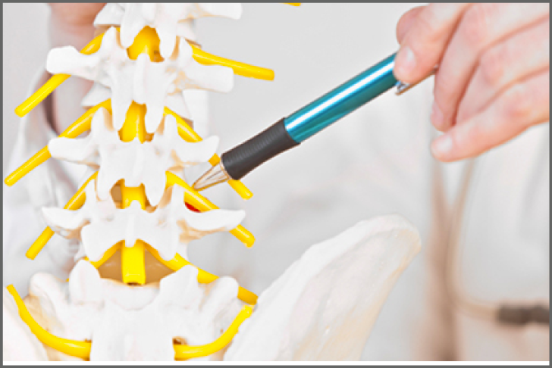
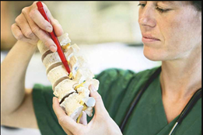
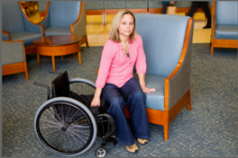
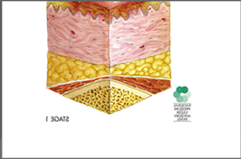
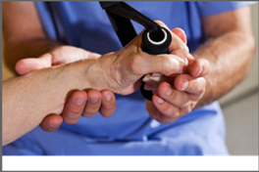
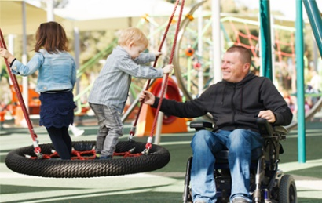
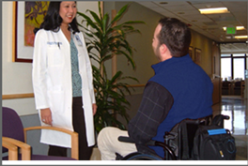
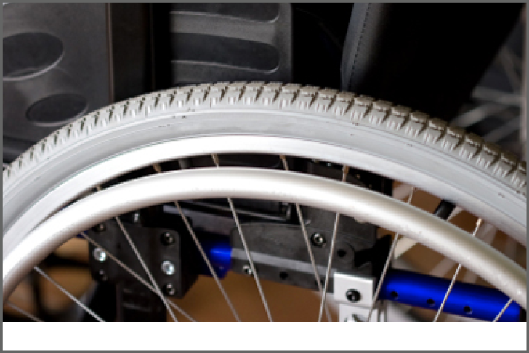
Living with Spinal Cord Injury (SCI)
https://msktc.org/sci
ALL TOPICS
Autonomic Dysreflexia
Managing Pain after SCI
Personal Care Attendants
Pregnancy and SCI
Adjusting to Life
Spasticity and SCI
Wheelchair Information

Slide 8
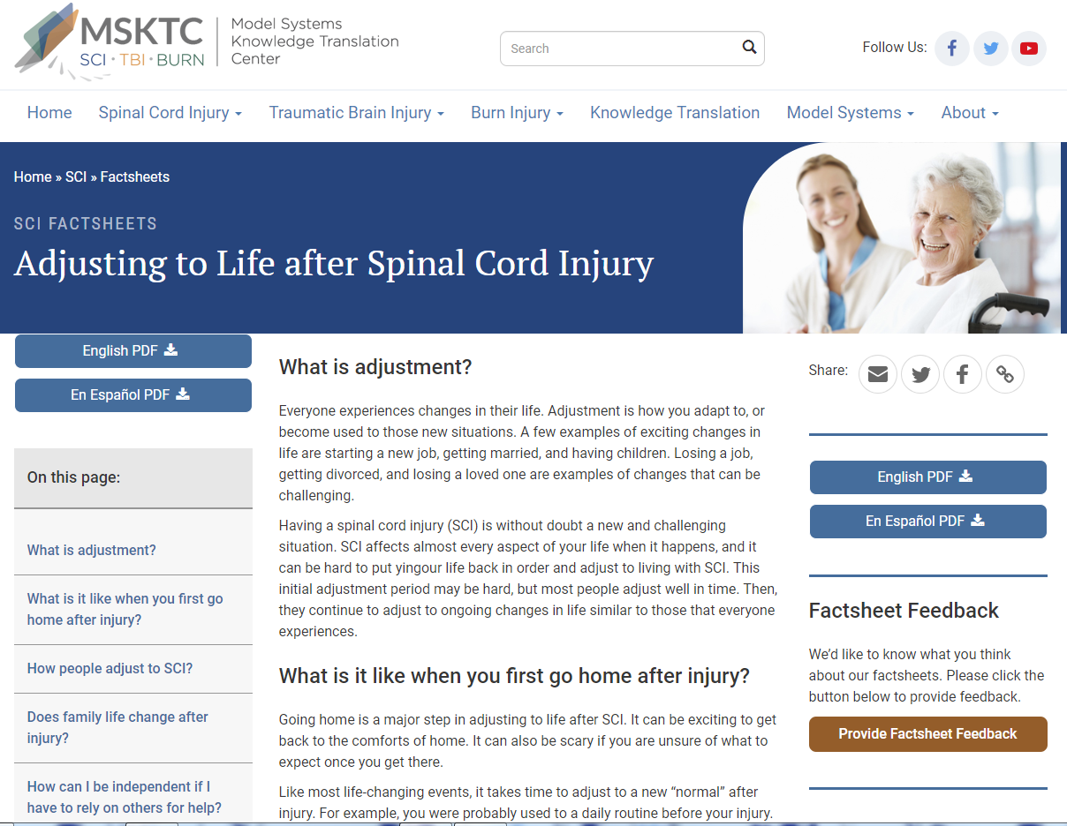
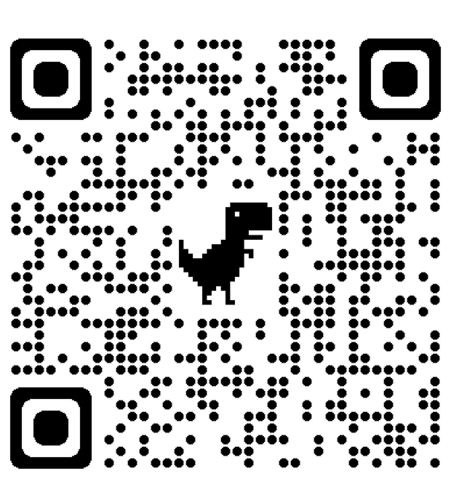
Adjusting to Life after SCI
https://msktc.org/sci-topics/adjusting-life
• Adjusting to Life after SCI

Slide 9
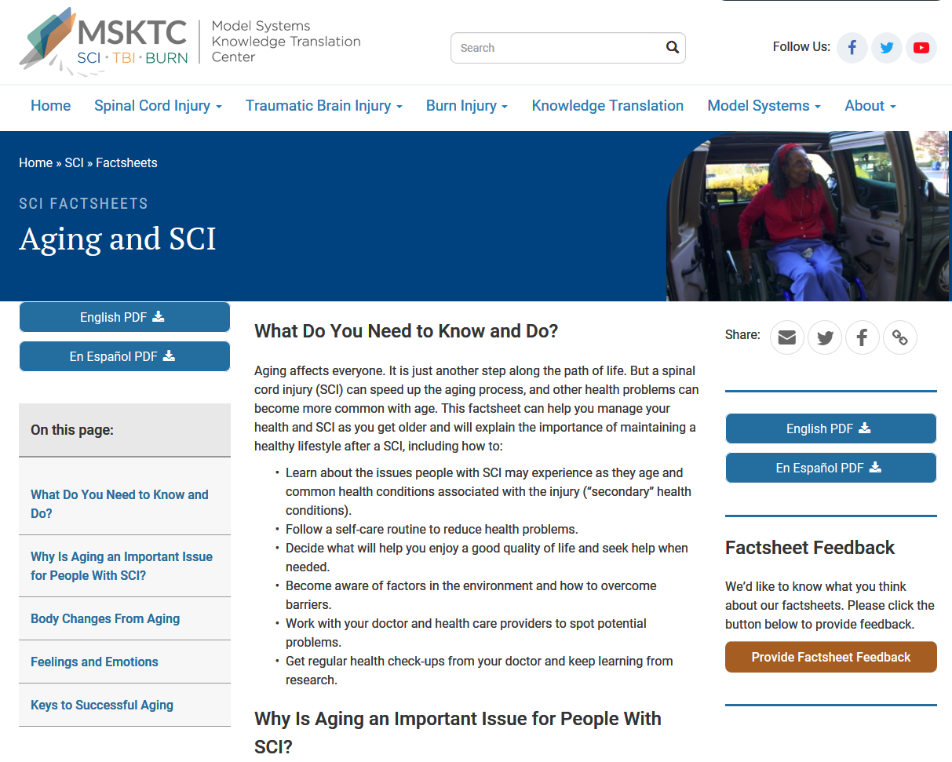
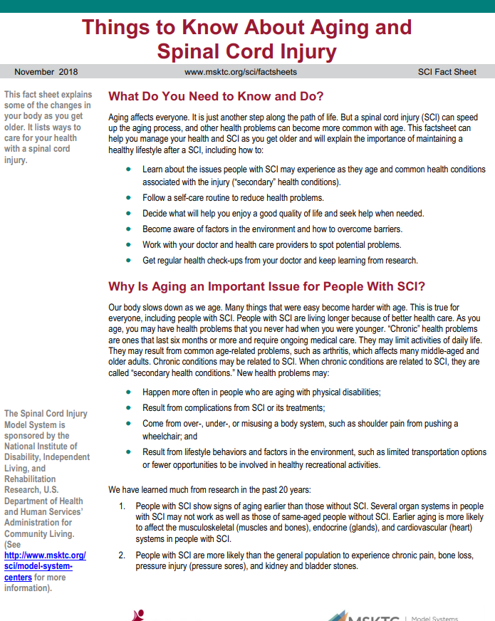
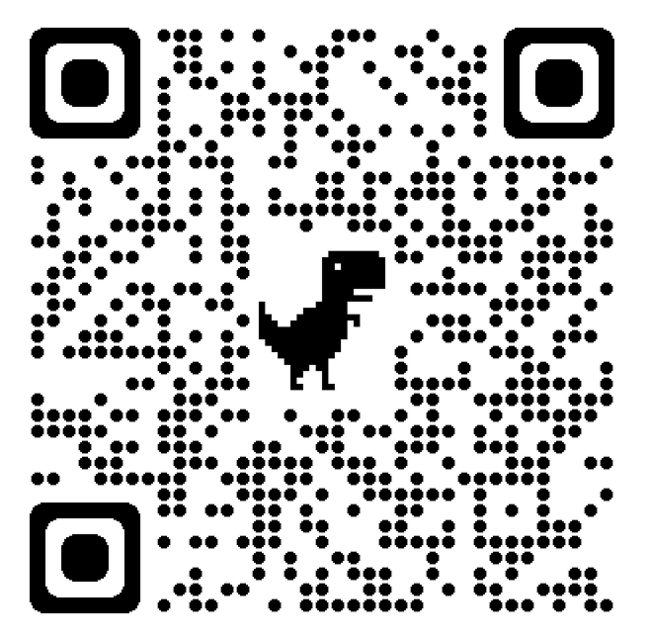
Aging and SCI
https://msktc.org/sci-topics/aging-sci
• Things to Know About Aging and SCI

Slide 10
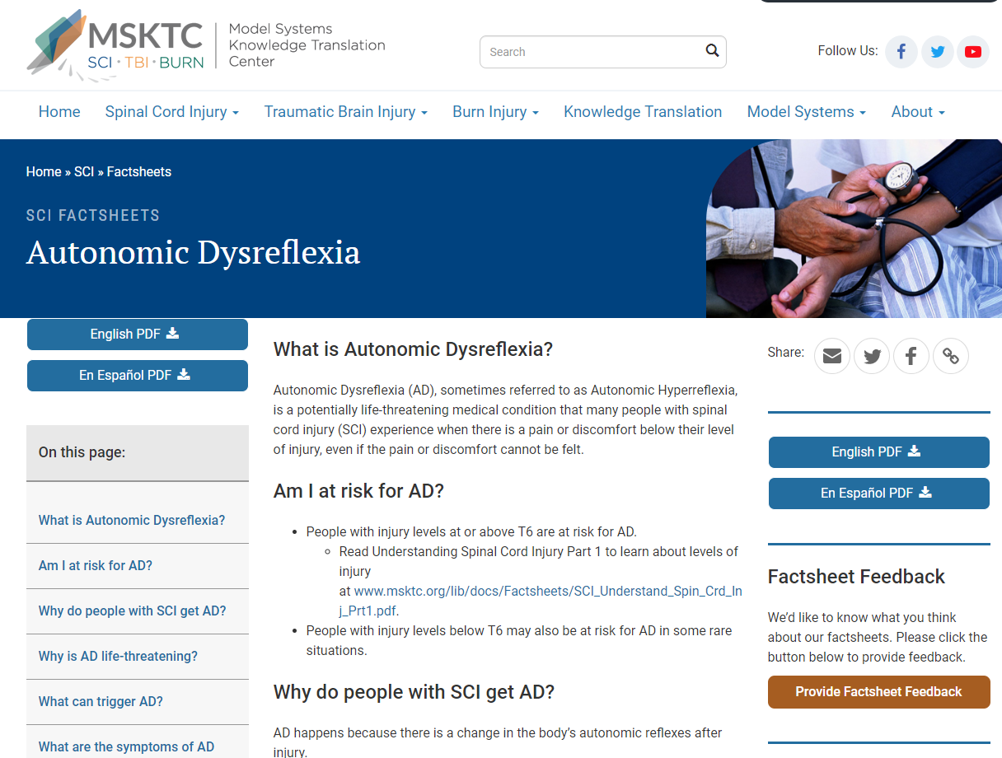
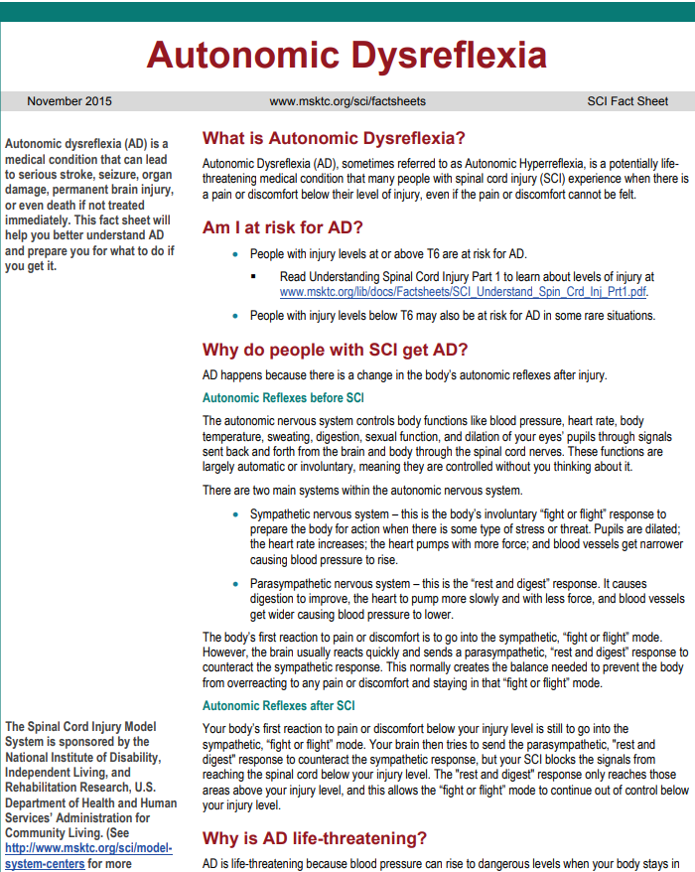
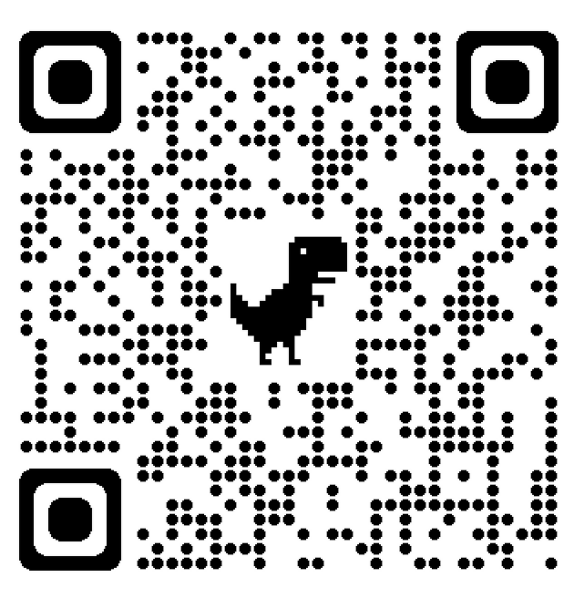
Autonomic Dysreflexia
https://msktc.org/sci-topics/autonomic-dysreflexia
• Autonomic Dysreflexia

Slide 11
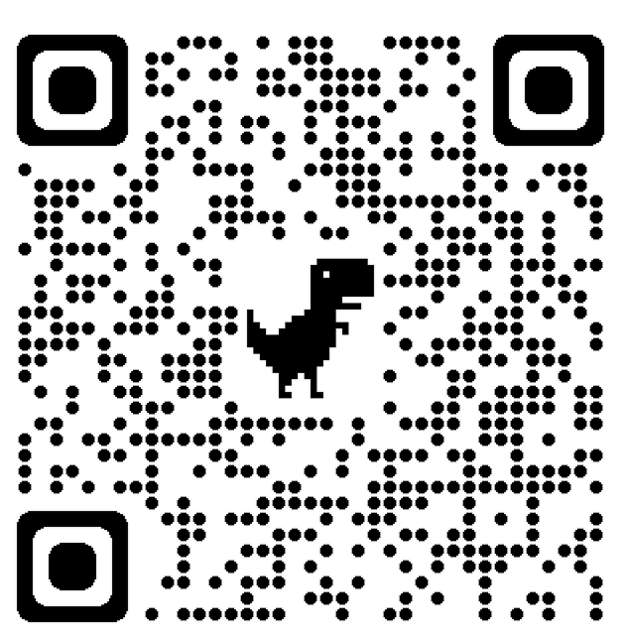
Bladder Management
https://msktc.org/sci-topics/bladder-management
• Bladder Management Options Following SCI
• Surgical Alternatives for Bladder Management Following SCI

Slide 12
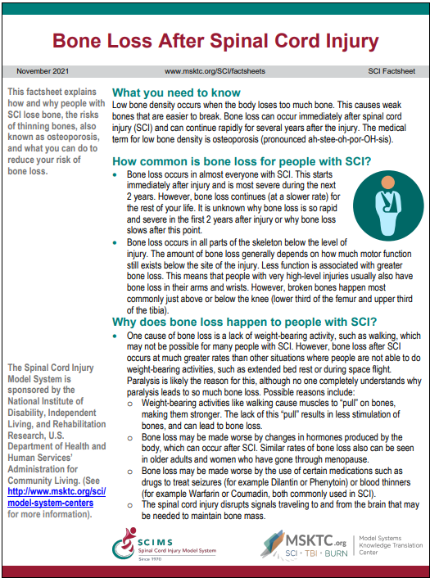
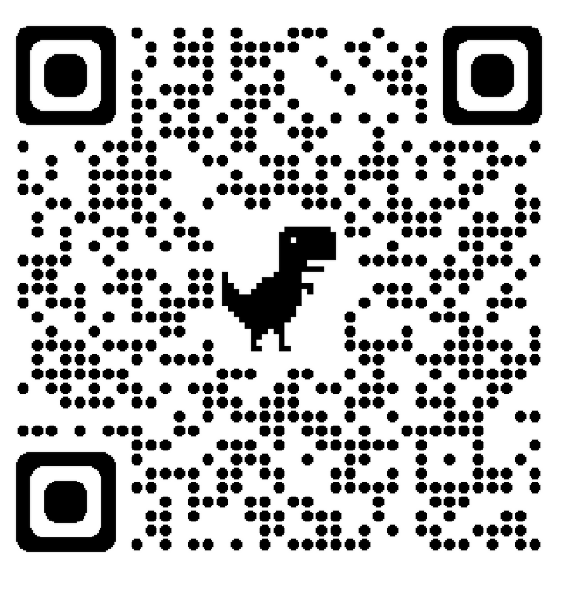
Bone Loss After Spinal Cord Injury
https://msktc.org/sci/factsheets/bone-loss-after-spinal-cord-injury
• Bone Loss After SCI

Slide 13
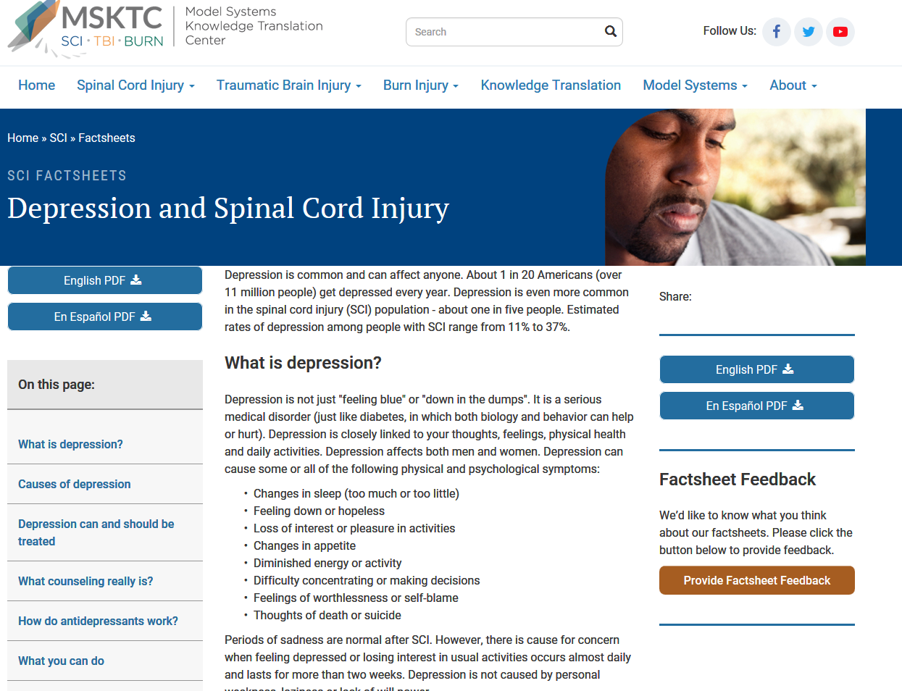
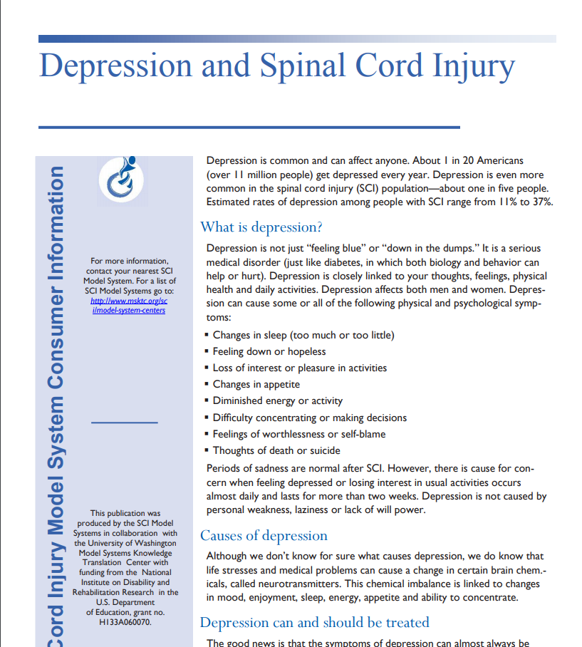
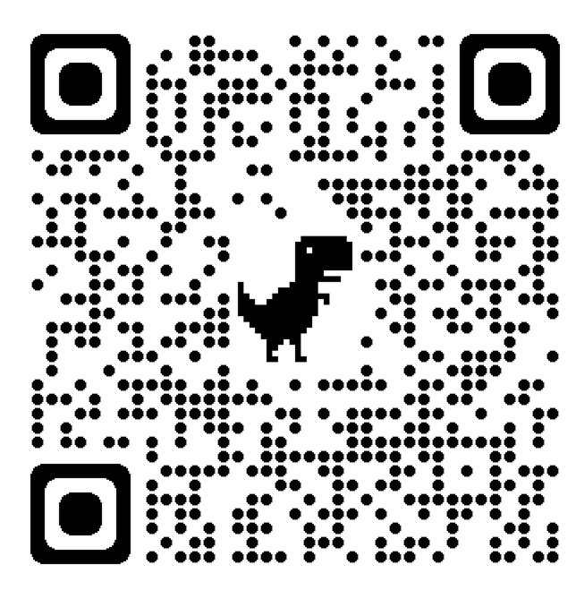
Depression and SCI
https://msktc.org/sci-topics/depression-sci
• Depression and SCI

Slide 14
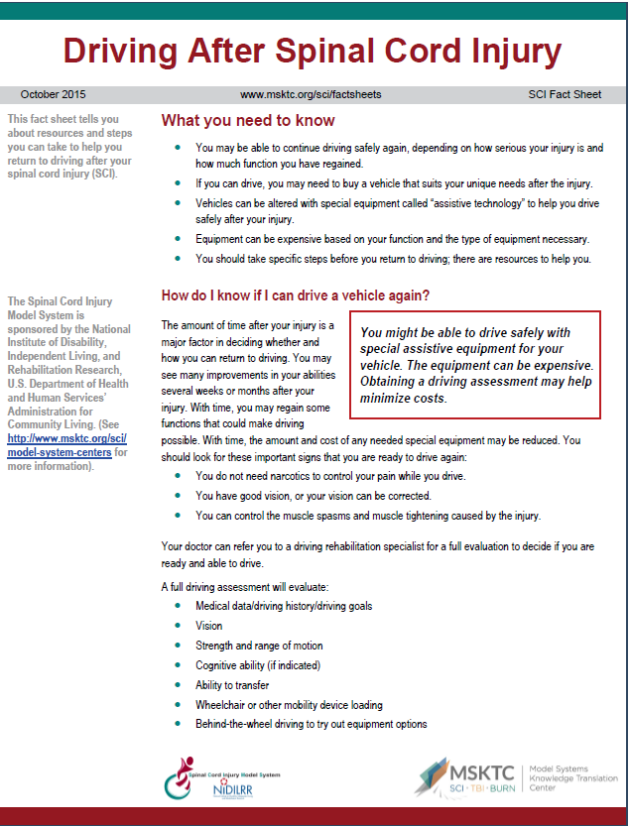
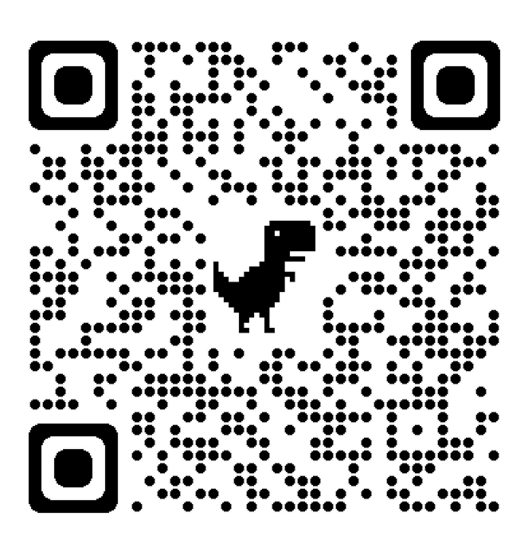
Driving after SCI
https://msktc.org/sci-topics/driving
• Driving after SCI

Slide 15
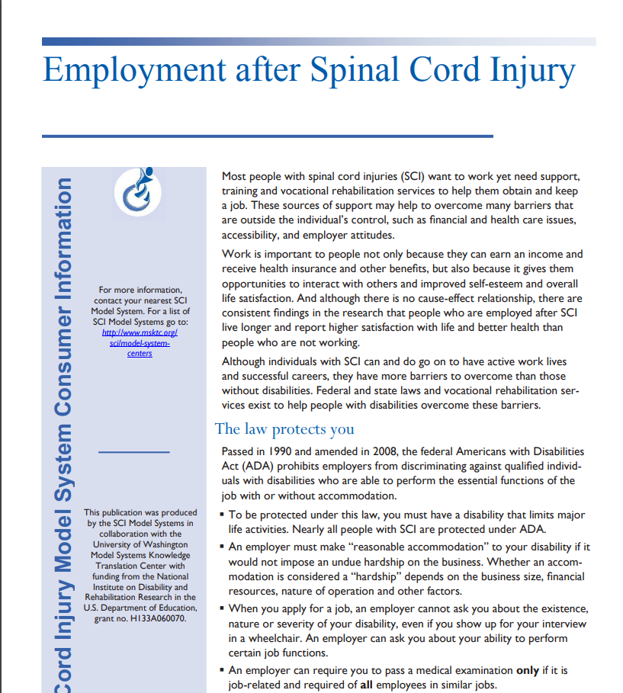
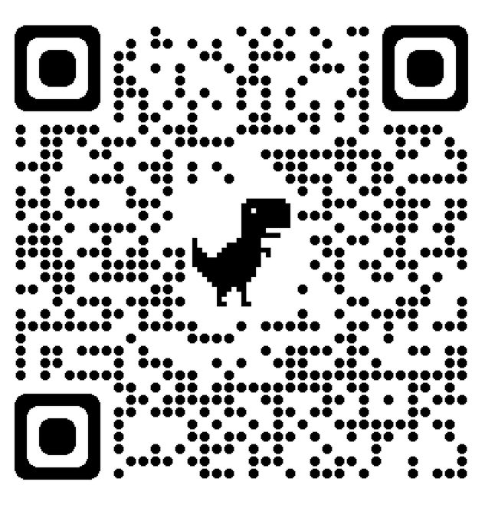
Employment after SCI
https://msktc.org/sci-topics/employment-after-sci
• Employment after SCI
• Employment after SCI

Slide 16
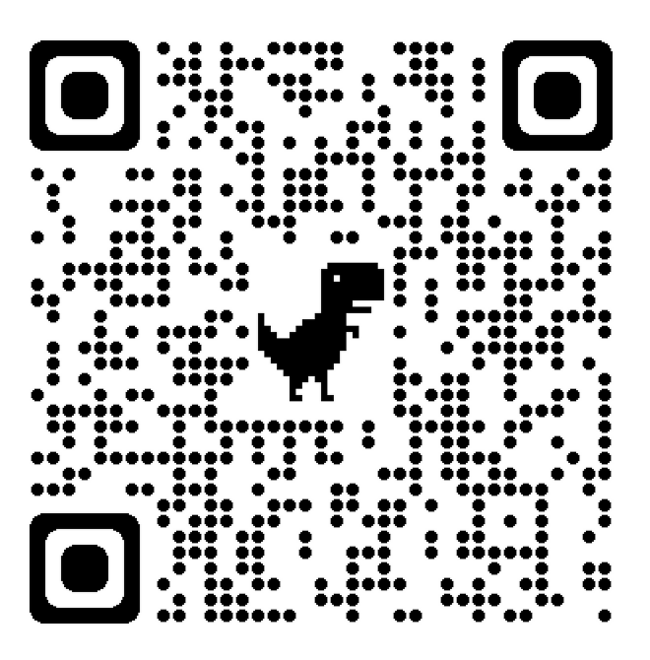
Exercise and Fitness after SCI
https://msktc.org/sci-topics/exercise-fitness-after-sci
• The Therapeutic Feeling of Fitness
• Things to Watch Out for When Starting an Exercise Routine
• Thinking about Exercise in a New Way
• Troubleshooting for a Better Exercise Routine
• Exercise & Fitness after SCI
• A Range of Fitness Activities
• About Hand Cycling
• About Wheelchair Rugby
• Accessing Adaptive Equipment
• Any Exercise is Better than No Exercise
• Breaking Down Barriers
• Collaborating on Accessibility
• Components of a Good Exercise Routine
• Exercise for People with High Levels of SCI
• Exercise, Health, & Happiness
• Exercising & Independence
• Horseback Riding with SCI
• Peer Support & Exercise
• Meeting Other People with SCI through Sports
• Peer Support & Exercise
• Strengthening & Protecting the Shoulders
• The Benefits of Team Sports
• Adaptive Sports & Recreation
• Exercise after SCI
• Exercise & Fitness after SCI
• Gait Training after SCI

Slide 17
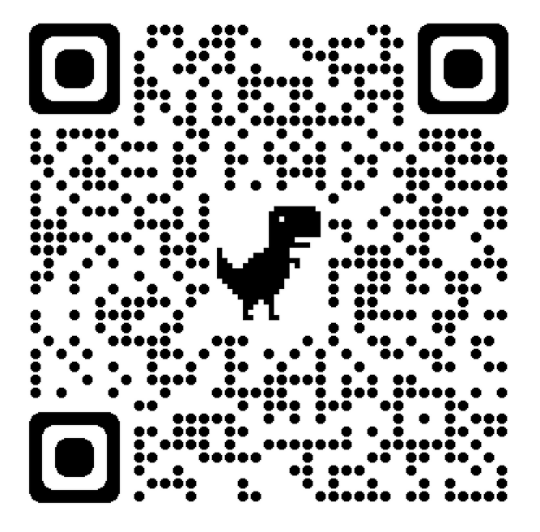
Gait Training and SCI
https://msktc.org/sci/slideshows/gait-training-after-spinal-cord-injury
• SCI and Gait Training
• SCI and Gait Training

Slide 18
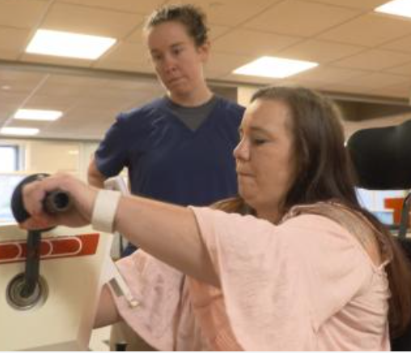
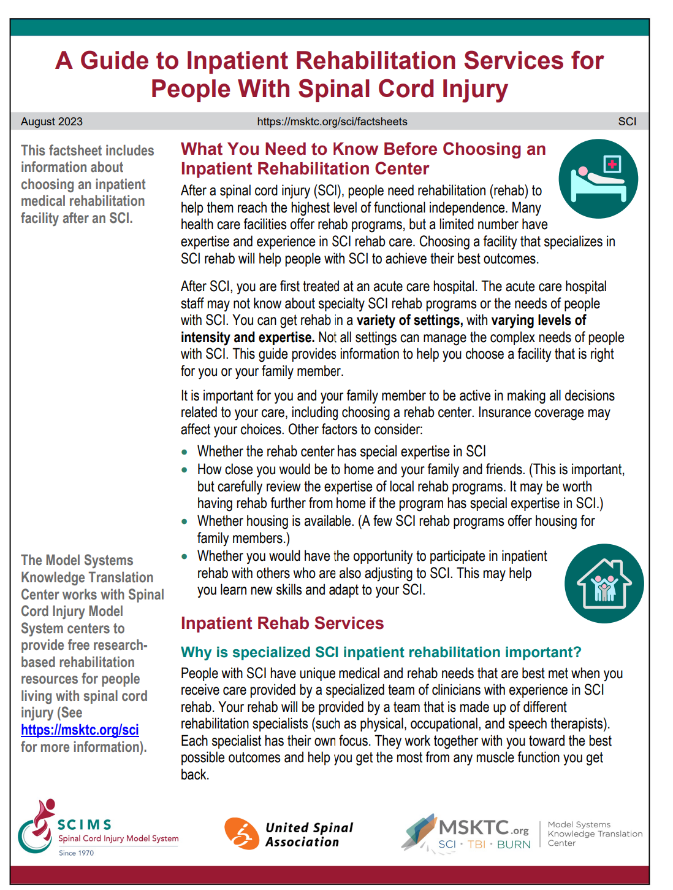
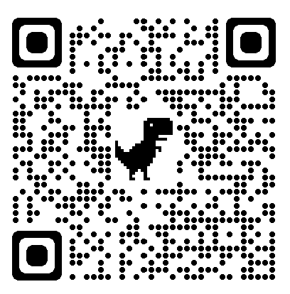
Inpatient Rehab Services
https://msktc.org/sci/sci-topics/inpatient-rehab-services-and-sci
• A Guide to Inpatient Rehabilitation Services for People with SCI

Slide 19
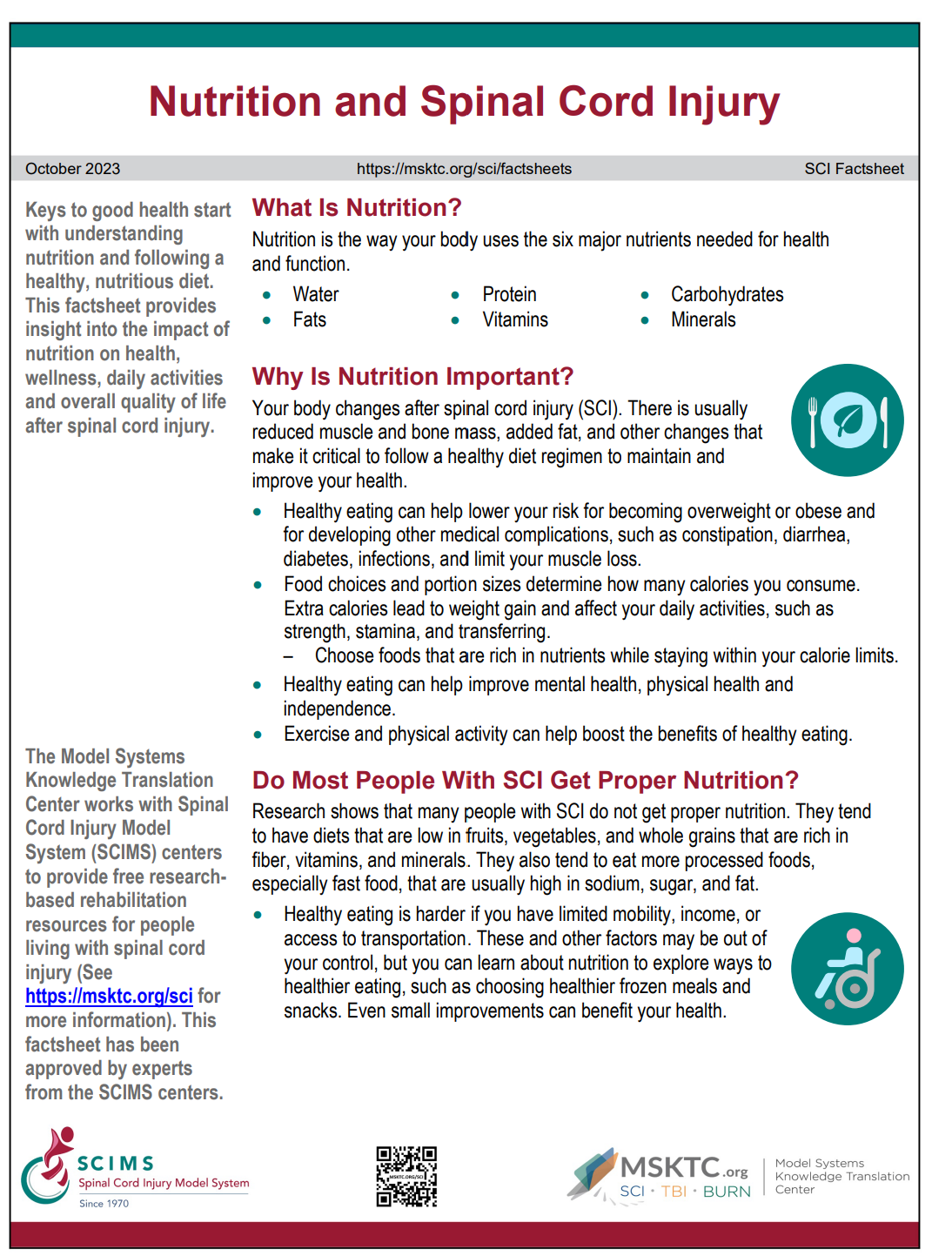
Nutrition and SCI
https://msktc.org/sci/sci-topics/nutrition-and-sci
• Nutrition and SCI

Slide 20
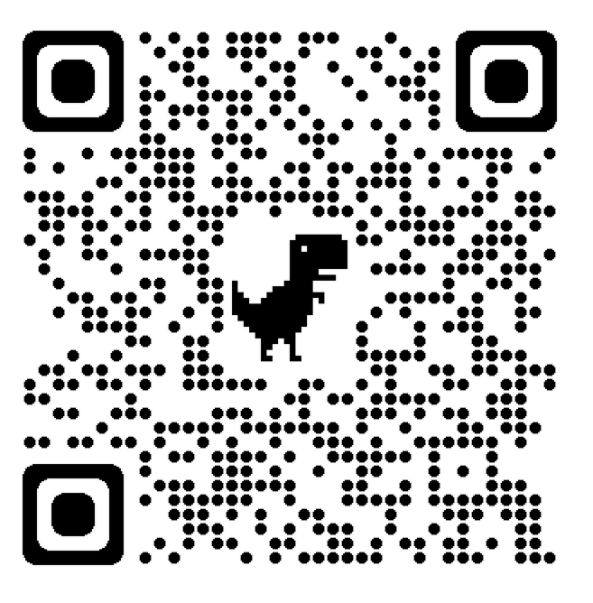
Managing Bowel Function
https://msktc.org/sci-topics/managing-bowel-function
• The Challenges of Maintaining a Good Diet for a Bowel Program
• Travel Challenges
• Troubleshooting and Seeking Help
• A Typical Bowel Program
• Analyzing Your Bowel Movements
• Barriers to Following a Bowel Program
• Colostomy as a Last Resort
• Dating and Sex
• Different Types of Independence
• Digital Stimulation and Evacuation by a Caregiver
• Don’t Let Your Bowels Control You
• Family Dynamics and Resilience
• Fecal Incontinence
• Fiber and Fluids
• Managing Bowel Function after SCI
• Medication, Techniques, and More
• Mental Challenges of a SCI
• Overcoming Embarrassment
• Research on the Causes of Constipation
• Technological Advanced Needed
• Bowel Function after SCI
• Managing Bowel Function after SCI
Infocomic

Slide 21
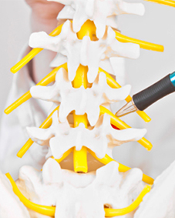
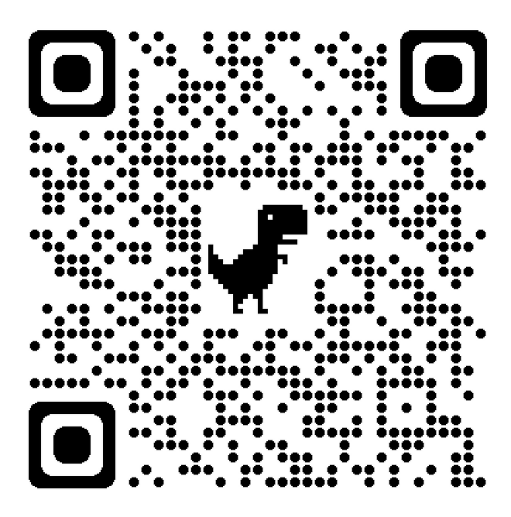
Managing Pain after SCI
https://msktc.org/sci-topics/managing-pain-after-spinal-cord-injury
• A New Standard of Care
• Asking About Pain
• Assessing Pain in People with SCI
• Coming to Terms with SCI
• Does Exercise Prevent or Reduce Pain in SCI patients
• Finding the Right Doctor
• Predicting Pain to Head It Off
• Shoulder Exercises for People with SCI
• Shoulder Pain and SCI
• The Impact of Pain
• Pain after SCI
• Managing Pain after SCI
• Pain after SCI

Slide 22
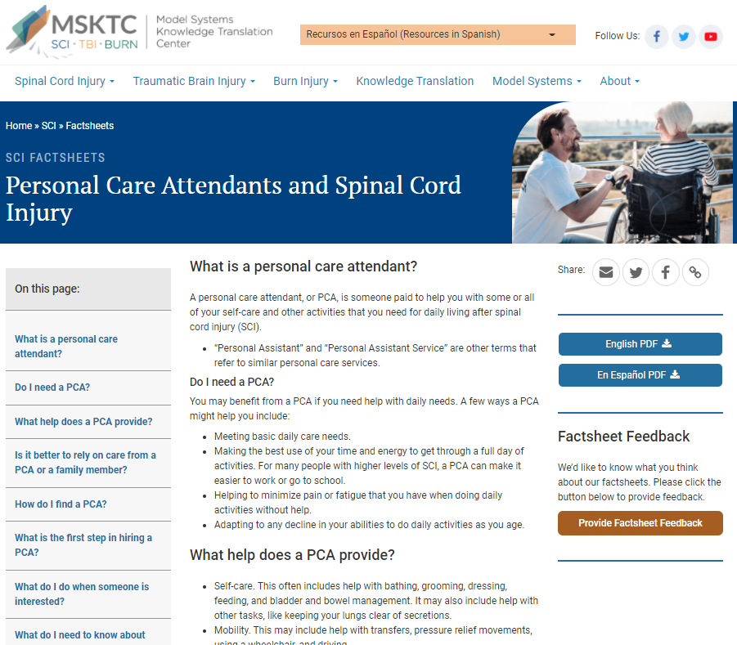
Personal Care Attendants and SCI
https://msktc.org/sci/factsheets/personal-care-attendants-and-spinal-cord-injury
• Personal Care Attendants and SCI

Slide 23
Pregnancy after SCI
https://msktc.org/sci-topics/pregnancy-sci
• Pregnancy and Women with SCI
Infocomic

Slide 24
Respiratory Health and SCI
https://msktc.org/sci-topics/respiratory-health
• Respiratory Health and SCI
Infocomic
• Respiratory Health and SCI

Slide 25
Safe Transfer Techniques
https://msktc.org/sci-topics/safe-transfer-techniques
• Safe Transfer Technique
• Safe Transfer Technique
Infographics
• Safe and Independent Manual Wheelchair Transfers
• Safe and Independent Power Wheelchair Transfers
Online Courses
• Safe Wheelchair Transfers Training

Slide 26
Sexuality and Sexual Functioning After SCI
https://msktc.org/sci-topics/sexuality
• Sexuality and Sexual Functioning After SCI

Slide 27
Skin Care and Pressure Sores
https://msktc.org/sci-topics/skin-care-pressure-sores
• Areas at High Risk for Developing Pressure Sores
• Building Skin Tolerance for Pressure
• Causes and Risks
• Preventing Pressure Sores
• Recognizing and Treating Pressure Sores
• Skin Care and Pressure Sores in SCI

Slide 28
Spasticity and SCI
https://msktc.org/sci-topics/spasticity-sci
• Spasticity and SCI

Slide 29
Surgical and Reconstructive Treatment of Pressure Injuries
https://msktc.org/sci-topics/surgical-and-reconstructive-treatment-pressure-injuries
• Surgical and Reconstructive Treatment of Pressure Injuries

Slide 30
Understanding SCI
https://msktc.org/sci-topics/understanding-sci
• Understanding SCI: Part 1—The Body Before and After Injury
• Understanding SCI: Part 2—Recovery and Rehabilitation

Slide 31
Urinary Tract Infection and SCI
https://msktc.org/sci-topics/urinary-tract-infection
• Urinary Tract Infection and SCI

Slide 32
Wheelchair Information
https://msktc.org/sci/sci-topics/wheelchair-information
• Maintenance Guide for Users of Manual and Power Wheelchairs
• The Power Wheelchair: What the SCI Consumer Needs to Know
• The Manual Wheelchair: What the SCI Consumers Need to Know
• Getting the Right Wheelchair: What the SCI Consumer Needs to know
Infographics
• Know and Maintain Your Folding Manual Wheelchair
• Know and Maintain Your Rigid Manual Wheelchair
• Know and Maintain Your Power Wheelchair
Online Courses
• Manual Wheelchair Maintenance Training
• Power Wheelchair Maintenance Training

Slide 33
Take a Brief Survey to Share Your Input

Slide 34
Become an Ambassador to Share MSKTC Resources

Slide 35
Visit MSKTC.org/SCI

Slide 36
Visit the MSKTC Website
Spinal Cord Injury
msktc.org/sci
Traumatic Brain Injury
msktc.org/tbi
Burn Injury
msktc.org/burn

Slide 37
Disclaimer
Disclaimer: This information is not meant to replace the advice of a medical professional. You should consult your health care provider about specific medical concerns or treatment. The contents of this resource were developed under grants (90DP0082 and 90DPKT0009) from the National Institute on Disability, Independent Living, and Rehabilitation Research (NIDILRR). NIDILRR is a Center within the Administration for Community Living (ACL), U.S. Department of Health and Human Services (HHS). The contents of this resource do not necessarily represent the policy of NIDILRR, ACL, or HHS, and you should not assume endorsement by the federal government.
Copyright © 2023 Model Systems Knowledge Translation Center (MSKTC). May be reproduced and distributed freely with appropriate attribution. Prior permission must be obtained for inclusion in fee-based materials.

